Slide 1

PBIS Data Collection for Data-based Decision Making in Alaska Schools

Slide 2
Tertiary Prevention:
Specialized
Individualized
Systems for Students with High-Risk Behavior
5%
15%
Secondary Prevention:
Specialized Group
Systems for Students with At-Risk Behavior
Primary Prevention:
School-/Classroom-
Wide Systems for
All Students,
Staff, & Settings
80% of Students
District/School Infrastructure
Infrastructure Development
Adapted from PBIS.org

Slide 3
State
District
Notes:
Sharon Slide:
Points to cover.

Slide 4
Stages of Implementation
2-3 yrs
Exploration/ Adoption
Installation
Initial Implementation
Development Commitment
Establish Leadership Teams, Set Up Data Systems
Full Implementation
Provide Significant Support to Implementers
Innovation and Sustainability
Embedding within Standard Practice
Should we do it?
Improvements: Increase Efficiency and Effectiveness
Doing it right
Doing it better
Adapted from www.pbis.org
Notes:
Sharon slide
Points to cover:

Slide 5
Universal Implementation Steps
National 8 Steps
Additional Alaska Steps
Establish a school-level PBIS Leadership Team.
School-behavior purpose statement.
Set of positive expectations and behaviors.
Procedures for teaching school-wide expected behaviors.
Procedures for teaching classroom-wide expected behaviors.
Continuum of procedures for encouraging expected behaviors.
Continuum of procedures for discouraging rule violations.
Procedures for on-going data-based monitoring and evaluation.
Support/gather baseline/readiness information.
Establish relationship.
Develop or support the staff to develop a consistent discipline process.
Develop a system for follow-up coaching.
Build capacity for Tier 2 intervention.
Build capacity for Tier 3 intervention.
Develop a plan-based on the Cultural Standards.
Notes:
Lori & Sharon
Points to cover:
Sharon:
National Steps
Lori:
Alaska steps

Slide 6
School-wide Positive Behavior Support
Supporting
Decision
Making
Supporting
Staff Behavior
INFORMATION
SYSTEMS
PRACTICES
Supporting
Student Behavior
Notes:
Sharon Slide
Points to cover:

Slide 7
Data-Based Decision Making
Determine what questions you want to answer.
Determine what data will help to answer questions.
Determine the simplest way to get data.
Put system in place to collect data.
Analyze data to answer questions.
Focus on both Academic and Social Outcomes

Slide 8
Collect data that serves multiple functions:
Student
    Small group and individualized plans
Staff
    What supports do staff need?
System
    How is our system working?
    Guide resource allocation - District/ School
    Visibility / Political support

Slide 9
Allocated Time
Teacher
Time
Student
Time
Engaged Time
Academic
Engaged
Time
Notes:
Sharon Slide
Points to cover:
Academic engaged time is the smallest amount of time, but is the time when there are the least amount of behaviors.

Slide 10
Benefits to school systems over time
Administrative Benefit
Springfield MS, MD
= 955 42% improvement
= 14,325 min. @15 min.
= 238.75 hours
= 40 days Administrative time
  2001-2002 2277
  2002-2003 1322
Instructional Benefit
Springfield MS, MD
= 955 42% improvement
= 42,975 min. @ 45 min.
= 716.25 hrs.
= 119 days Instructional
time
  2001-2002 2277
  2002-2003 1322

Slide 11
Why Collect Discipline Information?
Decision making.
Professional Accountability.
Decisions made with data (information) are more likely to be (a) implemented, and (b) effective.
Notes:
Not enough time to collect all the things students do right.

Slide 12
Data based decision-making logic
Establish Ground Rules
Start with Data
Match Practices to Data
Align Resources to Implement Practices
Notes:
Establish ground rules
Nothing sacred / Everything is important
Not about “philosophy” or “theory"
Keep focus on outcomes
Remember, if what we are doing now was meeting the needs of all students we wouldn’t be having the conversation
Allow for a transition period (Phase of Implementation) 2-3 years
Start with Data
Be prepared for the “examination & explanation”
Understand that data are simply a “sample” of what is going on
Data must be contextualized
Don’t drown in the data
Assess the integrity of the data (plan to correct)
Keep the conversation focused on data that are “in your control”
Be prepared with a draft action plan
Match Practices to Data
Strategies, curricula, and resources independent of what is currently in place
Don’t limit to what you currently know – outside resources
Build your daily schedule around priorities
Align Resources to Implement Practices
New roles to reach outcomes will require training and on-going technical assistance (systems)

Slide 13
What Types of data are suggested?
1. School System Data

Slide 14
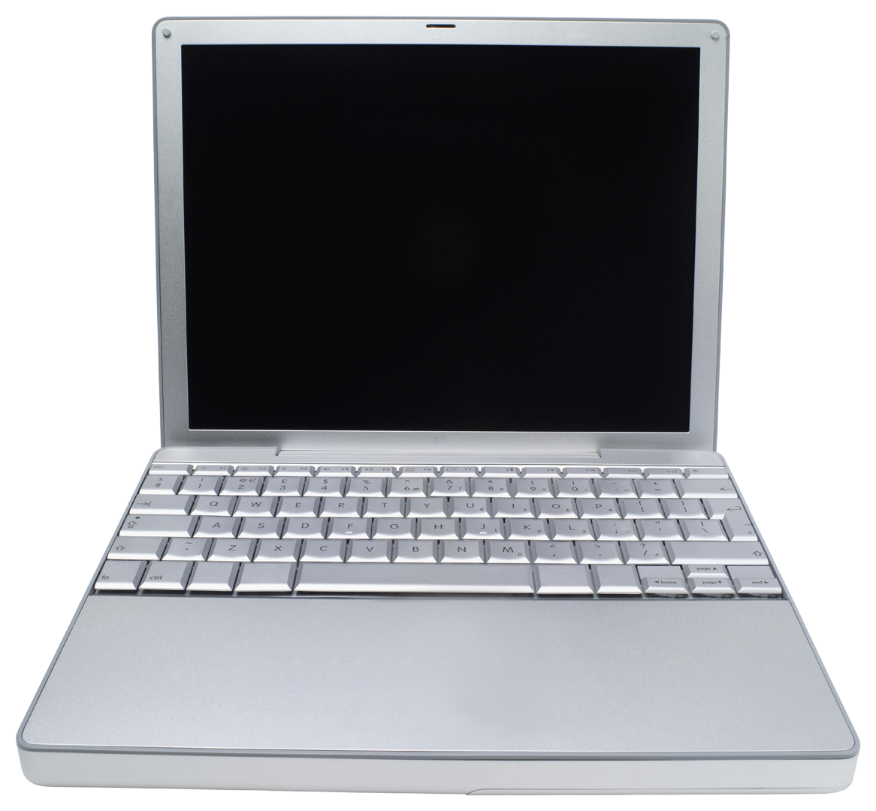
www.pbisassessment.org
System Data
  Staff surveys and assessments
    Self Assessment Survey (SAS)
    School Evaluation Tool (SET)
    Team Implementation Checklist (TIC)
    School Safety Survey (SSS)
Notes:
Discuss assessment versus survey
Surveys/ assesses the system being implemented. Provides information for improving the school wide system. Not student specific information

Slide 15
The School Wide Assessment Survey (SAS)
Measures the perspective from staff for schools to identify the status and priority for improvement in (4) four areas. Responses should be 100% across all areas if Tier 1 PBIS is being implemented with fidelity.

Slide 16
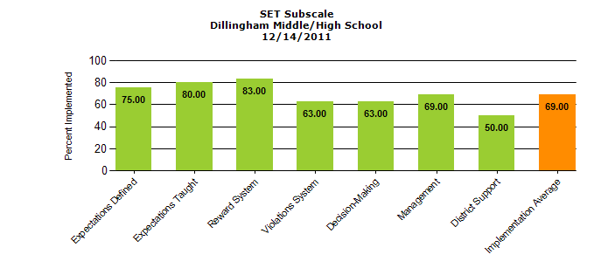
The School Wide Evaluation Tool (SET)
This research tool is designed to measure the critical features of PBIS annually through verbal interview with an administrator, a small number of students, and building staff by the SET evaluator. The SET measures the fidelity of implementation of the Tier 1 interventions based on the verbal responses.

Slide 17
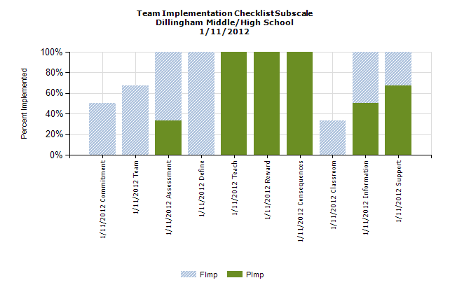
Team Implementation Checklist (TIC)
Is a monitoring tool for school teams implementing PBIS. Completed by the Leadership Team to self-evaluate their effectiveness and goal preparation. Completed three to four times per year, as appropriate.

Slide 18
School Safety Survey (SSS)
This survey is to be completed by the PBIS coaches through an interview format. The survey is conducted annually and is used to access and identify Risk and Protection Factors for the school.

Slide 19

2. Student Behavior data

Slide 20
Key features of data collection systems that works
Behaviors are operationally defined.
Standard practice for all.
The data should be very easy to collect (1% of staff time).
  Office Discipline Referral Form
Data are presented in picture (graph) format.
Data are used for decision-making.
    The data must be available when decisions need to be made (weekly?).
    Difference between data needs at a school building versus data needs for a district.
    The people who collect the data must see the information used for decision-making.
Notes:
What happens if data not easy to collect?...won’t do it.

Slide 21
Office Discipline Referral Processes/Form
Coherent system in place to collect office discipline referral data
  School-wide understanding of outcome of behavior.
  Faculty and staff agree on categories.
  Faculty and staff agree on process.
  Office Discipline Referral Form includes needed information
    Name, date, time
    Staff
    Problem Behavior, maintaining function
    Location

Slide 22
Minor vs. Major: what’s the difference?
Major Behaviors: Discipline incidents that must be handled by the administration.
Minor Behaviors: Discipline incidents that are handled by the classroom teacher and usually do not warrant a discipline referral to the office.
Notes:
Group questions: what makes a minor behavior become major (office referral)?
For some behaviors major/minor defined based on level of intensity.
Minor behaviors may be tracked for repeated offenses leading to a major intervention strategy.

Slide 23
OBSERVE BEHAVIOR
Elementary School
IS BEHAVIOR MAJOR?
IS CRISIS
RESPONSE
NEEDED?
PROBLEM SOLVE
NO
YES
NO
YES
YES
TEACHER DETERMINES
INTERVENTIONS/CONSEQUENCES
WRITE OFFICE REFERRAL &
DELIVER TO THE OFFICE
IMPLEMENT CRISIS
PLAN
COMPLETE MINOR INFRACTION
INCIDENT REPORT FORM &
SEND HOME FOR PARENT SIGNATURE
YES
ADMINISTRATOR
DETERMINES
OUTCOMES/
CONSEQUENCES
NOTIFY CRISIS TEAM
FILE IN TEACHER’S
BLACK BEHAVIOR
BOX
IS THIS THE 4TH
INCIDENT OF THE
SAME TYPE
WITHIN 1-2
WEEKS
NO

Slide 24
Middle School
DISCIPLINE FLOW CHART
NO
IS THE
INCIDENT
MAJOR?
YES
Verbal
Warning.
Restate
Expectation/rule
Behavior
ceases.
No further
action
Write Referral
(Attach minor
incident forms if applicable.)
Send the student with the referral
to Room 1.
2nd Offense
(Same behavior)
Complete
Tracking form
Intervention
Behavior
ceases.
No further
action
Administration
determines
course of action
or consequences.
3rd Offense
(Same behavior)
Complete
Tracking form
Intervention
Contact Parent
Behavior
ceases.
No further
action
a) Copy of
referral and/or
letter sent to the parent.
b) School
retains copies.
c) Copy of
referral to (how given to teacher?)
teacher for files
(when?…time frame?).
4th Offense
(Same behavior)
Follow
Referral
Procedure

Slide 25
Why define behaviors?
We know what they are!

Slide 26
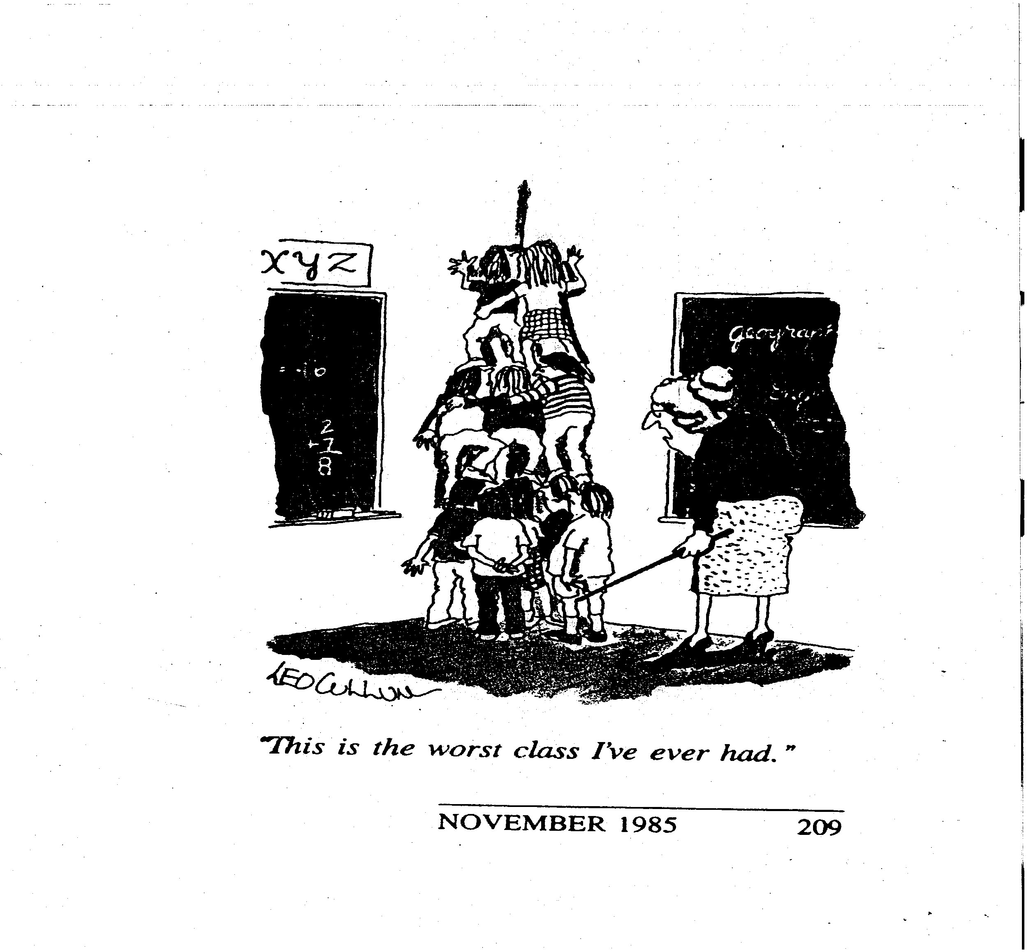
Was that a major or minor?

Slide 27
Why Operationally defined?
One problem behavior cannot fit into more than one definition
Define so all staff can learn to identify the same behaviors
What one teacher may consider disrespectful, may not be disrespectful to another teacher. For that reason, problem behaviors must be operationally defined

Slide 28
Behavior Incident types
Major Behaviors
Some examples:
physical fights, property damage, drugs, weapons, tobacco, etc.
Noncompliance, disrespect (others).
Minor Behaviors
Some examples:
tardiness to class, lack of classroom material, incomplete classroom. assignments, gum chewing, etc.
Noncompliance, disrespect (others).
Notes:
Major:
Once problem behaviors are operationally defined, it is essential that the team distinguish the major discipline incidents from the minor to determine the appropriate consequence
Minor:
Purpose
To determine appropriate consequence and where the consequence should be delivered
* These incidences are still tracked but the consequence is delivered in the classroom

Slide 29
Is this operationally defined????
Disruption: student bothers teachers and students.

Slide 30
Is this operationally defined?
Disruption: student engages in behavior causing an interruption in a class or activity. Disruption includes: sustained loud talk, yelling, or screaming; noise with materials; horseplay or roughhousing; and/or sustained out of seat behavior.

Slide 31
Your turn: 5 minute Group Activity
Operationally define “Fighting”:
Notes:
Activity: Break into groups of 2-3 (4 if a lot of people). Take 5 minutes to write 1 operational definition of fighting. Share definitions in large group.
Operational definition of fighting: student is involved in mutual participation in an incident involving physical violence.

Slide 32
Operational definition of fighting:
student is involved in mutual participation in an incident involving physical violence.

Slide 33
How to determine if your referral process working?
Is the discipline referral process meaningful and effective?
Identify whether teachers are following the current plan for completing referrals.
Interview teachers on their perceptions regarding the school’s responsiveness to problem behavior.

Slide 34
Effectiveness of an Office Discipline Referral Form
Ease of use
Track behaviors
Consistency across staff
Data input

Slide 35
Office Discipline Referral Form: Your vehicle for Data collection
Major data points
Student name
Date
Location of behavior
Time of behavior
Type of behavior
Additional data points
Referring staff member
Possible motivation
Others involved
Administrative decision
Notes:
Be sure to train staff in the new definitions and system for collecting and reporting data.

Slide 36
In some cases: Emergency or Crisis Incidents Data
Discipline incidents that require immediate response from administration and/or crisis response team.
    These incidences may cause short-term change to a school’s SW-PBS Plan and may include, but are not limited to: bomb threats, weapons alerts, intruder, fire evacuations, etc.
Notes:
Purpose
Maintain order and safety during emergency situations
* Each school is urged to consult their district and school policies for emergency/crisis incidents

Slide 37
Sneak Peak at SWIS™
www.swis.org

Slide 38
Basic features of SWIS™
Only reports on discipline
Web-based data collection system
Real-time data
Local control
Prints graphics for decision-making
Confidential and secure
SWIS™ facilitator for support
Notes:
What is SWIS:
Collects and summarize student discipline data
Developed by University of Oregon with middle, elementary, and high school personnel
Confidential (managed by the Positive Behavior Intervention and Supports Technical Assistance Center)
Used by over 8,400 schools to date
Major area to Monitor: (Big 5)
Number of ODR’s per month
Type of problem behaviors leading to the referral
Location of problem behavior
Time of day of behavior
Students receiving ODR
Purpose:
Provide schools accurate, efficient, practical information for decision-making about school-wide discipline.
Internal decision-making
Designed for individual students and families
Generate reports for schools, state, and feds.
Used as a method to collect aggregate data across schools
Why use SWIS
Facilitates data based decision-making based on the “Big 5”.
How does it work
Specialized computer software to summarize, collect, and house data.
Creates systems of school-wide meetings, data summary, and communication through data based processes.
Confidentiality:
Controlled at the school level though passwords
Full access
Read only
Where is SWIS
Austria, Canada, Iceland, New Zealand, United States
8,343 Schools
Over 1,000,000 students

Slide 39
Big 5 graphs
Average number of referrals per day
Location of incident
Time of incident
Referring teacher
Behavior that occurred

Slide 40
Our Goal: Data based Decision-making System
Not just data collection.

Slide 41
Decision-Making System
What do you want the data to tell you?
  School-wide
  Individual student
Adapted from www.swis.org

Slide 42
Decision making questions to consider
Is there a problem?
What areas/systems are involved?
Are there many students or few involved?
What kind of problem behaviors are occurring?
When are these behaviors most likely?
What is the most effective use of our resources to address the problem?
Possible “function” of problem behavior?
Who needs targeted or intensive academic supports?
What environmental changes/supports are needed?

Slide 43
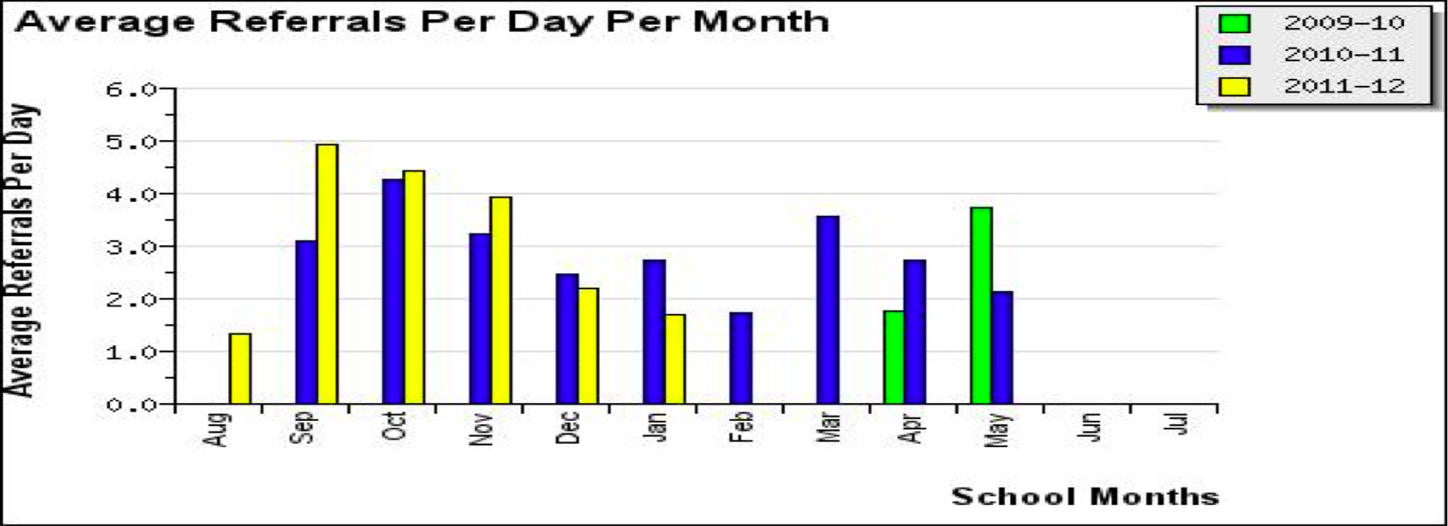
Data based decision-making
Notes:
Is there a problem?

Slide 44
Notes:
What kind of behaviors are occurring. Is there a problem?

Slide 45
Notes:
Is there a problem?

Slide 46
Some resources from:
www.swis.org /
www.pbis.org

Slide 47
Sample Decision Rules
If……… | Then
More than 35% of students received one or more office discipline referrals There are more than 2.5 office discipline referrals per student | School-wide System
More than 35% of referrals come from non-classroom settings There are more than 15% of students receiving referrals from non-classroom settings | Non-Classroom Setting Specific System
More than 50% of referrals come from the classroom More than 40% of referrals come from less than 10% of classrooms | Classroom System
More than 10-15 students receive more than 10 office discipline referrals | Targeted Group Interventions
Less than 10 students receive more than 10 office discipline referrals Less than 10 students continue the same rate of referrals after receiving targeted group support A small number of students destabilize the overall functioning of school | Individual Systems with Action Team Structure
Taken from www.pbis.org

Slide 48
Taken from: Making Data-Based Decisions. Tim Lewis, Ph.D.
University of Missouri. OSEP Center on Positive Behavioral Interventions and Supports pbis.org

Slide 49
Taken from: Making Data-Based Decisions. Tim Lewis, Ph.D.
University of Missouri. OSEP Center on Positive Behavioral Interventions and Supports pbis.org

Slide 50
Big 5 Data Review Guide
*A Problem Statement is one that allows a team to develop a specific, actionable, proactive intervention
with clear steps and outcomes..
For Example: “Disruptive behavior is occurring in the classroom, typically at the beginning of each hour, with 25% of students involved.”
Taken from University of Missouri web site.

Slide 51
Next steps
Train staff and students new discipline system
Set up system
Train local users to input data
On-going data based decision-making
Notes:
Local users input data
No more than 3
Trained by facilitator
External support (facilitator)
Data collection & decision-making
Real time data, develop fluent and consistent system. Data for decision-making not data sake.

Slide 52
IMPLEMENTATION WITH FIDELITY
PREVENTION
& EARLY INTERVENTION
CONTINUOUS
PROGRESS MONITORING
DATA-BASED
DECISION MAKING & PROBLEM SOLVING
CONTINUUM OF EVIDENCE-BASED
INTERVENTIONS
CONTENT EXPERTISE & FLUENCY
UNIVERSAL SCREENING
RtI

Slide 53
Resources
OSEP Center on Positive Behavioral Interventions & Supports
  www.PBIS.org
PBIS Assessment
  www.pbisassessment.org
SWIS
  www.swis.org
Contact Info:
Lori Roth
Education Consultation Services of Alaska
lroth507@gmail.com
907-360-0148
Sharon Fishel
EED Sharon.Fishel@alaska.gov 907-465-6523

