Slide 1
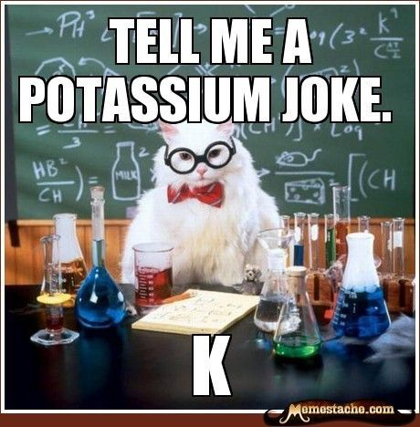
Welcome! Introduction to the Science Standards for Alaska for 9-12 Grade
I was reading a book on Helium. I couldn’t put it down.
Notes:
Welcome! We hope you find this presentation uplifting.

Slide 2
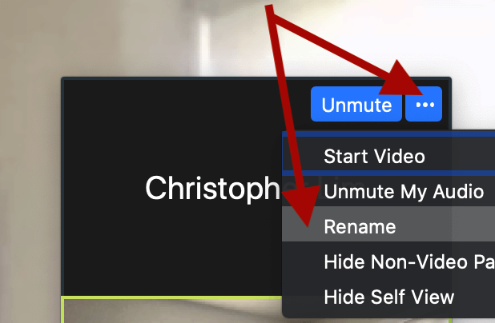
Introduce Yourself
Rename your Zoom settings to include your district and subjects you teach.
Notes:
Please introduce yourself by adding your name, district and grade level or subjects you teach in science.

Slide 3
Vicki Lowe Kenai Peninsula Borough School District
vixinak@gmail.com Andrea Pokrzywinski Lower Kuskokwim School District
andreaupnorth@gmail.com Gary Cooper Alaska Science Teachers Association
9-12 Introduction to Science Standards for Alaska Webinar Team
Alaska Department of Education & Early Development
February 12, 2021
Notes:
Every DEED presentation should start with this title slide. Adjust presenter(s) names as appropriate.
Contacts

Slide 4
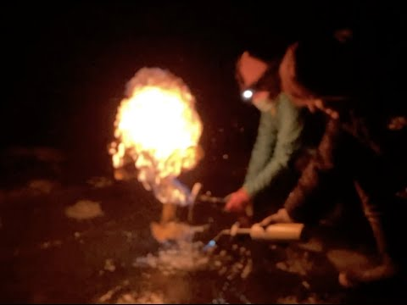
What is in the bubbles? How did it get there?
Notes:
Vicki- padlet url

Slide 5


https://padlet.com/vickilowe/phenomena
Open this link and share your thoughts. What do you wonder?
In what lesson, unit or class would you use this phenomena as anchor to teach from?
Notes:
Vicki - Presenter adds link into the chat.
https://padlet.com/vickilowe/phenomena

Slide 6
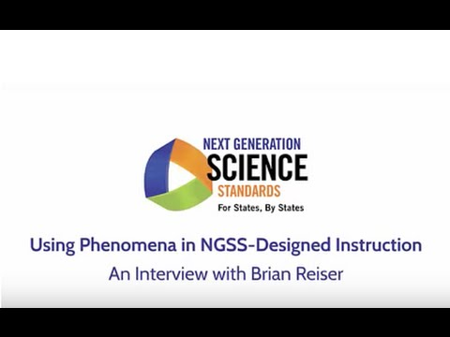
Next Generation Science Standards
Notes:
Andy (plays first half) The SSAs are building a vision for science education that connect science curriculum with students at a deep level by integrating phenomena.

Slide 7
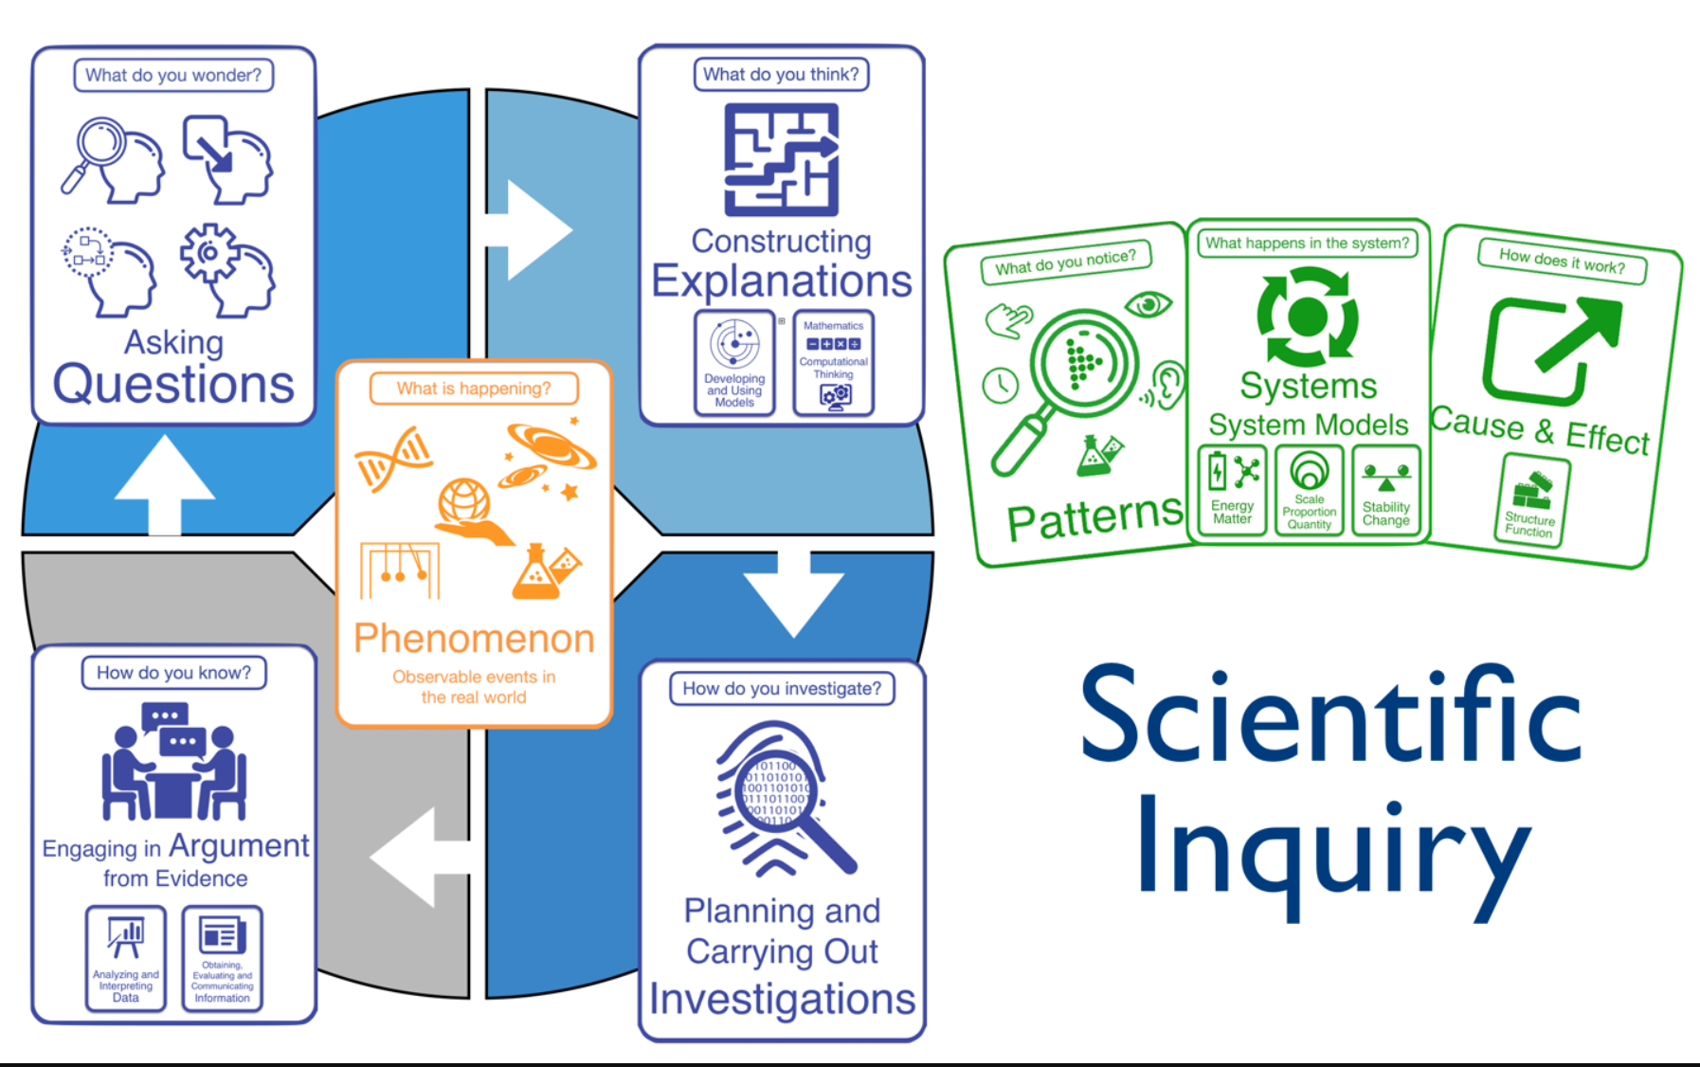
Scientific Inquiry
Notes:
Andy - in this presentation, we will describe the 3 dimensional learning structure that builds upon a phenomenon. This is a strategy of using storylines, questioning, and phenomena to structure units that build scientific literacy. As we introduce you to the Science Standards for Alaska.

Slide 8
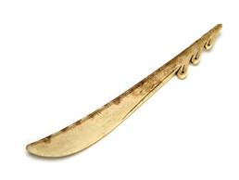

Story Knife
Notes:
Does anyone know what this is? I’d like to make the analogy that the Science Standards of Alaska are like a story knife. They are a tool. A tool that helps the storyteller!

Slide 9
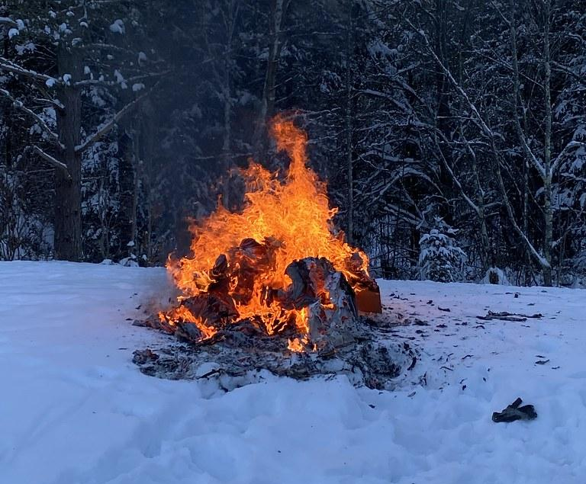
What are your burning questions about the Alaska Science Standards?
Post your questions in the chat
Notes:
Before we move on, we would like to hear your story. What brought you here today? What would you like to know?

Slide 10
Presentation Objectives
Review the 3 Dimensional foundations that support each performance expectation
Describe the anatomy of a science standard for Alaska
Share tools and models to assist in implementation of the Science Standards for Alaska
Notes:
Andy- Our specific objectives are to…

Slide 11
Science Standards in the Past
Facts about science
Doing science
Notes:
A sys- tem is an organized group of related objects or components that form a whole.
Currently, K-12 science education in the United States fails to achieve these outcomes, in part because it is not organized systematically across multiple years of school, emphasizes discrete facts with a focus on breadth over depth, and does not provide students with engaging opportunities to experience how science is actually done.

Slide 12
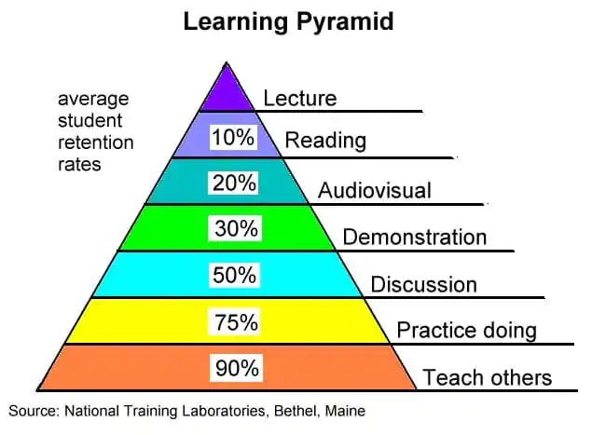
Why a revision?
Facts about science
Doing science
Notes:
A sys- tem is an organized group of related objects or components that form a whole.
Currently, K-12 science education in the United States fails to achieve these outcomes, in part because it is not organized systematically across multiple years of school, emphasizes discrete facts with a focus on breadth over depth, and does not provide students with engaging opportunities to experience how science is actually done.

Slide 13
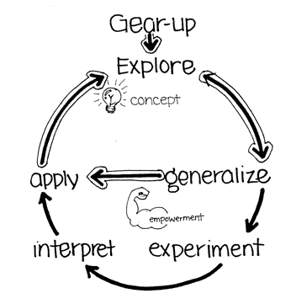
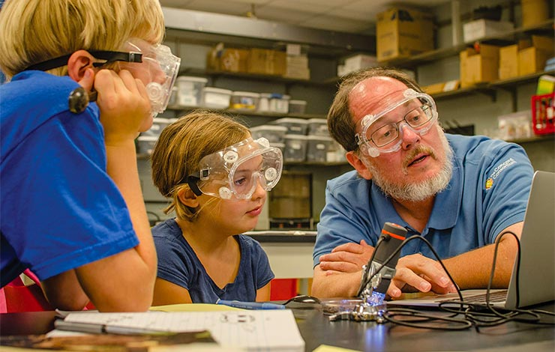

New Science Standards for Alaska?
1. Engage
5. Evaluate
3. Explain
4. Elaborate
Notes:
15 diverse professionals were selected based upon merit, to serve on the science content standards Writing Committee. An additional 15 individuals were chosen to review the writing committee’s recommendations.

Slide 14
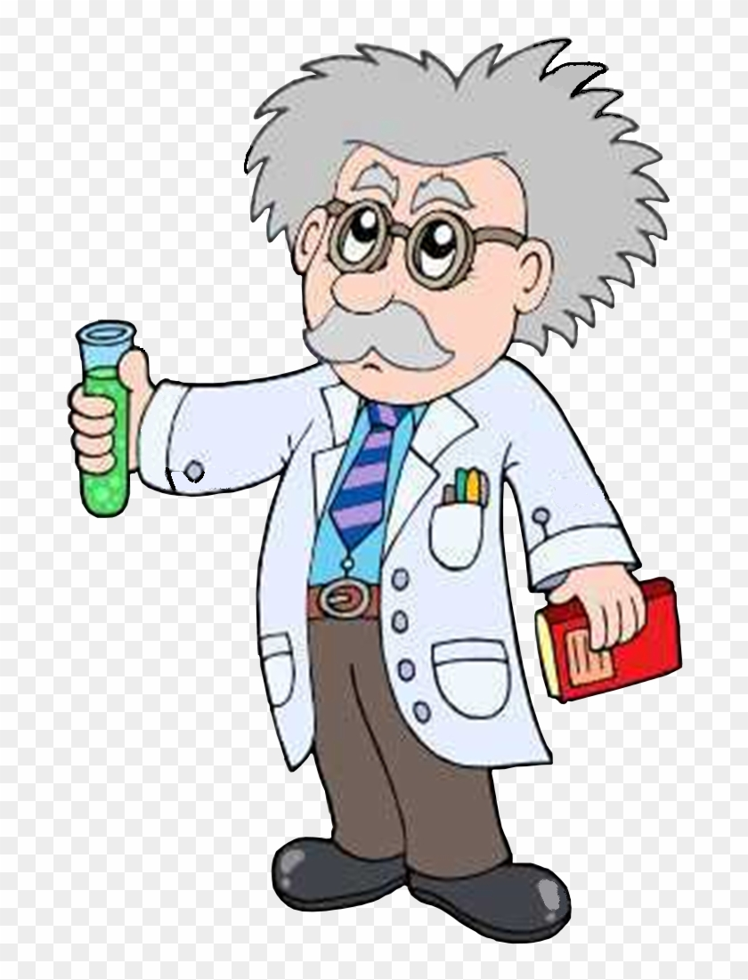
Addressing Common Misconceptions
Scientific ideas are absolute and unchanging.
The process of science is purely analytic and does not involve creativity.
Science is complete.
Science is a solitary pursuit.
Science is boring.
UC Museum of Paleontology, Misconceptions About Science. Retrieved from http://undsci.berkeley.edu/teaching/misconceptions.php
Notes:
number
one of my favorite introduction to science activity is to have my students draw a picture of a scientist. Many students draw a picture of a mad scientist in a lab coat. We all have preconceived notions of science and not all of them are true.

Slide 15
More misconceptions about science
Because scientific ideas are tentative and subject to change, they can't be trusted.
Scientific ideas are judged democratically based on popularity.
Scientists are judged on the basis of how many correct hypotheses they propose (i.e., good scientists are the ones who are "right" most often).
Science is a collection of facts.
UC Museum of Paleontology, Misconceptions About Science. Retrieved from http://undsci.berkeley.edu/teaching/misconceptions.php
Notes:
number
Dai: footer changed to white

Slide 16
Quick Poll
How familiar are you with the Science Standards for Alaska?
The 3 dimensions are cross cutting concepts, disciplinary core ideas and____________.
Notes:
https://docs.google.com/document/d/1icgpTmWSi9f_QCl2hicL75MFvwrP92MmvYWOuy6KLxw/edit?usp=sharing

Slide 17
3 Dimensions Science Standards for Alaska
Science and Engineering Practices
(doing science)
Disciplinary Core Ideas
(facts)
Crosscutting Concepts
(connecting science)
*
Notes:
number

Slide 18
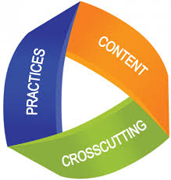

Student Performance Expectations (PE)
This symbol actually
means something!
Disciplinary
Core Ideas
(facts)
Crosscutting Concepts
(connecting science)
Science & Engineering Practices
(doing science)
Student Performance Expectation (PE)
Notes:
Performance Expectation- Standards are PEs not content standards

Slide 19
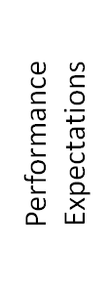
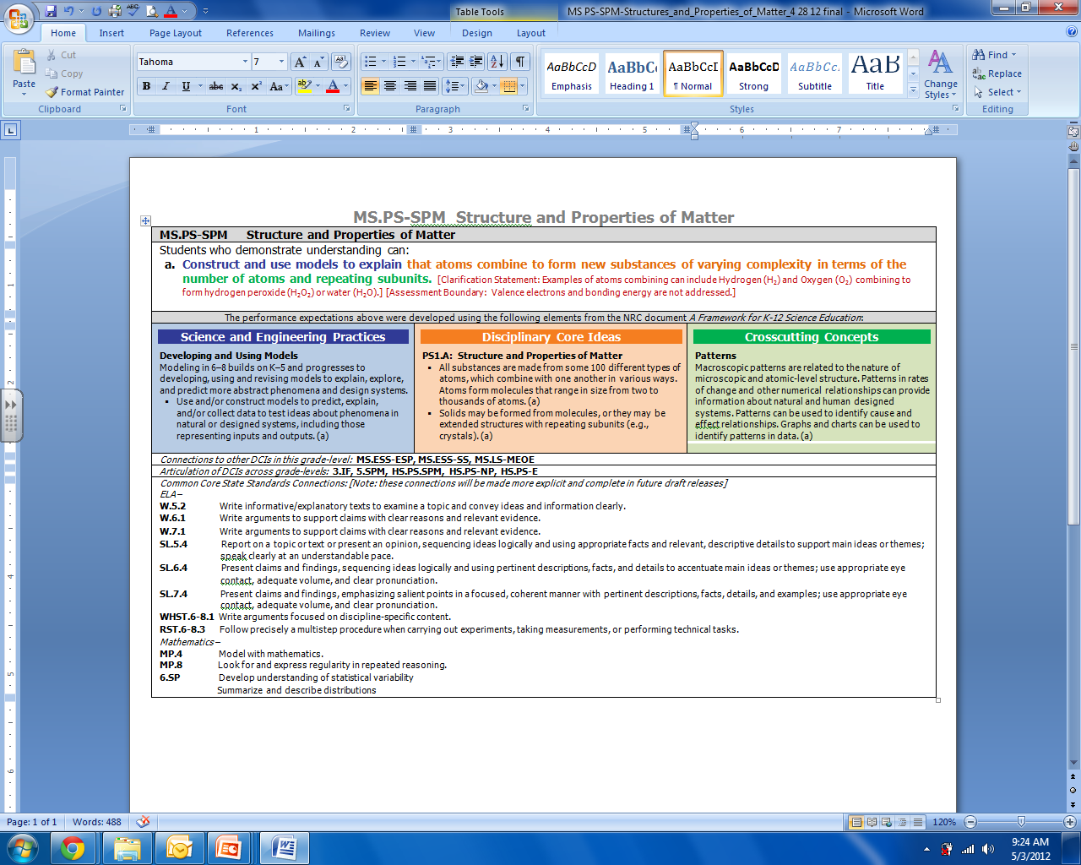
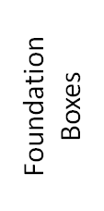
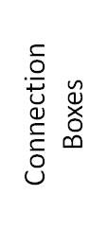
MS.PS-SPM Structure and Properties of Matter

Slide 20
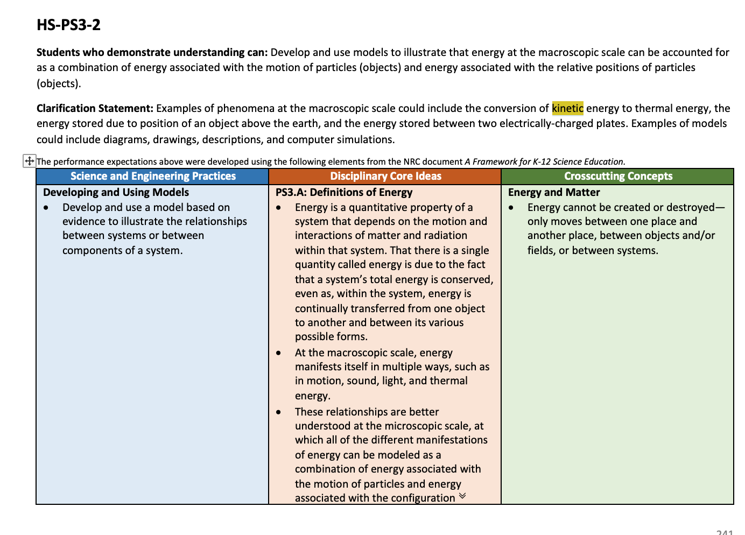
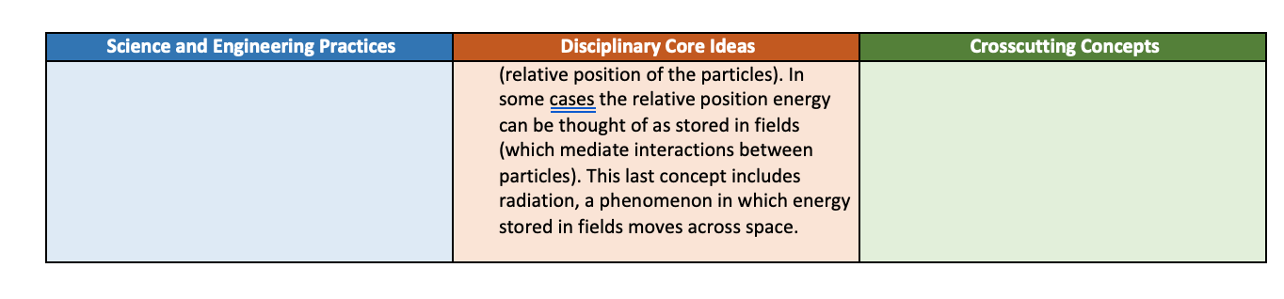
HS-PS3-2
PE
Standard
Assessment boundaries
will be found here
Clarification Statement
CCC
SEP
DCI

Slide 21
Science and Engineering Practices
Asking questions and defining problems
Developing and using models
Planning and carrying out investigations
Analyzing and interpreting data
Using mathematics, information and computer technology, and computational thinking
Constructing explanations and designing solutions
Engaging in argument from evidence
Obtaining, evaluating, and communicating information
Framework pp.41-82
Notes:
These are not simply teaching strategies. They also represent a body of knowledge that represent how scientists accumulate and communicate knowledge.

Slide 22
Crosscutting Concepts
Patterns
Cause and effect
Scale, proportion, and quantity
Systems and system models
Energy and matter
Structure and function
Stability and change
Framework pp.83-102

Slide 23

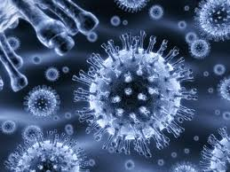
Disciplinary Core Ideas
Physical Science
PS1: Matter and Its Interactions
PS2: Motion and Stability: Forces and Interactions
PS3: Energy
PS4: Waves and Their Applications in Technologies for Information Transfer
Life Science
LS1: From Molecules to Organisms: Structure and Processes
LS2: Ecosystems: Interactions, Energy, and Dynamics
LS3: Heredity: Inheritance and Variation of Traits
LS4: Biological Evolution: Unity and Diversity

Slide 24
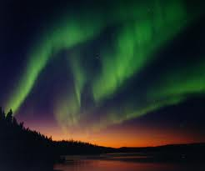
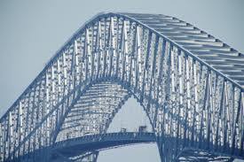
Disciplinary Core Ideas (cont.)
Earth and Space Science
ESS1: Earth’s Place in the Universe
ESS2: Earth’s Systems
ESS3: Earth and Human Activity
Engineering, Technology, and Applications of Science
ETS1: Engineering Design
ETS2: Links Among Engineering, Technology, Science, and Society

Slide 25
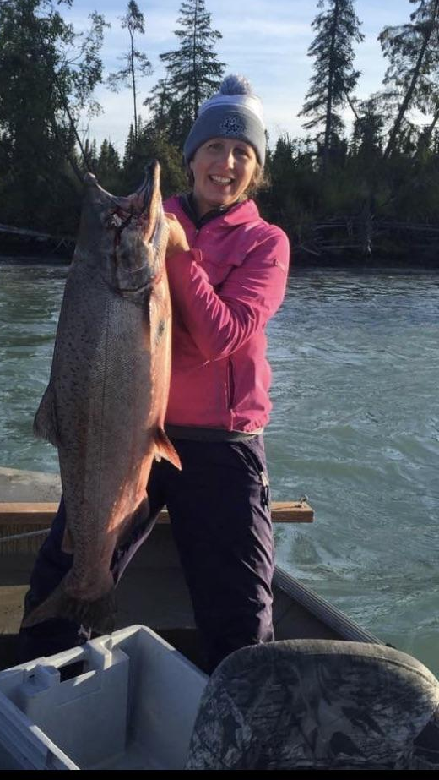
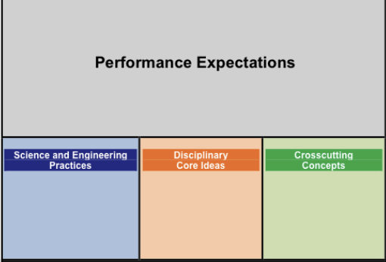
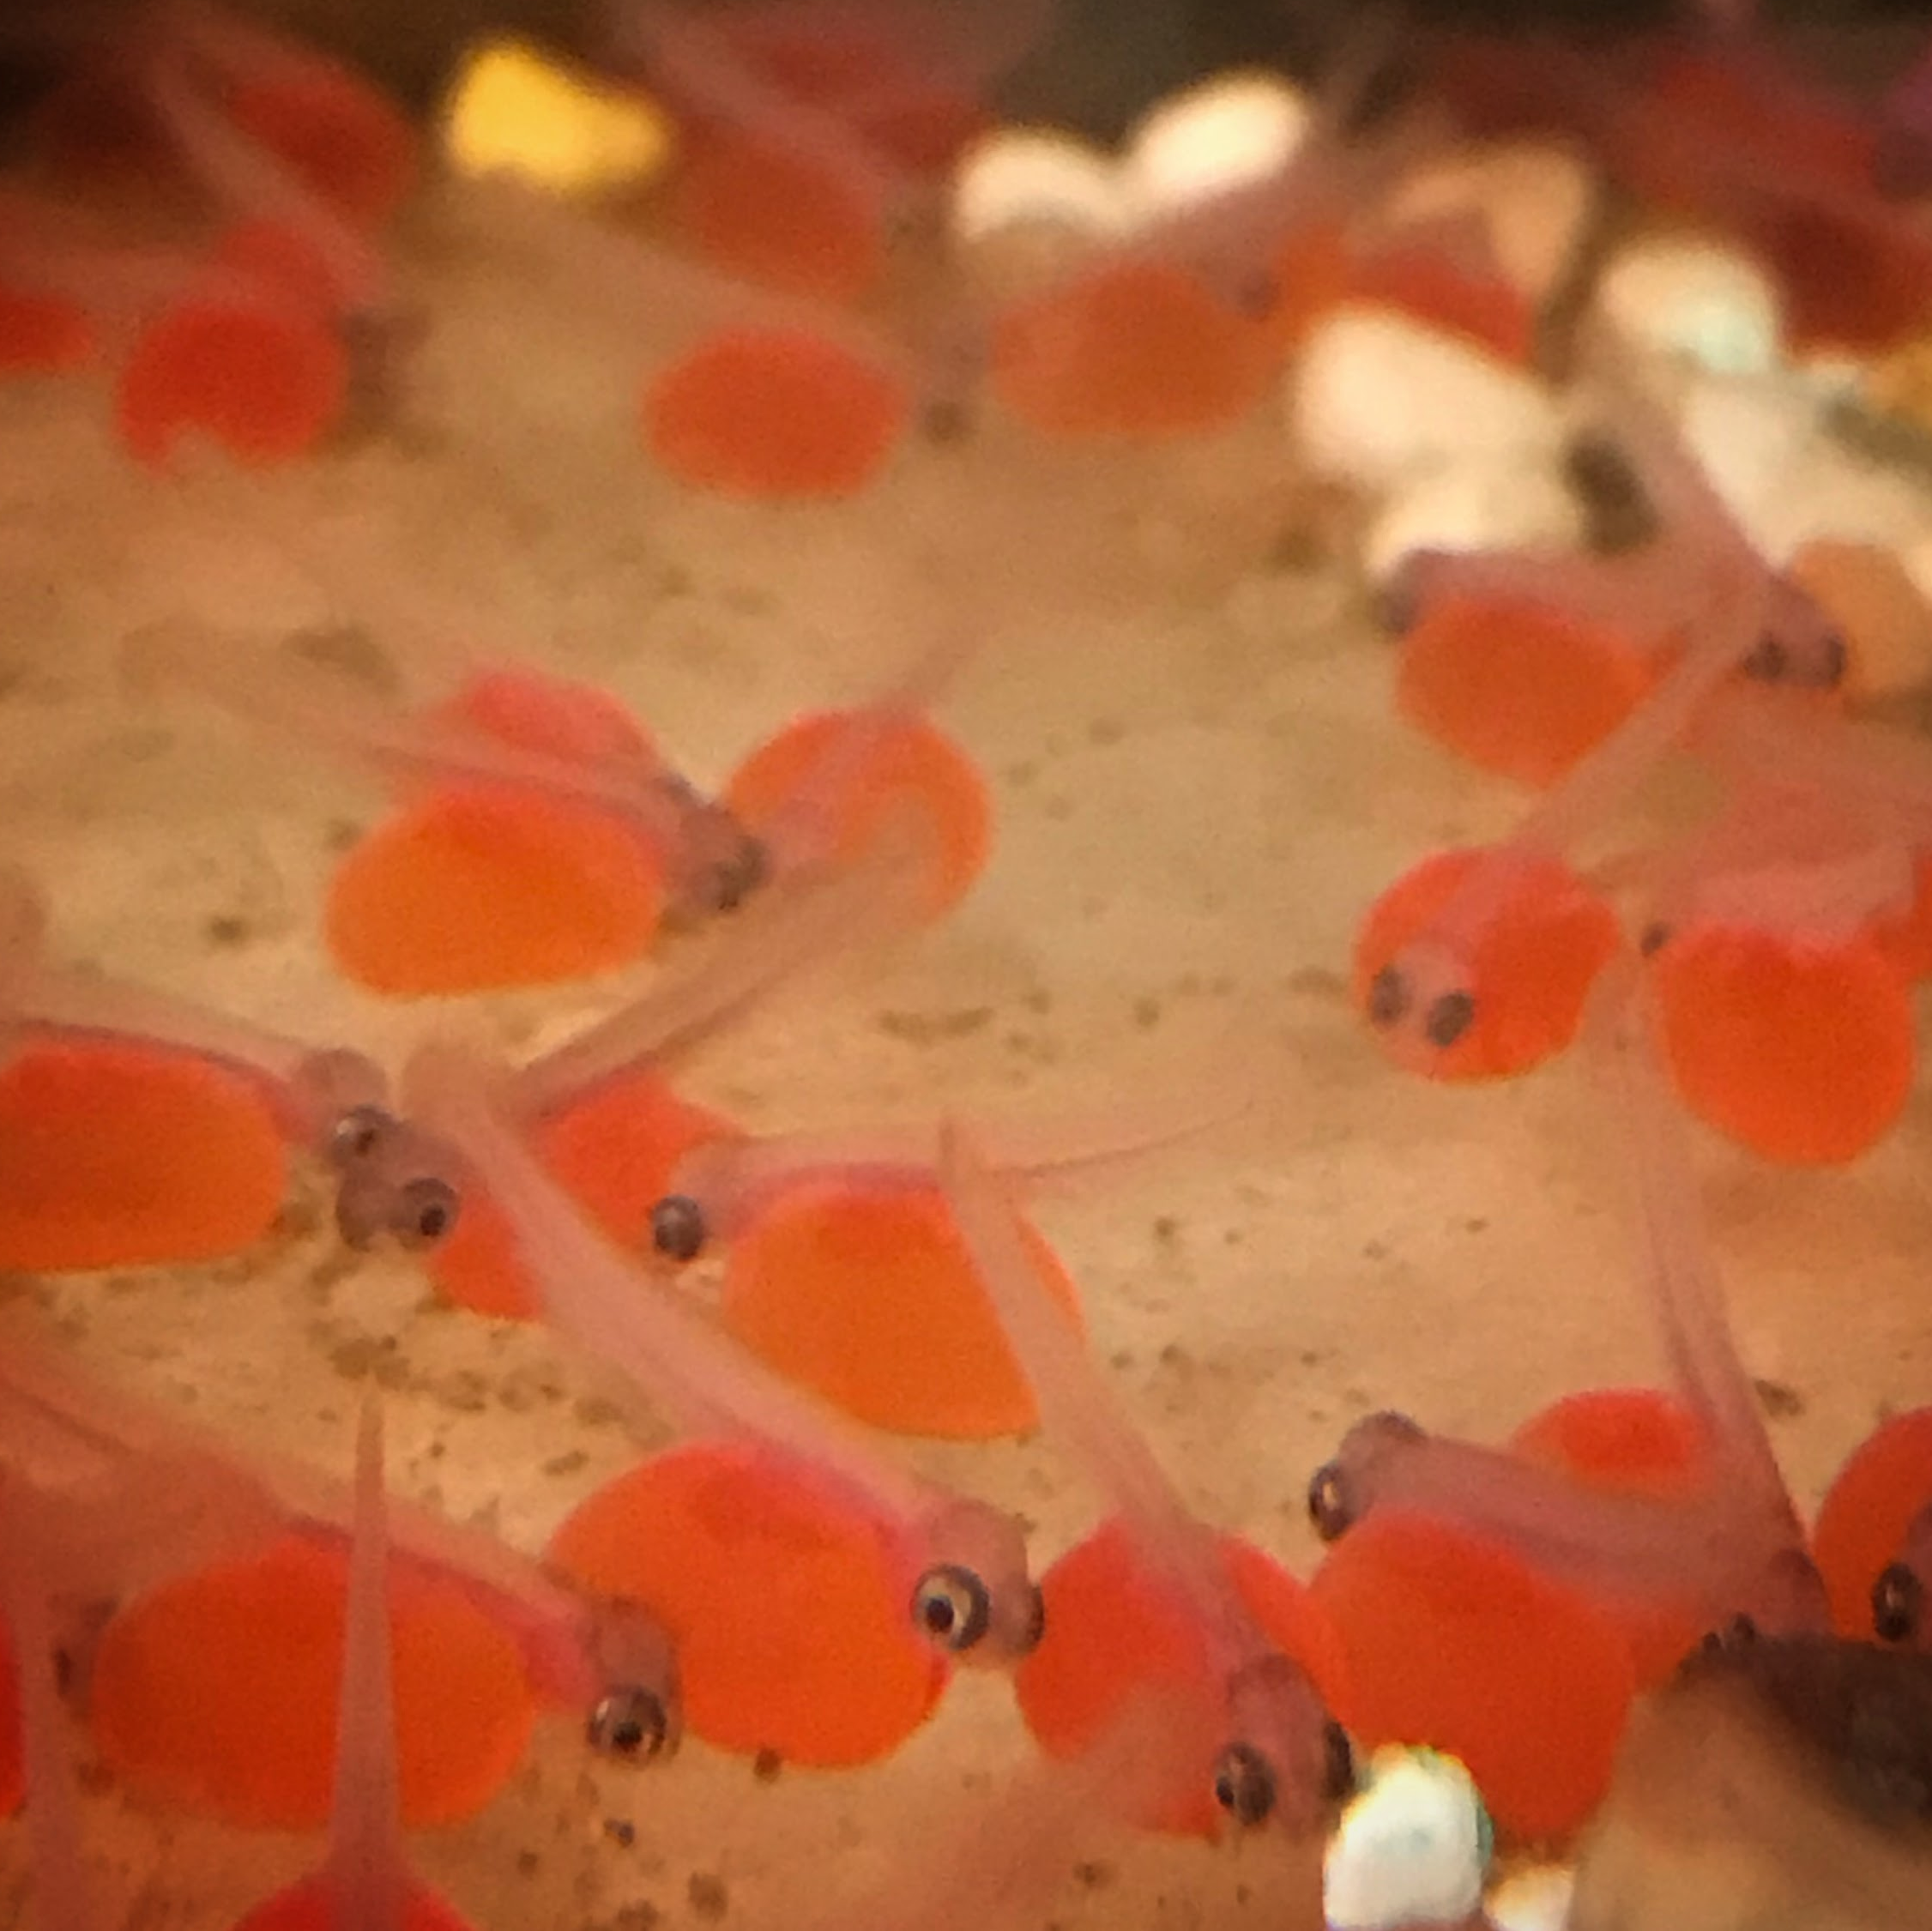
The old way:
List the phases of the king salmon life cycle
new and improved
Create a simulation illustrating how salmon development is impacted by increasing water temperature.
Using mathematics, information and computer technology, and computational thinking
From Molecules to Organisms:
Structure and Processes
Cause and effect

Slide 26
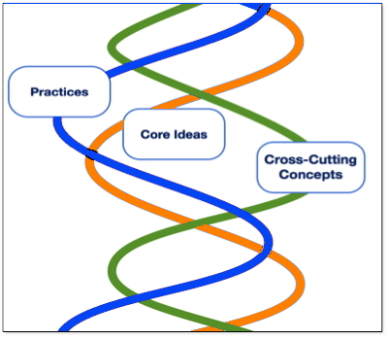
Three Dimensions Intertwined
Performance Expectations
The Framework requires contextual application of the three dimensions by students.
Focus is on how and why as well as what
Notes:
The NGSS require students to operate at the Nexus of the three dimensions.

Slide 27
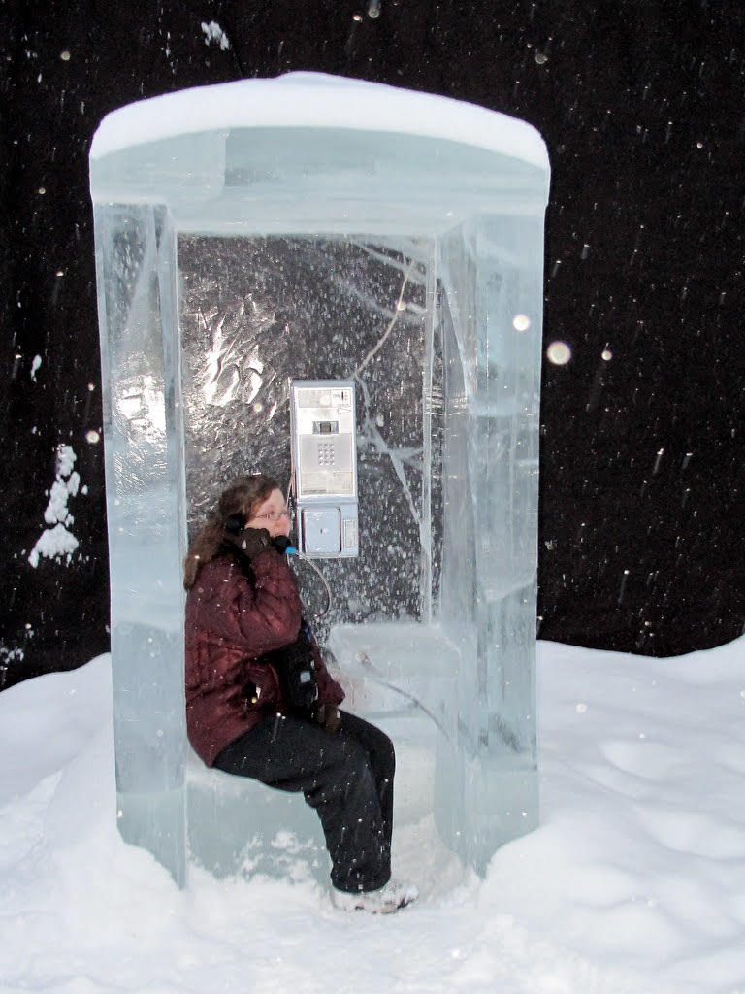
Time for a Quick Poll
How I’m feeling about all of this?

Slide 28
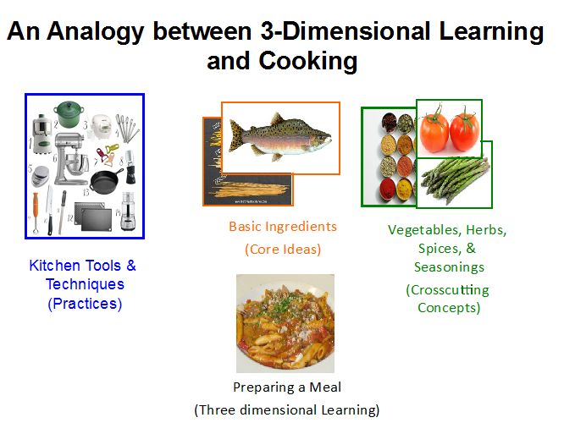
An Analogy between 3-Dimensional Learning and Cooking
Notes:
https://www.nsta.org/blog/how-select-and-design-materials-align-next-generation-science-standards

Slide 29

Where to find the SSA’s
https://education.alaska.gov/akstandards/science/science-standards-for-alaska.pdf?v=

Slide 30
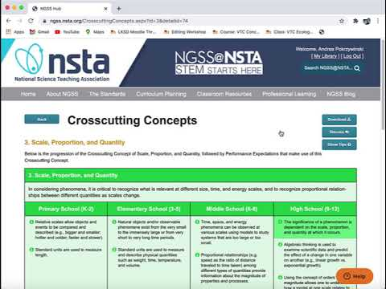
NSTA Website Address
https://ngss.nsta.org/
Notes:
Andy will take participants on a tour of looking up standards and PE’S on the hun

Slide 31
Break Out Activity-Explore SSA
Explore the NGSS NSTA HUB for 5 minutes - https://ngss.nsta.org/AccessStandardsByTopic.aspx
In your breakout group, share what you found. Chat about reflections, share thoughts and questions.
Notes:
We want to give you a moment to work in small groups and explore the hub.

Slide 32
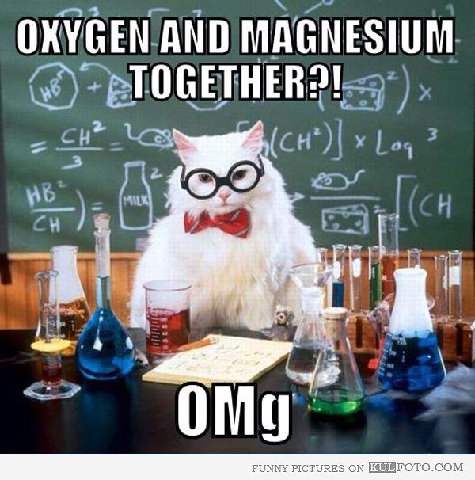
Meme

Slide 33
Break Out Activity -Explore SSA
Explore the NGSS NSTA HUB for 5 minutes - https://ngss.nsta.org/AccessStandardsByTopic.aspx
In your breakout group, share what you found. Chat about reflections, share thoughts and questions.
Notes:
Share out

Slide 34
HS-ESS2-2
HS-ESS2-2 Students who demonstrate understanding can: Analyze geoscience data to evaluate claims that one change to Earth’s surface creates feedbacks that cause changes to other Earth systems.
Clarification Statement: Examples should include climate feedbacks, such as how an increase in greenhouse gases causes a rise in global temperature that melts glacial and sea ice, which reduces the amount of sunlight reflected from Earth’s surface, increasing surface temperatures and further reducing the amount of ice. Examples could also be taken from other system interactions, such as feedbacks due to the effects of permafrost thawing; how the loss of ground vegetation causes an increase in water runoff and soil erosion; how dammed rivers increase groundwater recharge and decrease sediment transport, and how the loss of wetlands causes a decrease in local humidity that further reduces wetland extent.
Notes:
Example of how the NGSS have been customized for Alaska

Slide 35
Science Engineering Practices and Cross-Cutting Concepts
https://thewonderofscience.com/teaching
Science Engineering Practices
Cross Cutting Concepts
Notes:
How do we layer our instruction so that as we are teaching the content of science, we are addressing the SEP’s the CCC all while weaving a story

Slide 36
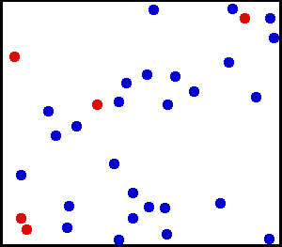
Unit 1 Kinetic Molecular Theory and Climate Change

Slide 37
By the End of this Activity You Should Be Able to Say…
Science and Engineering Practice
Content Objective
I can make a model to predict what happens to a substance when the kinetic energy of the particles changes.
Disc.Core Idea
Cross Cutting Concept
Language Objective
I can use my model to make a claim and support it with evidence and reasoning.
Language Arts and Nature of Science Connections

Slide 38
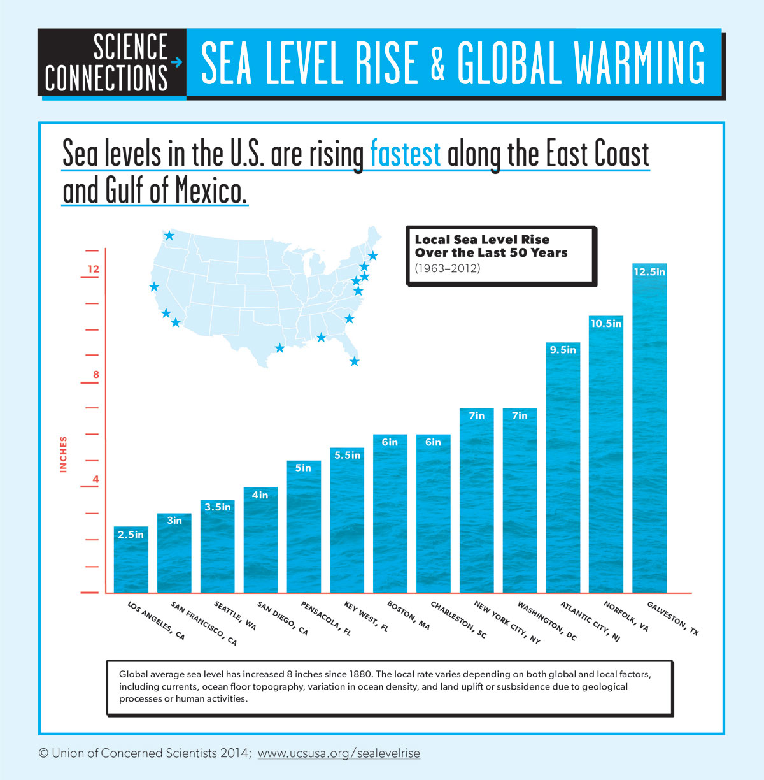
Science Connections Sea Level Rise and Global Warming
Notes:
Why is sea level rising faster on the East Coast vs. West Coast?

Slide 39
What is causing sea level to rise faster on the East vs. West Coast?
In your breakout group or small discussion group come up with an answer to this question.
Use this model to build a prediction to explain this phenomenon.https://phet.colorado.edu/en/simulation/gas-properties
Sentence Frames:
I believe that _____ because…
The evidence suggests that…
In watching/reading/listening to ______, it lead me to think that…
Notes:
Divide students into breakout rooms or small discussion groups of 4

Slide 40
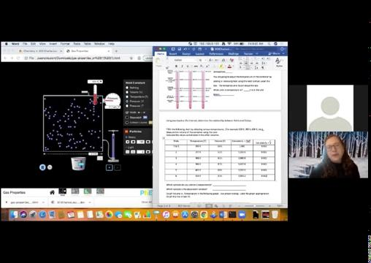
Image

Slide 41
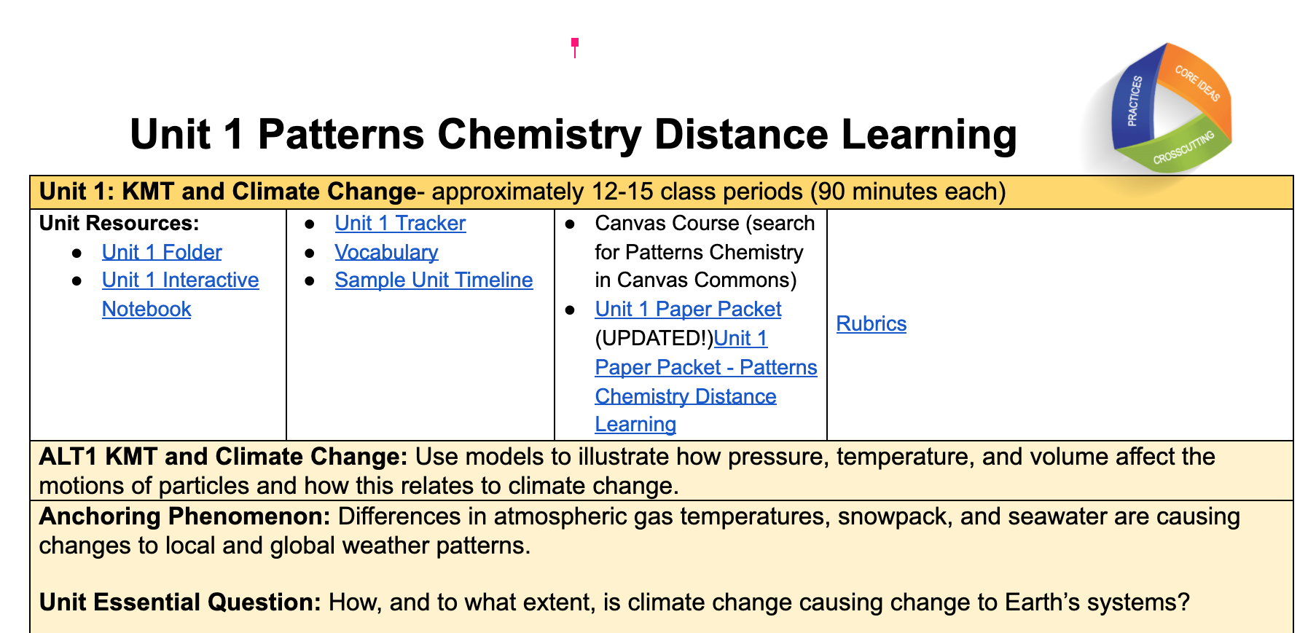
Unit-1 Kinetic Molecular Theory and Climate Change
https://docs.google.com/document/d/1OzevRazXw5C_gcQ46mVfK0TX8Jbn_8lhC2DmjHwPsiE/edit

Slide 42
Implementing New Science Standard
Share tools and models to assist in implementation of the Science Standards for Alaska

Slide 43
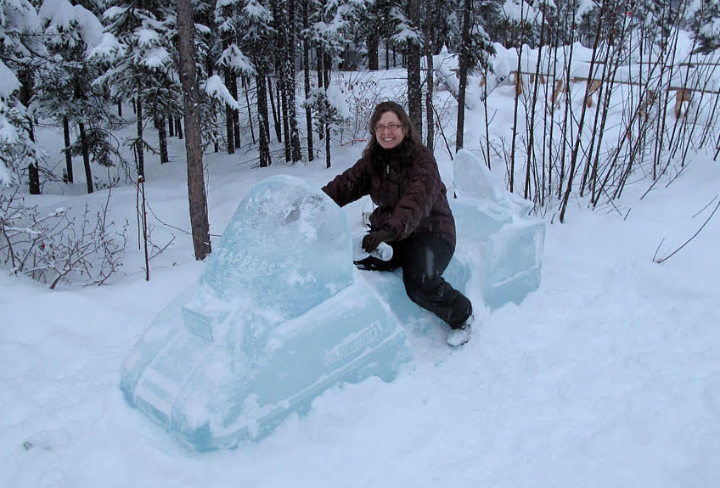
Is it the destination or the journey?

Slide 44
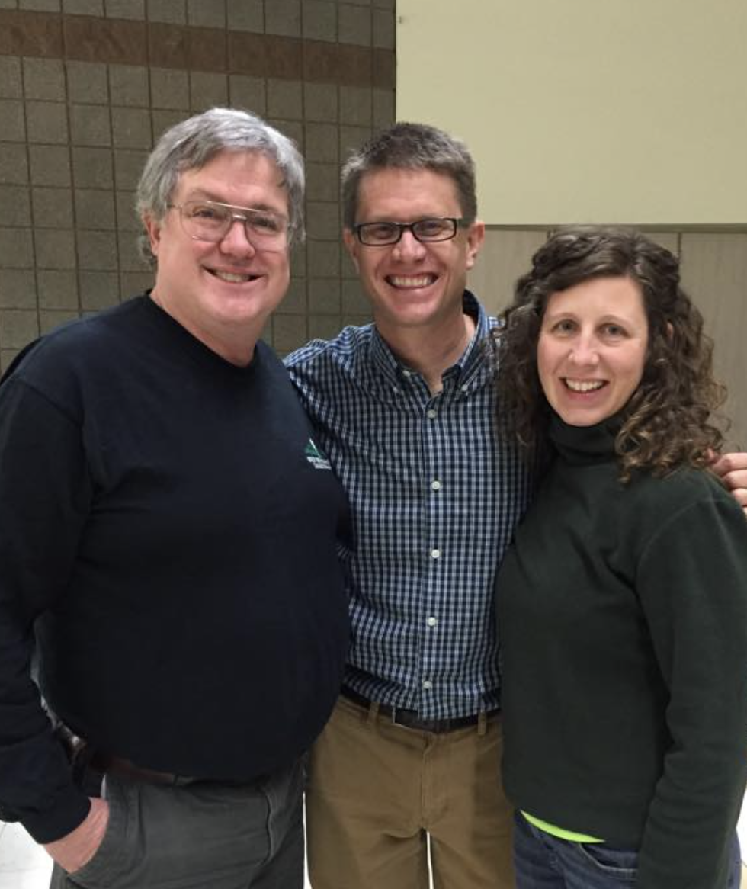


The Wonder of Science
https://thewonderofscience.com/
Notes:
Vic’s Tour of Paul Anderson’s Site

Slide 45

Don’t Kill the Wonder of Science
vJump Right Into It
Organizers, planners,
Assistance
vExpanding List
My Go To Spot
Notes:
Vic’s Tour of Paul Anderson’s Site

Slide 46
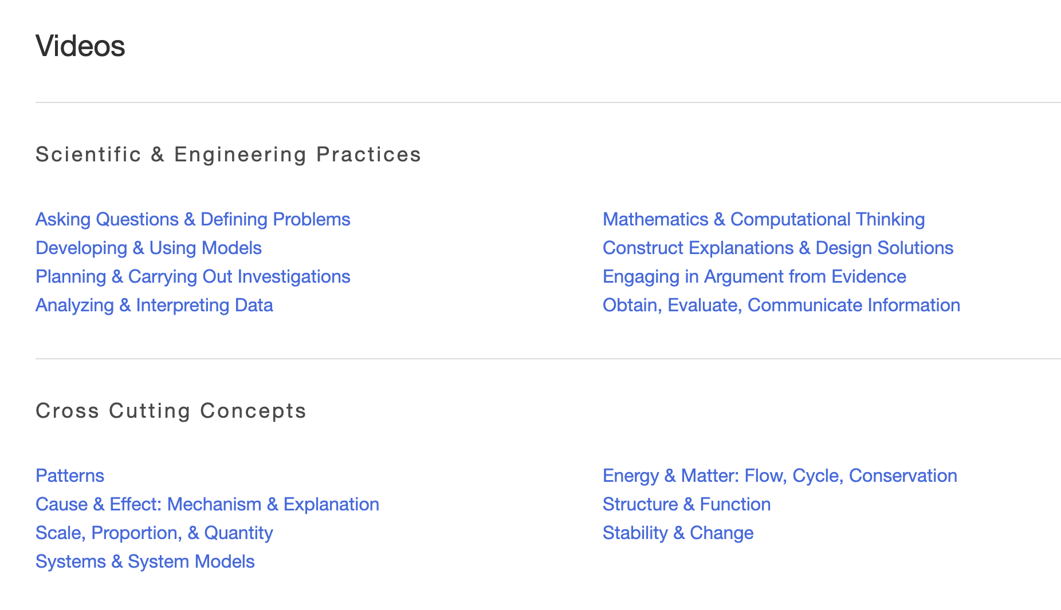
The Wonder of Science Videos
SEP
CCC
DCI
Notes:
Vic’s Tour of Paul Anderson’s Site

Slide 47
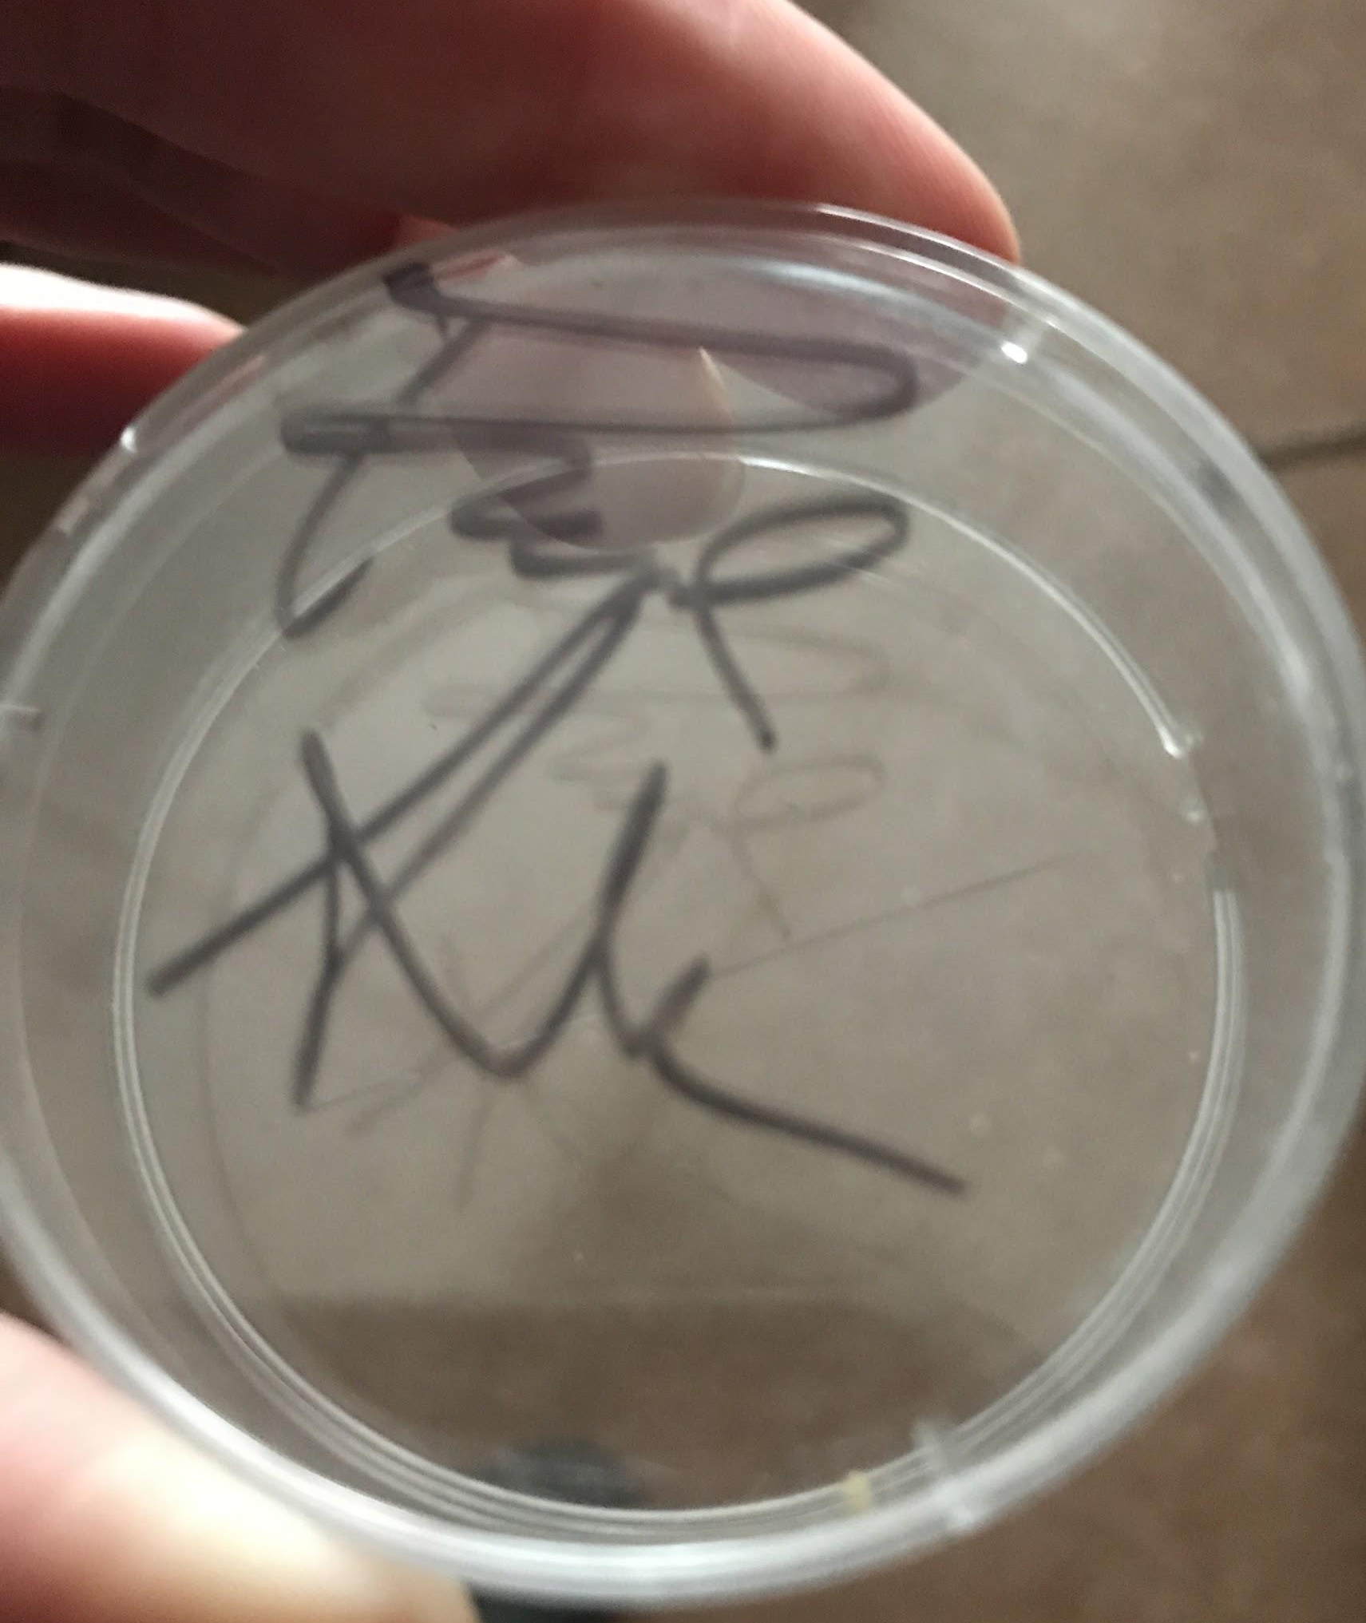
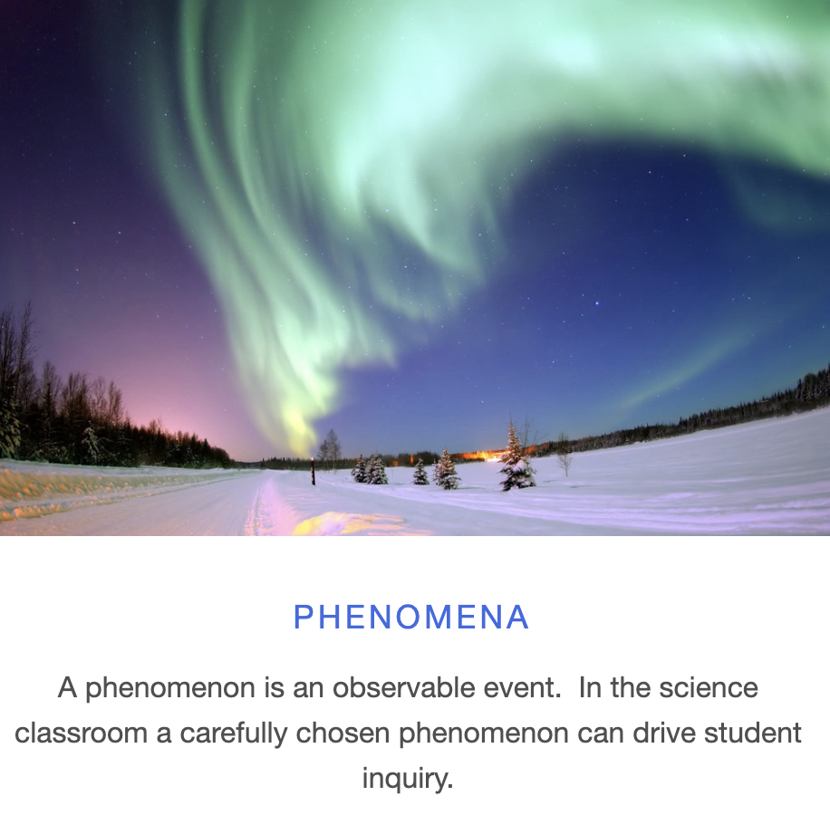
The Wonder of Science Phenomena
Notes:
Vic’s Tour of Paul Anderson’s Site

Slide 48
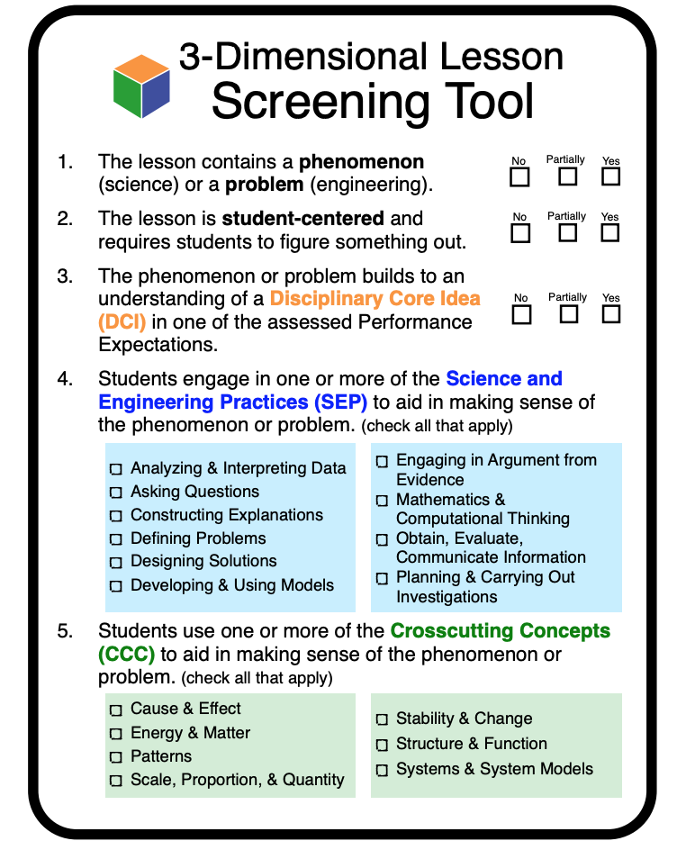
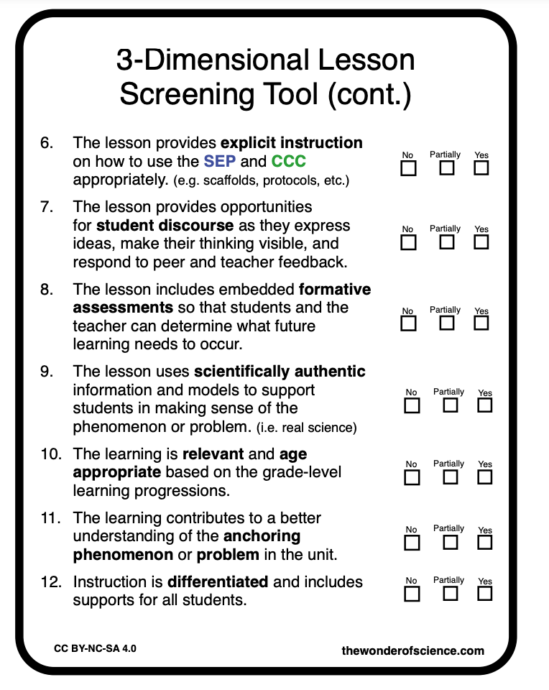
3-Dimensional Lesson Screening Tool

Slide 49
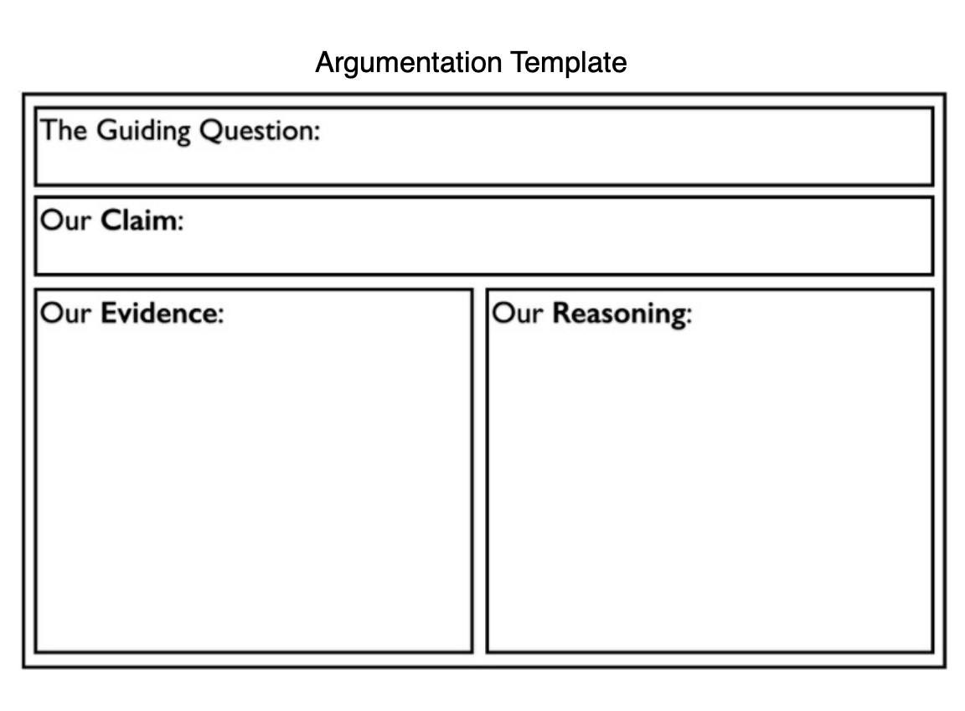
Argumentation Template

Slide 50
Break Out Activity-Explore the Wonder of Science
Spend 5 minutes exploring
https://thewonderofscience.com/teaching
In your breakout group, share what you found that will be useful to you. Chat about reflections, share thoughts and questions.
Notes:
Share link in chat: https://thewonderofscience.com/

Slide 51
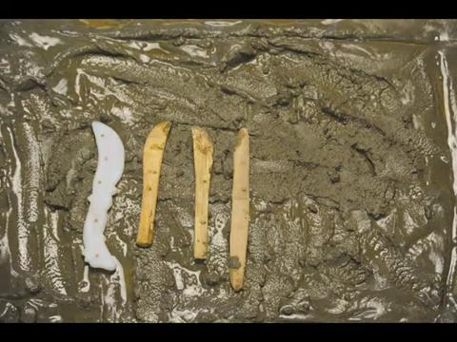
Layer Instruction
Notes:
How do we layer our instruction so that as we are teaching the content of science, we are addressing the SEP’s the CCC all while weaving a story

Slide 52
Blank Slide

Slide 53
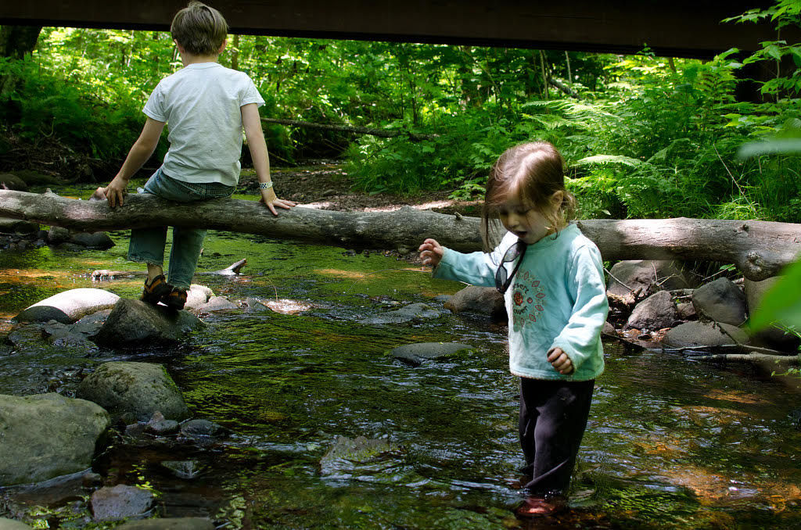
Questions?

Slide 54
Alaska Science Teacher Networking
AK Listserv- h
ttp://list.state.ak.us/mailman/listinfo/ak.scienceteachers?fbclid=IwAR1Lx1YLNKx6B9RsSDeW4Y_MPGO2PkQNC83eXI8yJY58s3zpOIFKOD__z6c
Alaska Science Teachers Facebook
https://www.facebook.com/groups/179916432073354
Alaska Science Teachers Association- https://asta.wildapricot.org/sys/website

Slide 55
Model Open Source Learning Models Links
Inquiry Hub Biology - https://www.colorado.edu/program/inquiryhub/curricula/inquiryhub-biology
Inquiry Hub Chemistry - https://docs.google.com/document/d/1gSVXTDxPRsY7PTR1zQxCY5aU02E8VwHlRaH-0WQ9fAs/edit (Under construction
Patterns Science- https://sites.google.com/beaverton.k12.or.us/patterns/home

Slide 56
Model Open Source Learning Models Links page 2
Model Open Source Learning Models Links
New Visions Science
Living Environment - Transitional https://curriculum.newvisions.org/science/course/living-environment/
Earth Science - Transitional https://curriculum.newvisions.org/science/course/earth-science/
HS Earth Science - NGSS https://curriculum.newvisions.org/science/course/earth-space-science/

Slide 57
Model Open Source Learning Models Links page 3
Model Open Source Learning Models Links
Physics- (Under construction) https://curriculum.newvisions.org/science/course/physics/
HS Biology- NGSS
https://curriculum.newvisions.org/science/course/biology/
Chemistry- https://curriculum.newvisions.org/science/course/chemistry/
Inquiry Hub Stem - Middle School- https://www.colorado.edu/program/schoolwide-labs/computational-thinking-classroom-resources-ct-integrated-storyline-units

