Slide 1
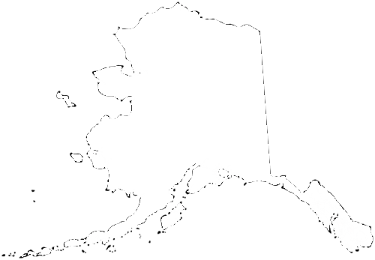
School Improvement Planning, Tracking & Indistar 3.0
Alaska department of education & Early development
Brad Billings, Administrator, School Improvement
Scot Fiscus, Education Specialist II

Slide 2
Purpose:
Provide a quick overview of School Improvement
Provide an overview of Indistar’s 3.0 facelift for Alaska STEPP (Steps Towards Educational Progress and Partnership)
Provide resources to develop and implement an Alaska STEPP School Improvement Plan
Notes:
I’ve found in both being an educator, now an EED employee and a world traveler; We are all continually searching, innovating and implementing processes to improve the education of students.
That in Alaska, school improvement is driven by the school designations.
I’ll also go over some of the pieces that can provide technical assistance for School Improvement Plans

Slide 3
School Improvement Plan
Definitions
According to one definition, a school improvement plan is a “road map that sets out the changes a school needs to make to improve the level of student achievement, and shows how and when these changes will be made.” (“School Improvement Planning: A Handbook,” Op. cit., p. 6.)
The “The ultimate goal of school improvement is for the people attached to the school to drive continuous improvement for the sake of their own children and students.” Dr. Sam Redding Center on Innovation and Improvement
Notes:
As districts engage in school improvement and continuous improvement planning processes, they must embed this concept of quality improvement into the daily activities and tasks of its various actors. ( Best Practices for School Improvement Planning Oct. ’14 “Hanover Research”)

Slide 4
School Improvement plans are based on the
Continuous Improvement Model
Plan
Create
Implement
Monitor
Assess
Revise
Notes:
Successful plans facilitates a shift in the improvement planning process from one year plans addressing only compliance-related requirements to a continuous process of assessing, planning, and self-monitoring.
Plans can be in any form – word, excel, online tool
It assists teams in setting up plans that are strategic because key areas are assessed first
It assists teams in avoiding the planning whirlpool with a built in self monitoring mechanism
It adapts to the changing nature of schools by allowing for revisions based on the results of the monitoring

Slide 5
Data Analysis - analyze state and local test data MAP/AIMSWeb/Dibels/attendance/graduation rate/behavior/perception
School Needs Assessment Form
Enter sources of data used and areas of need.
Write specific goals based on need.
Determine indicators to assess based on disaggregated data and data strands/trends.
Write a narrative statement that reflects strengths and/or needs.
Notes:
Objectives created for school improvement are based upon the needs emerging from the data analysis and the needs assessment; therefore, it is important that schools, with the support of districts, are able to collect appropriate data efficiently and find ways to manage and display the data so that all staff members are able to analyze, communicate, and act upon it. This analysis, communication, and subsequent actions are the heart of the continuous improvement process.

Slide 6
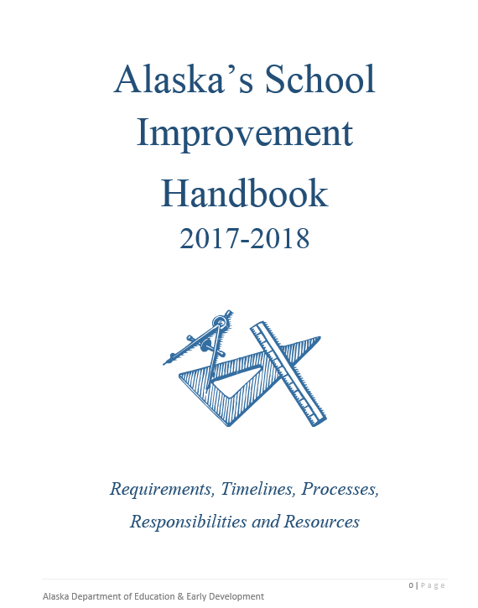
START WITH A NEEDS ASSESSMENT
Consider subgroups such :
  economically disadvantaged
  English learners
  students with disabilities
  racial/ethnic subgroups
  migrant students
  others
DEED Website; Orange Support Star; Alaska STEPP Tab
https://education.alaska.gov/aksupport/akstepp/AK_School_Improvement_Handbook.pdf
Notes:
The intent of the Handbook is to provide a structure for the processes of School improvement planning for specifically designated schools while supporting the Alaska Department of Education & Early Development’s Mission: to ensure quality standards-based instruction to improve academic achievement for all students.
Includes details about types of schools: star ratings and designations.
Our goal is to update the handbook annually.

Slide 7
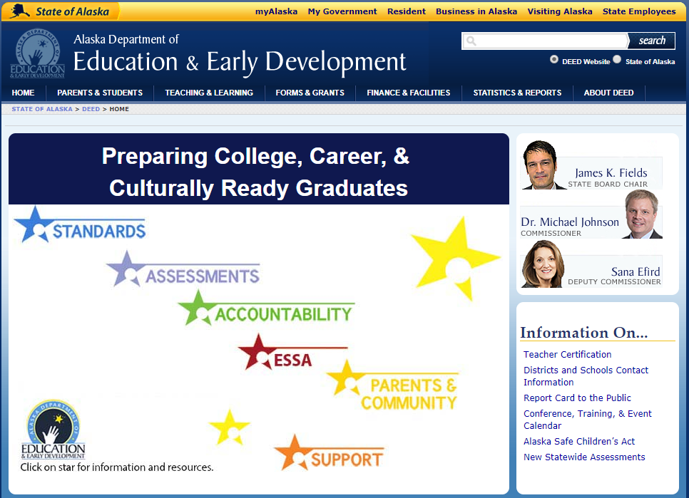
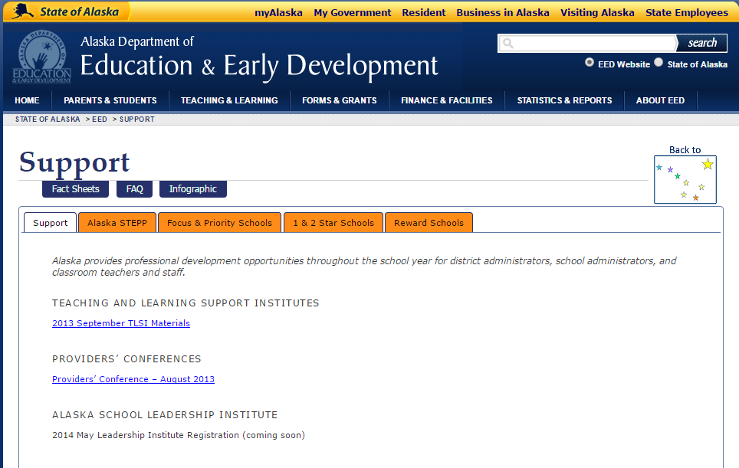
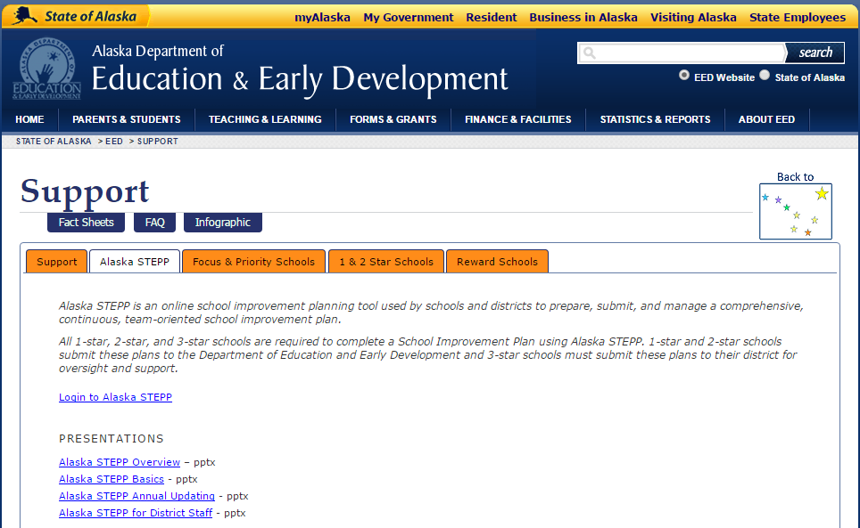

Notes:
Upper left: is the Education and Early Development page accessed through Alaska’s main page
Upper right: Once “Support” is clicked it will take you to the upper right – click on the “Alaska STEPP” tab
Lower Left: you are now on the page accessing information regarding Alaska STEPP as well as the link to it.
Lower right : This is the main page of information and access to Indistar’s website as well as Alaska STEPP log in.

Slide 8
What is Alaska STEPP
Alaska STEPP, which stands for Steps Toward Educational Progress and Partnership, is an online, school improvement planning tool based upon Indistar, a software template. Twenty-four states, including Alaska, currently use the software program to serve school, and district-level, improvement planning.
The program is designed to help schools and districts create an improvement plan by assessing, planning and monitoring data driven instructional needs.
Notes:
How many of you have worked with Alaska STEPP?

Slide 9

Establish a Team
Teacher representatives
Special education teacher
Related arts teacher
Paraprofessional
Parents
Community representative
Business partner
Notes:
The key people will be those who are continuously around and typically are parents and paraprofessionals or other community members.
Look to have these people on your teams.

Slide 10
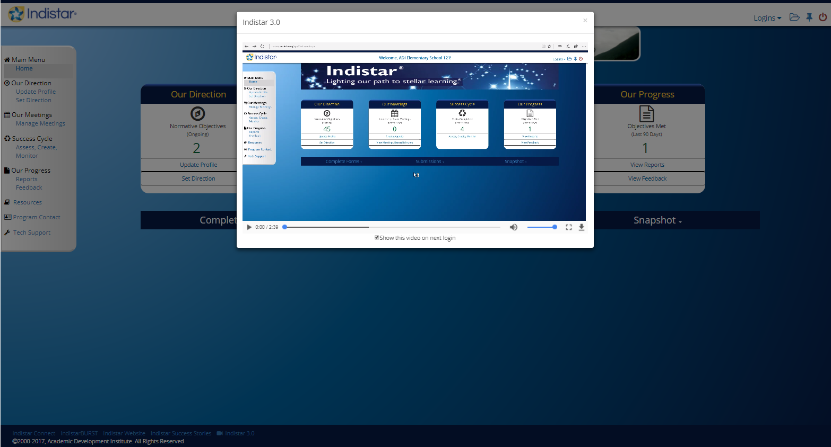
Indistar’s New Layout
Notes:
Here is the video laying out the changes in Indistar’s updates.

Slide 11
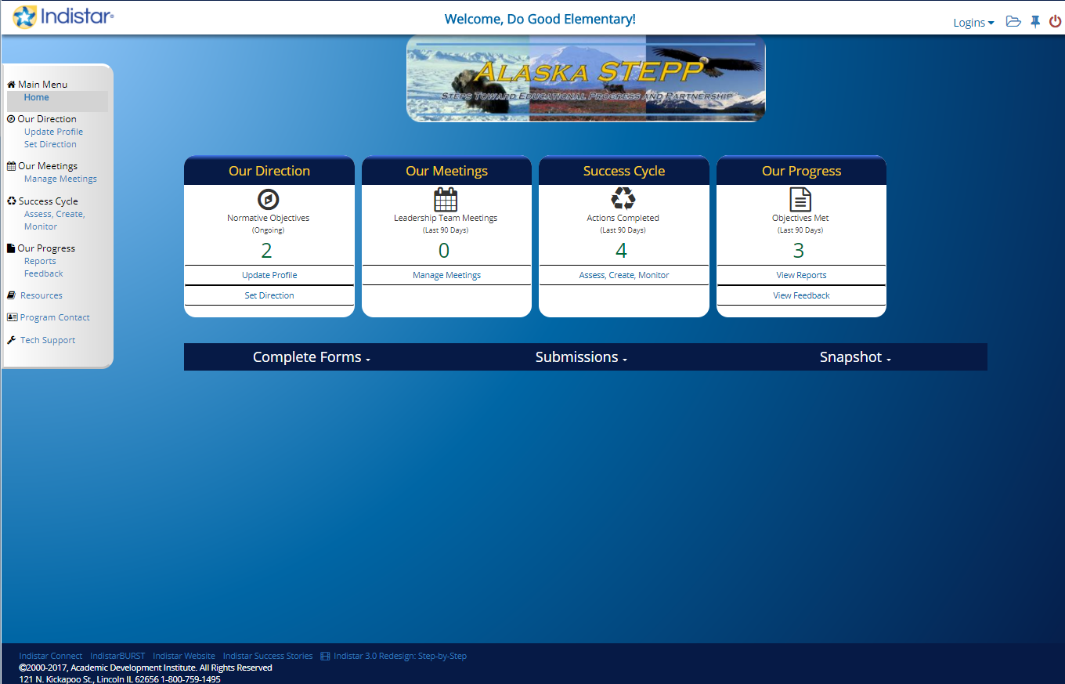
Entering Alaska STEPP
Home
Notes:
The presentation slides so far have overviewed a general look at school improvement. The next few slides dive into the Alaska STEPP program.
This is considered the Home page previously the Dashboard.
The main pieces here are from left to right:1 Gray menu bar, 2 the four main Icon 3 the login and upload links to the upper right and 4 the blue banner below the icons.

Slide 12
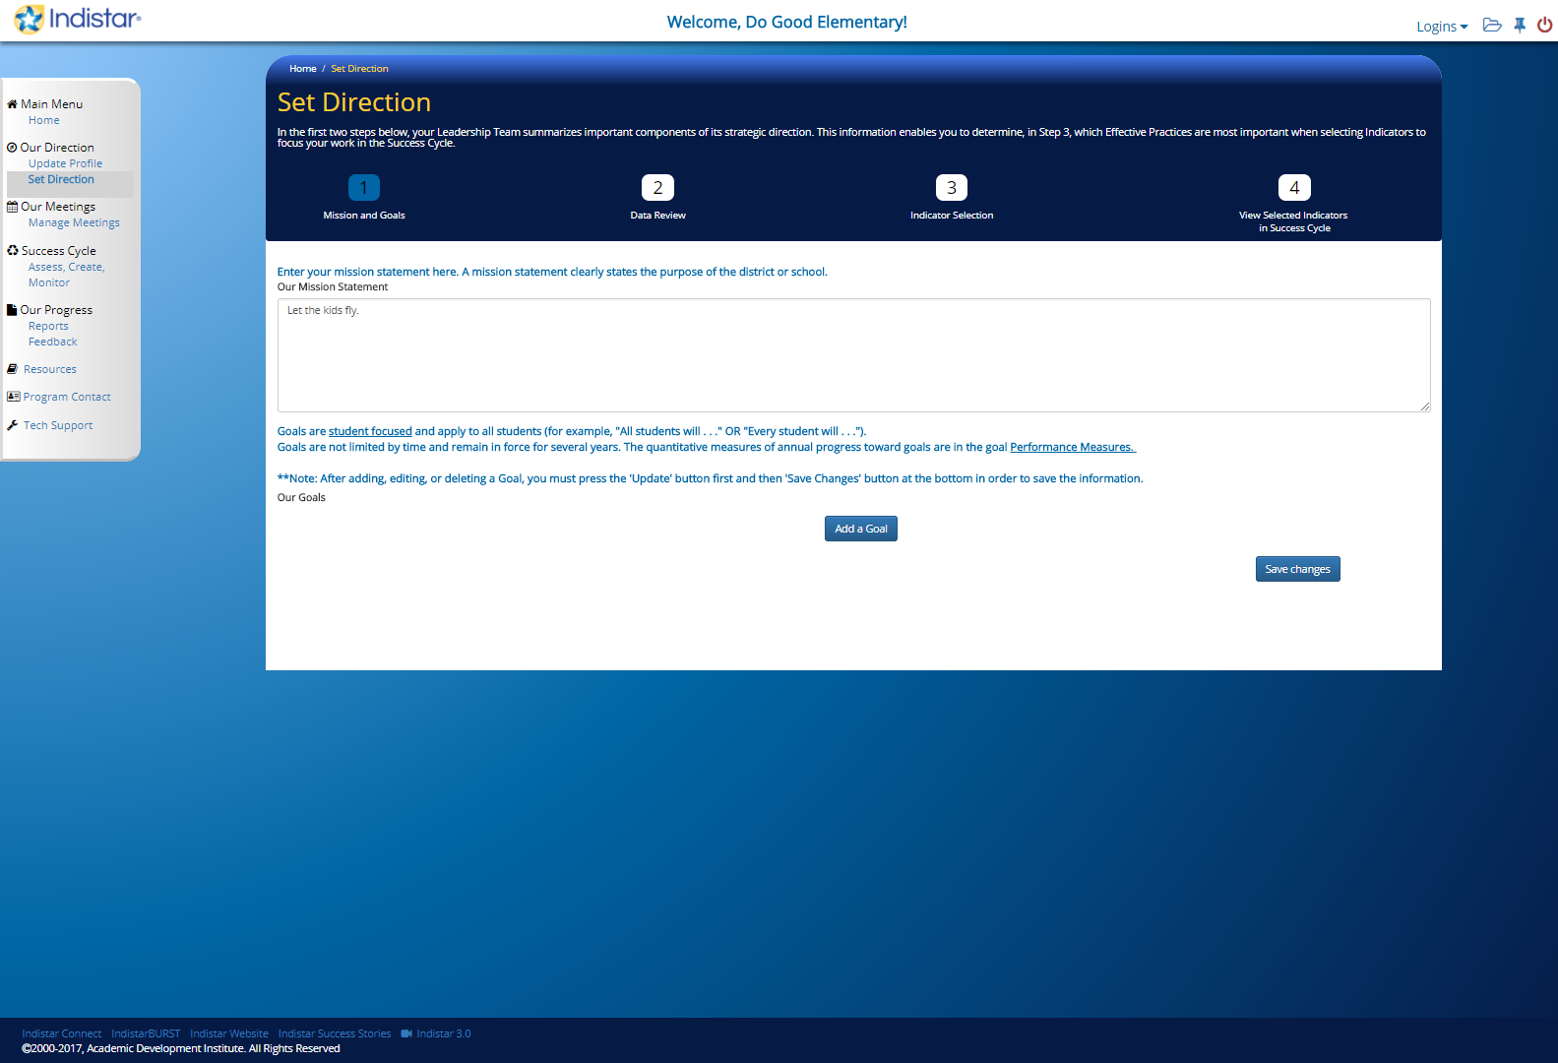
Our Direction
Notes:
Mission and Goals
Data Review
Indicator Selection – Must select in order to report from – Indicators were not auto selected unless they were spotlight indicators.
View Selected Indicators in Success Cycle

Slide 13
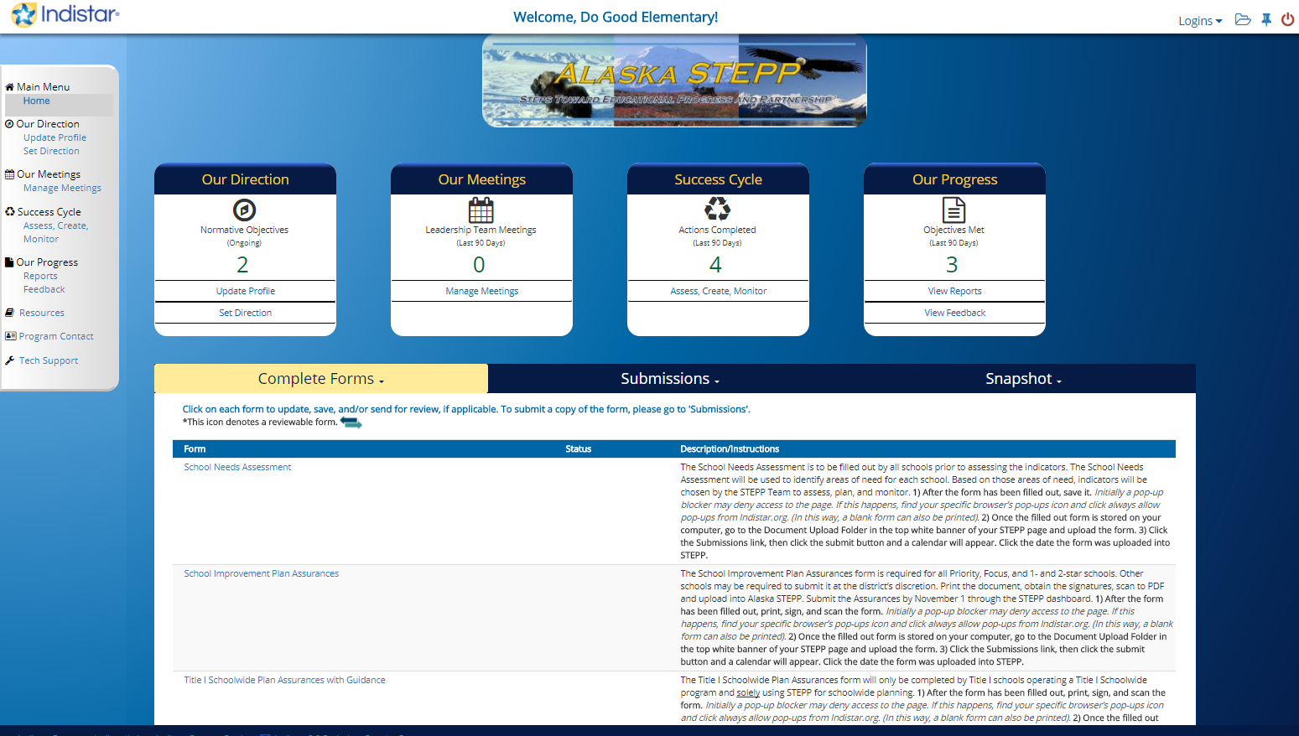
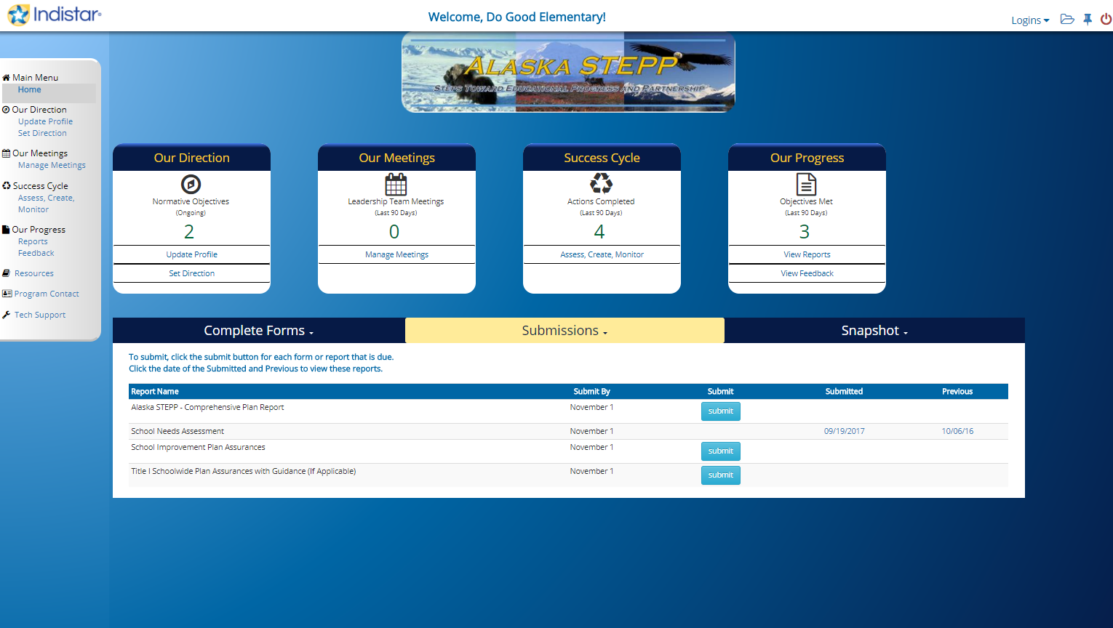

Home page of AK STEPP
School Needs Assessment
AK STEPP Comprehensive Report
School Needs Assessment
School Improvement Plan Assurances
School Improvement Plan Assurances
Title 1 SW Plan Assurances w/Guidance
Title 1 Schoolwide Plan Assurances with Guidance
When ready to send in applications:
1) Click on submit for Comprehensive report
2) Upload documents to 2017-18 folder
3) Click Submit for each document
Notes:
I want to point out a couple quick pieces that have been bumps to submitting/uploading forms in the power point and then we will jump to the site itself.
Once you get into STEPP and click in “Our Direction”, the banner at the bottom opens into three categories
The first is where to find forms, the second is where to submit forms and the third is a snapshot of the work completed. Again, we’ll come back to set direction in the site.

Slide 14
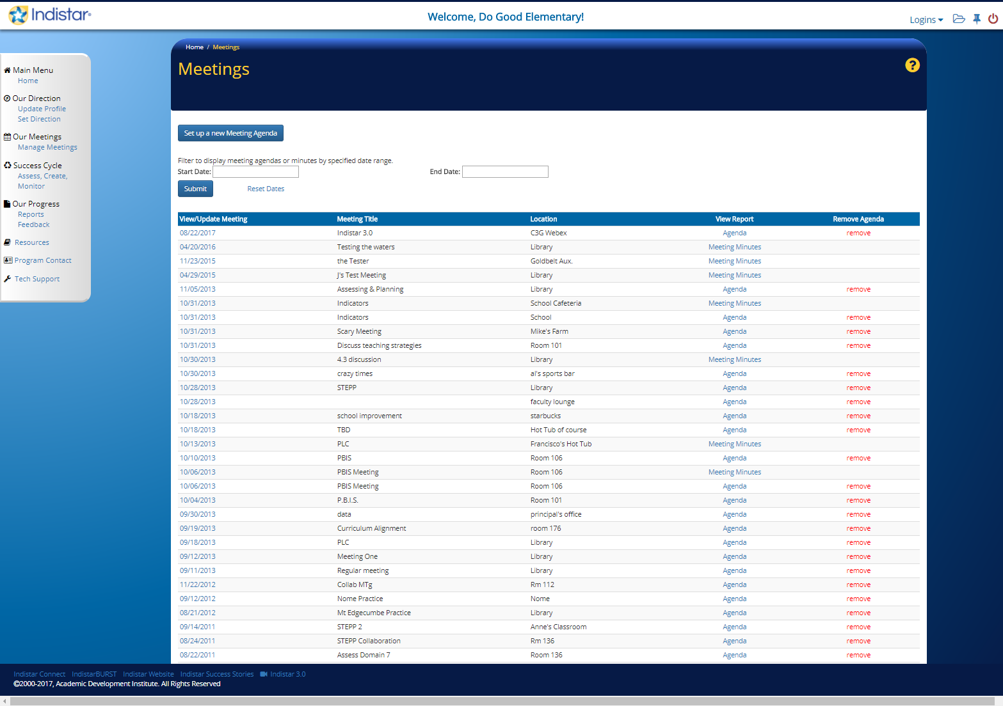
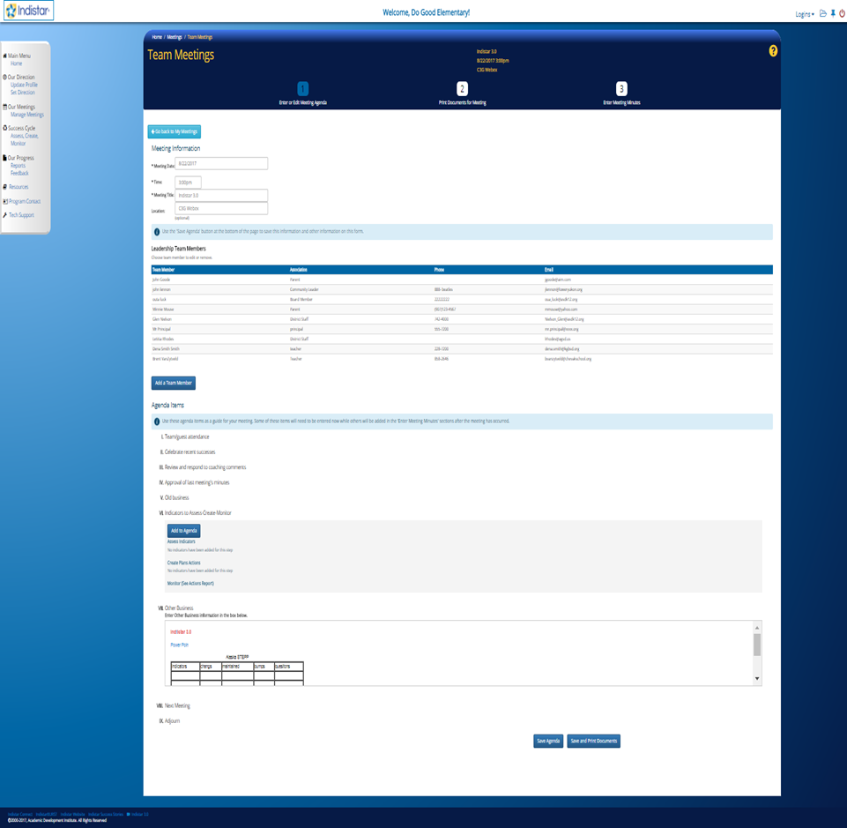
Our Meetings
Notes:
Our meetings has the same options as previously but accessed a little different. We’d like to see more districts using this page for PLC’s or other meetings. You can paste in an agenda made in word or other text editor.
Or the agenda can be created here and printed or emailed to the entered team members.

Slide 15
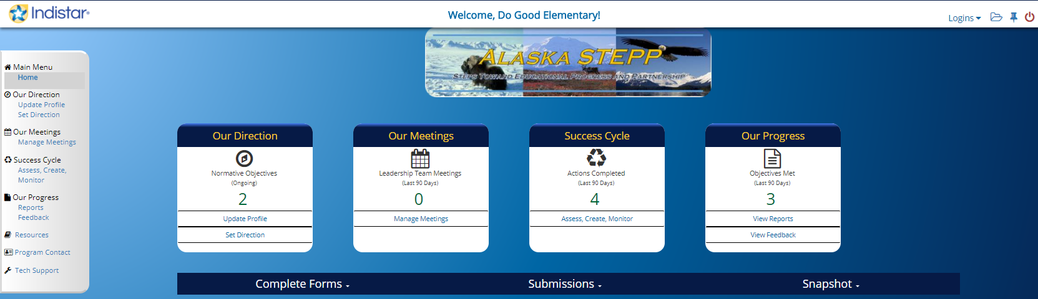
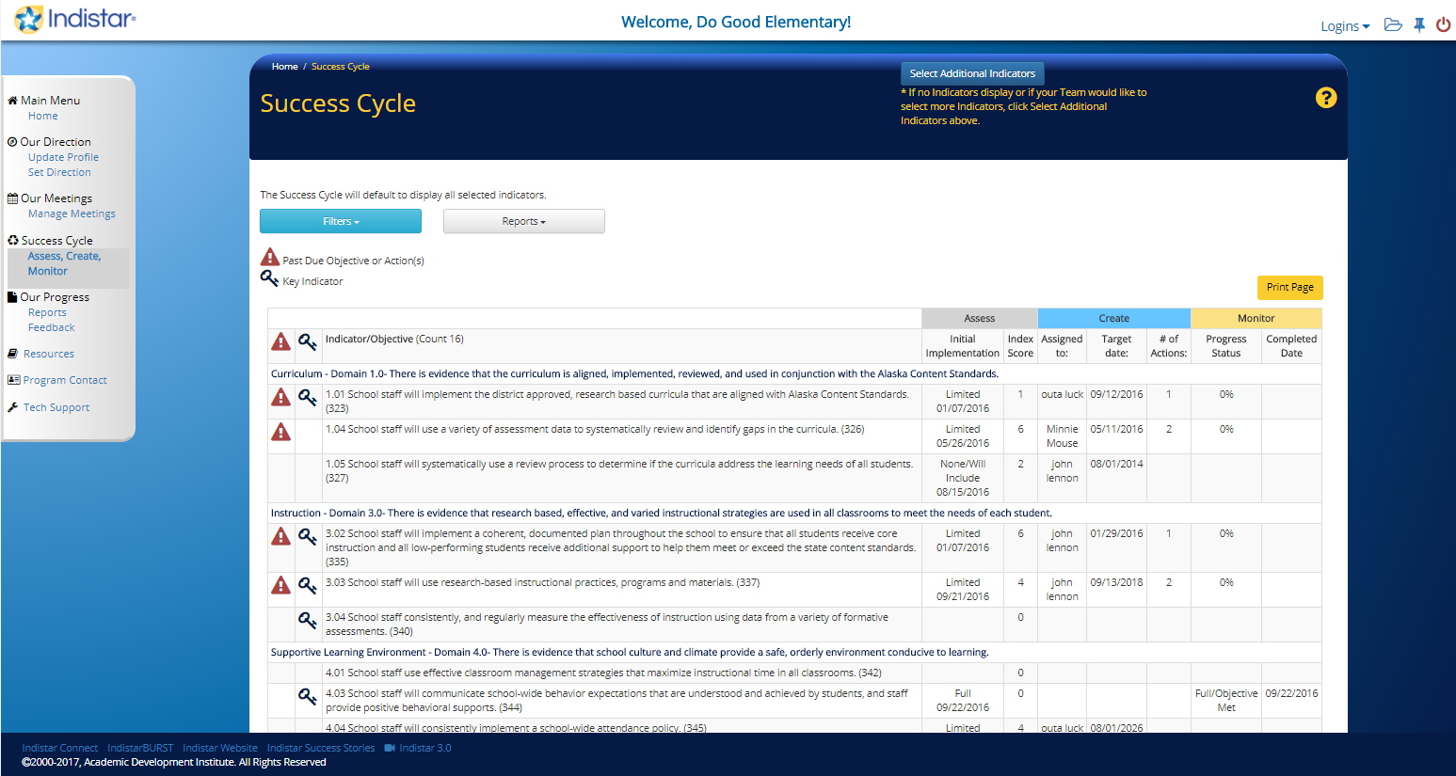
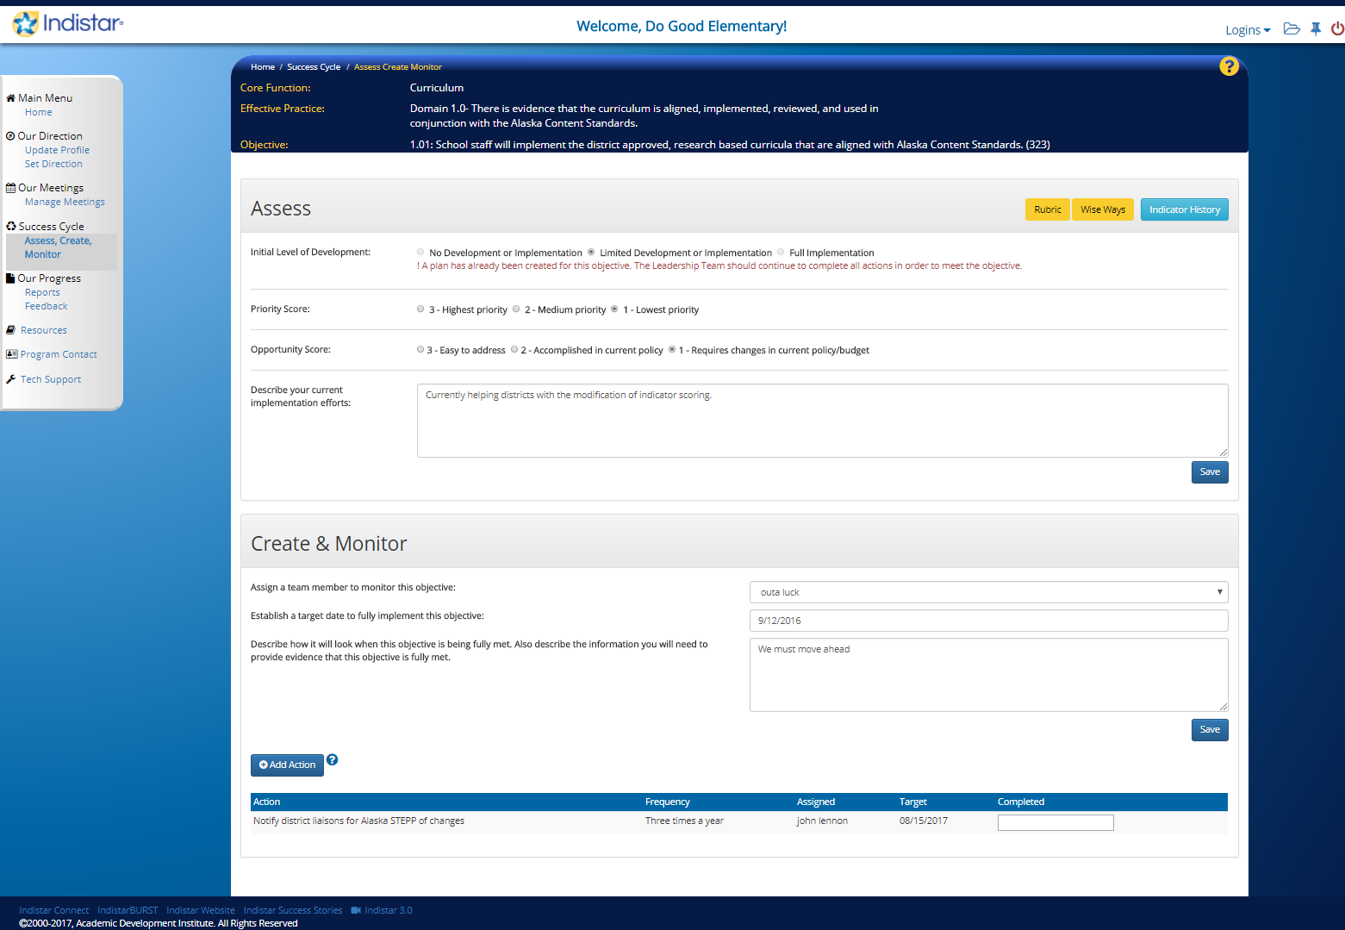
Success Cycle
2
1
3
Notes:
This is where the bulk of the work happens.
All three actions on the same page – Assess Create and Monitor

Slide 16
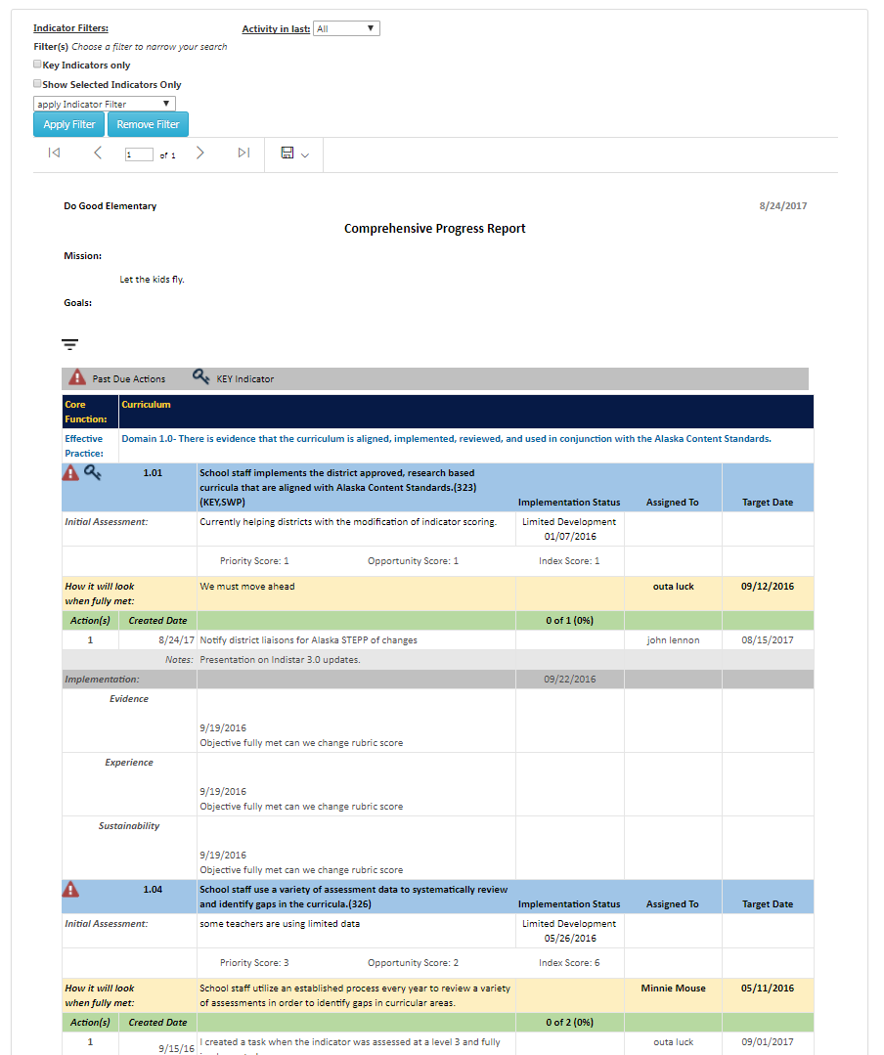
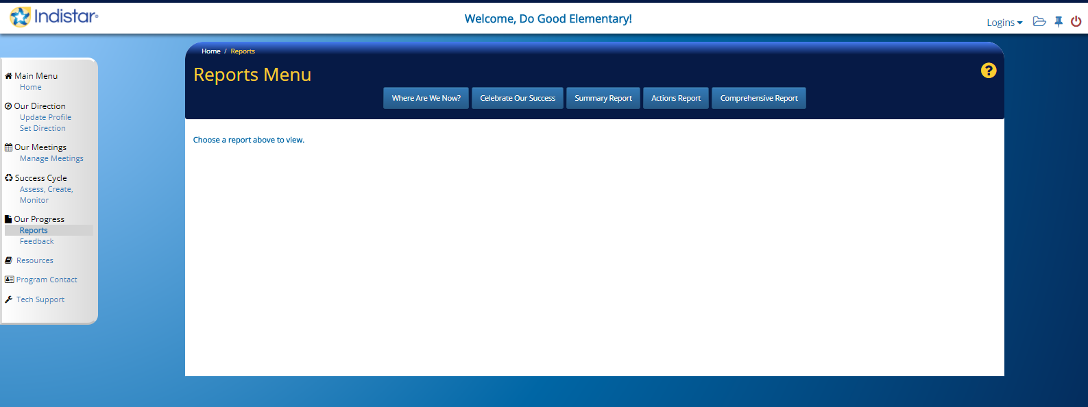
Our Progress
Access printable final reports and filterable reports that can all be used for websites or presentations.
Notes:
Comprehensive report shown that is filterable for indicator status.

Slide 17
Indistar 3.0
http://alaska.gov/
Notes:
This will take us from the power point to the Department of Education and Early Development

Slide 18

STEPP Search
Login to STEPP using
Login: ak - Password: ak.
With a partner, complete each item.
Go between home page, main menu , and success cycle.
Add a person to the School Team.
Delete a person from the School Team.
Enter new school information.
Figure out how to upload the School Needs Assessment.
Assess an indicator.
Write an objective and add actions.
Monitor an indicator that has actions.
Create a new Meeting Agenda.
Generate a Comprehensive Plan Report.
Generate a Report of Assessed Indicators
Generate a List of Objectives Included in Plan
Notes:
20 minutes

Slide 19
Thoughts to Ponder
Plans can only drive school improvement when they are regularly reviewed and revised through a Data Team process.
What gets measured and monitored gets done.
Plans will most likely be realized when representatives from the people who are responsible for carrying them out are included in the planning process.
Plans are only as effective as the leadership that monitors their Implementation.
Notes:
The last slide before the citing’s and credits I’ll leave you with are these school improvement thoughts.

Slide 20


More technical assistance
announced via the newsletter.
Contact:
Scot Fiscus * scot.fiscus@alaska.gov * 907-465-8718
Brad Billings * brad.billings@Alaska.gov * 907-465-8720
Steps Toward Educational Progress & Partnerships

