Slide 1

School-wide Positive Behavior & Supports
Staff Introduction
www.pbis.org

Slide 2
School Supports
Family/ Community
Behavioral Health
Positive School Climate / Culture
*developed by EED in collaboration with Behavioral Health for the State of Alaska SW-PBS Blueprint
Notes:
The Goal of this slide is to get the audience thinking of all of the entities that should be considered when planning for a successful implementation of a positive school climate/ culture.

Slide 3
Academics
Home
Cultural
Social Emotional
Student
Success
*developed by EED in collaboration with Behavioral Health for the State of Alaska SW-PBS Blueprint
Notes:
The goal of this slide is to show the connection of the roles from the previous slide (slide 2) entities and how they contribute to student success.

Slide 4
What is School-wide Positive Behavior Supports?
SW-PBS is:
Evidence-based (over 10,000 schools in the US)
A structural framework, NOT a curriculum, intervention, or practice
It is a Decision making framework
A positive approach based on teaching students appropriate behavior
Individualized for each school
An excellent match for Alaskan schools
Cultural match
Rural/remote match
www.pbis.org

Slide 5
Challenges
Bullying
Suicide
Substance Abuse
Homelessness
Job Skills
Cultural Diversity
Depression
Support
Health
Supportive Relationships
Violence
Family Violence
Notes:
The goal of this slide is to remind people of all the challenges students face in their day to day lives.

Slide 6
Why Use School-wide Positive Behavior Support?
Schools face a set of difficult challenges today
Multiple expectations (academic accomplishment, social competence, safety)
Students arrive at school with widely differing understandings of what is socially acceptable
Traditional “get tough” and “zero tolerance” approaches are insufficient
Individual student interventions
Effective, but can’t meet need
School-wide discipline systems
Establish a social culture
within which both social
and academic success is more likely
www.pbis.org

Slide 7
Designing School-wide Systems for Student Success
Academic Systems
Behavioral Systems
Intensive, Individual Interventions
Individual Students
Assessment-based
High Intensity
Intensive, Individual Interventions
Individual Students
Assessment-based (Data Driven)
Intense, durable procedures
1-5%
1-5%
Targeted Group Interventions
Some students (at-risk)
High efficiency
Rapid response
5-10%
5-10%
Targeted Group Interventions
Some students (at-risk)
High efficiency
Rapid response
80-90%
Universal Interventions
All settings, all students
Preventive, proactive
Universal Interventions
All students
Preventive, proactive
80-90%
www.pbis.org

Slide 8
Individualized supports
Tertiary Prevention:
Specialized
Individualized
Systems for Students with High-Risk Behavior
~5%
Early Identification/ referral
~15%
Secondary Prevention:
Specialized Group
Systems for Students with At-Risk Behavior
Alaska SW-PBS
Primary Prevention:
School-/Classroom-
Wide Systems for
All Students,
Staff, & Settings
Leadership/
Support Behavioral Expectations
~80% of Students
Readiness
School Infrastructure
Infrastructure Development
Adapted for EED from PBS.org
Notes:
The Goal of this slide is to explain the three Tiers of implementation with an emphasis on readiness and school infrastructure.

Slide 9
State
District
www.pbis.org
Notes:
The goal of this slide is to show all of the levels of interaction and support that is needed for adoption.

Slide 10
Stages of Implementation
2-3 yrs
Exploration/ Adoption
Installation
Development Commitment
Initial Implementation
Establish Leadership Teams, Set Up Data Systems
Full Implementation
Provide Significant Support to Implementers
Innovation and Sustainability
Embedding within Standard Practice
Should we do it?
Improvements: Increase Efficiency and Effectiveness
Doing it right
Doing it better
Adapted from www.pbis.org
Notes:
The goal of this slide is:
Follow basic logic, but use resources and tools to accomplish what you would like to achieve
Continue to self-evaluate
Continue to keep key stake holders involved (Parents, School Board, Staff, etc. )

Slide 11
What Outcomes are Associated with Implementation of SW-PBS?
Implementation with integrity and durability have teaching and learning environments that are…
Less reactive, aversive, dangerous, and exclusionary, and
More engaging, responsive, preventive, and productive
Address classroom management and disciplinary issues (e.g., attendance, tardy, antisocial behavior),
Improve supports for students whose behaviors require more specialized assistance (e.g., emotional and behavioral disorders, mental health), and
Most importantly, maximize academic engagement and achievement for all students
www.pbis.org

Slide 12
Tier 1: Implementation “8 Steps”
Establish a school-level SW-PBS Leadership Team
School-behavior purpose statement
Set of positive expectations and behaviors.
Procedures for teaching school-wide expected behaviors
Procedures for teaching classroom wide expected behaviors.
Continuum of procedures for encouraging expected behaviors.
Continuum of procedures for discouraging rule violations.
Procedures for on-going data-based monitoring and evaluation.
www.pbis.org

Slide 13
Evidence-based features of SW-PBIS?
Prevention
Define and teach positive social expectations
Acknowledge positive behavior
Arrange consistent consequences for problem behavior
On-going collection and use of data for decision-making
Continuum of intensive, individual interventions
Administrative leadership – Team-based implementation (systems that support effective practices)
www.pbis.org

Slide 14
Social Competence &
Academic Achievement
OUTCOMES
Supporting
Decision
Making
Supporting
Staff Behavior
SYSTEMS
DATA
What does SW-PBIS
Emphasize?
PRACTICES
Supporting
Student Behavior
www.pbis.org

Slide 15
Important Principles
Develop a continuum of scientifically based behavior and academic interventions and supports
Use data to make decisions and solve problems
Arrange the environment to prevent the development and occurrence of problem behavior
Teach and encourage pro-social skills and behaviors
Implement evidence-based behavioral practices with fidelity and accountability
Screen universally and monitor student performance & progress continuously
www.pbis.org

Slide 16
Universal
Targeted
Intensive
Continuum of Support for ALL
Anger man.
Prob Sol.
Ind. play
Adult rel.
Attend.
Coop play
Peer interac
Label behavior…not people
www.pbis.org
Dec 7, 2007
Notes:
The goal of this slide is to show that tiers are fluid and that students can go from one tier to another.

Slide 17
SW-PBS Problem Solving Logic

Slide 18
SW-PBS Problem Solving Logic
Establish Ground Rules
Start with Data
Match Practices to Data
Align Resources to Implement Practices
www.pbis.org

Slide 19
Data Collection

Slide 20
Considerations for Collecting Data
1. Determine what questions you want to answer
2. Determine what data will help to answer questions
3. Determine the simplest way to get data
4. Put system in place to collect data
5. Analyze data to answer questions

Slide 21
Types of Data
Discipline Referral Process
Define behavior
ODR
Reporting
PBIS Assessment
Staff surveys and assessments
Self Assessment Survey
School Evaluation Tool
Team Implementation Checklist
School Safety Survey
www.pbisassessment.org
www.pbisassessment.org

Slide 22
Behavior Data Points
School-wide data
Student specific
Academic Proficiency
Suspension/Expulsion/ truancy
Graduation rates
Drop-out rates
Attendance
Child support data
Teacher/Behavior Associate retention rate
Office discipline Referral
Major data points
Student name
Date
Location of behavior
Time of behavior
Type of behavior
Referring staff member
Possible motivation
Others involved
Administrative decision
Adapted from www.pbis.org & swis.org

Slide 23
Notes:
The goal of this slide is to represent how school-wide and individual data work together to promote positive school climate and academic achievement.

Slide 24
5 Key Components to Data Based Decision Making
Average number of referrals per day
Location of incident
Time of incident
Referring teacher
Behavior that occurred
www.swis.org

Slide 25
Data based decision-making

Slide 26
Our Goal: Decision-Making System
What do you want the data to tell you?
School-wide
Individual student
Adapted from www.swis.org
Notes:
www.swis.org

Slide 27
Decision making questions to consider
Is there a problem?
What areas/systems are involved?
Are there many students or few involved?
What kind of problem behaviors are occurring?
When are these behaviors most likely?
What is the most effective use of our resources to address the problem?
Possible “function” of problem behavior?
Who needs targeted or intensive academic supports?
What environmental changes/supports are needed?
Adapted from www.pbis.org

Slide 28
Sample Decision Rules
If……… | Then
More than 35% of students received one or more office discipline referrals There are more than 2.5 office discipline referrals per student | School-wide System
More than 35% of referrals come from non-classroom settings There are more than 15% of students receiving referrals from non-classroom settings | Non-Classroom Setting Specific System
More than 50% of referrals come from the classroom More than 40% of referrals come from less than 10% of classrooms | Classroom System
More than 10-15 students receive more than 10 office discipline referrals | Targeted Group Interventions
Less than 10 students receive more than 10 office discipline referrals Less than 10 students continue the same rate of referrals after receiving targeted group support A small number of students destabilize the overall functioning of school | Individual Systems with Action Team Structure
www.pbis.org

Slide 29
Allocated Time
(school day)
Support
Time
Student
Time
Engaged Time
(classroom time)
Academic
Engaged
Time
adapted from www.pbis.org
Notes:
The goal of this slide is to point out that academic engaged time is the smallest amount of time, but it is the time when there are the least amount of behaviors.

Slide 30
Benefits to school systems over time
Instructional Benefit
Springfield MS, MD
= 955 42% improvement
= 42,975 min. @ 45 min.
= 716.25 hrs.
= 119 days Instructional time
2001-2002 2277
2002-2003 1322
Administrative Benefit
Springfield MS, MD
= 955 42% improvement
= 14,325 min. @15 min.
= 238.75 hours
= 40 days Administrative time
2001-2002 2277
2002-2003 1322
Notes:
The goal of this slide is to show the time benefit to implementing SW-PBS.

Slide 31
Universal Strategies: School-Wide Tier 1
This is what you do!
Statement of purpose
Clearly define expected behaviors (Rules)
Procedures for teaching & practicing expected behaviors
Procedures for encouraging expected behaviors
Procedures for discouraging problem behaviors
Procedures for record-keeping and decision making

Slide 32
Universal Strategies: Classroom
Needed at the classroom level...
Use of school-wide expectations/rules
Effective Classroom Management
Behavior management
Instructional management
Environmental management
Support for teachers who deal with students who display high rates of problem behavior

Slide 33
Classroom Expectations
Classroom-wide positive expectations are taught and encouraged
Teaching classroom routines are taught and encouraged
Ratio of 6-8 positive to 1 negative adult interaction
Active supervision
Redirection for minor, infrequent behaviors
Pre-correction for chronic errors
Active supervision
Effective academic instruction and curriculum

Slide 34
Non Classroom Intervention
Positive expectations (social skills)
routines are taught in natural environment
Behavior examples for common focus
Active supervision
Scan, move, interact
Pre-corrections & reminders (proactive)
Positive reinforcement

Slide 35
The Matrix : Clear Set of Positive Schoolwide Behavior
Expectations Why is this important?
Provides consistency in language
Provides consistency in what to teach
Provides consistency in what to recognize
Provides consistency in what to correct
The cornerstone for everything else you will do related to SW-­‐PBS!

Slide 36

Behavior Purpose Statement: (AK school), we are respectful to the community and ourselves, and we are responsible to our tribe. We value hard work and cooperation. Together, we create a safe and encouraging environment for all students to learn.
Native Tribal Values “Inupiaq” | RULES WITHIN SETTINGS Expectations | Commons/ Hallway | Gym/ Recess | Lunch room | Bathroom/ Restroom | Office | library | sporting events | Assemblies
Kamaksrijiq | Respect | Walk quietly Follow directions Keep your hands to yourself | Listen to staff Treat gym equipment with care Follow directions | Use good manners Be polite to all Thank the cooks | Flush when you’re done Keep bathrooms clean | Keep your hands to yourself Speak politely Wait patiently | Be calm Walk Treat books and equipment with care Use your indoors voice | Be polite to guests Use good manners | Listen to speaker Use good manners
Inuuiaqatiuni ikayuutijiq | Responsibility | Be on time Always walk Be where you are needed | Clean up after yourself Put away equipment Use kind words | Keep area clean Use your indoors voice Clean up after yourself | Wash your hands Report problems Use bathrooms for intended purpose | Understand your behavior Accept consequences Listen actively | Return books to original place Clean up after yourself | Remain in gym area Clean up after yourself Use kind words | Keep your hands and feet to yourself Clean up after yourself Walk quietly
Savqatigiiyujiq | Cooperation | Be mindful of others Look out for others Participate willingly | Share Lookout for others Take turns | Wait quietly and patiently for food Stay seated | Help others when they ask Clean up after yourself | Offer to help Communicate a better choice | Be good listeners Keep hands and feet to self Be mindful of others | Show good sportsmanship Help others | Help each other behave Follow directions
Notes:
Sample matrix

Slide 37
CONTINUUM OF
SCHOOL-WIDE
INSTRUCTIONAL &
POSITIVE BEHAVIOR
SUPPORT
Tertiary Prevention:
Specialized
Individualized
Systems for Students with High-Risk Behavior
~5%
Secondary Prevention:
Specialized Group
Systems for Students with At-Risk Behavior
~15%
Primary Prevention:
School-/Classroom-
Wide Systems for
All Students,
Staff, & Settings
~80% of Students

Slide 38
Tier II/III Support Process
Step 1 – Insure Universals, including Classroom, in place
Step 2 – Student Identification Process
Decision Rules
Referral
Screen
Step 3 – Classroom Problem Solving
Classroom supports (function-based)
Progress monitor
Step 4 - Tier II/III supports
Non-responders to grade level supports
Match function of student behavior to intervention
Progress monitor
Step 5 - Evaluate Process
www.pbis.org

Slide 39
Important Themes
Tier 2
Part of a continuum – must link to school-wide PBS system
Efficient and effective way to identify students
Assessment = simple sort
Intervention matched to presenting problem but not highly individualized
www.pbis.org

Slide 40
Character & Social Skills Education
Easy to change moral knowledge……difficult to change moral conduct
To change moral conduct
Adults must model behavior being taught
Students must experience academic success
Students must be taught social skills for success
www.pbis.org

Slide 41
Individual Support Plans
Tier 3
When small group not sufficient
When problem intense and chronic
Driven by Functional Behavioral Assessment
Linked to school-wide system
www.pbis.org

Slide 42
Process (FBA to PBS)
Conduct functional behavioral assessment
Create plan based on functional assessment outcome
Develop infra-structure to support behavior change (school environment must change)
www.pbis.org

Slide 43
Diagnostic
Individualized supports
Screening
Evidence Based Practices
Small group
Social skills
Data based decision making
Substance abuse
Bullying
Suicide prevention
Teen dating violence
Risky sexual behaviors
Domestic violence
Trauma
Academic Supports
School-wide positive behavior supports
Types of Supports/ Services by Tier
Notes:
The Goal of this slide is to give examples of supports/services that could be done in each tier.

Slide 44
Behavior Support Elements of Tier 3
*Response class
*Routine analysis
*Hypothesis statement
*Alternative behaviors
*Competing behavior analysis
*Contextual fit
*Strengths, preferences, & lifestyle outcomes
*Evidence-based interventions
Problem Behavior
Functional Assessment
*Implementation support
*Data plan
Team-based
Behavior competence
Intervention & Support Plan
*Continuous improvement
*Sustainability plan
Fidelity of Implementation
Impact on Behavior & Lifestyle
Notes:
The goal of this slide is to show the different elements that need to be review at Tier 3.

Slide 45
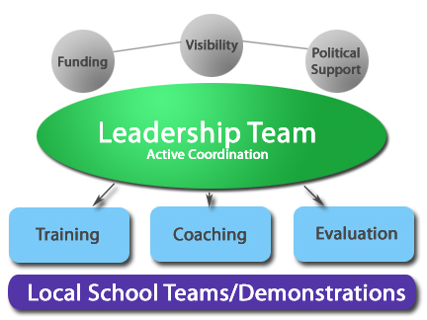
www.pbis.org
Notes:
Transition slide to leadership team

Slide 46
A School-based PBS Leadership Team
School Administrative Team must be committed to school-wide PBIS and actively participate on the team
SW-PBS team should remain small (3-8 members)
Consider representatives that include: administration, general education teachers, special education teachers, guidance, specials teachers, parents…
Consider Core Team vs. Peripheral Team
www.pbis.org

Slide 47
School-wide PBS Leadership Team Tasks
Develop a written school-wide PBS action plan
Monitor behavior data
Hold regular team meetings (at least monthly)
Maintain communication with staff and coach
Evaluate progress
Report outcomes to Coach/Facilitator & District Coordinator
www.pbis.org

Slide 48
Define Roles for Effective Meetings
Core roles
Facilitator
Minute taker
Data analyst
Active team member
Administrator
Backup for each role
Typically NOT the administrator
Are there other roles needed?
-time keeper
-munchies manager
Newton, J.S., Todd, A. W., Horner, R.H., Algozzine, B., & Algozzine K., 2010

Slide 49
Administration’s Roles and Responsibilities
ALL administrators are encouraged to participate in the process
Administrator should play an active role in the school-wide PBS change process
Administrators should actively communicate their commitment to the process
Administrator should be familiar with school’s current data and reporting system
If a principal is not committed to the change process, it is unwise to move forward in the process
www.pbis.org

Slide 50
School-based PBS Team Meets Frequently
During initial planning, teams may need to meet more often
Team should meet at least once a month to:
Analyze existing data
Make changes to the existing database
Problem-solve solutions to critical issues
Begin to outline actions for the development
of a plan
www.pbis.org

Slide 51
Coaching within SW-PBS Implementation
Internal Coach
External Coach
Expectations of coaching
Notes:
Transition slide

Slide 52
Summary
Investing in SW-PBS results in:
Change in school discipline systems creates an environment that promotes appropriate behavior
Reduction in problem behavior resulting in less staff time dealing with problems, more student time in the classroom
Improved perception of school safety, mental health
Improved academic performance
Improved social behavior performance
Improved effectiveness and acceptability of individual interventions

Slide 53
Systems Framework
AK PBS State Coordinator
District Leadership Team
School Leadership Teams
Data
District PBS Coordinator
Coaches/Facilitators
Notes:
The goal of this slide is to show the basic systems framework .

Slide 54
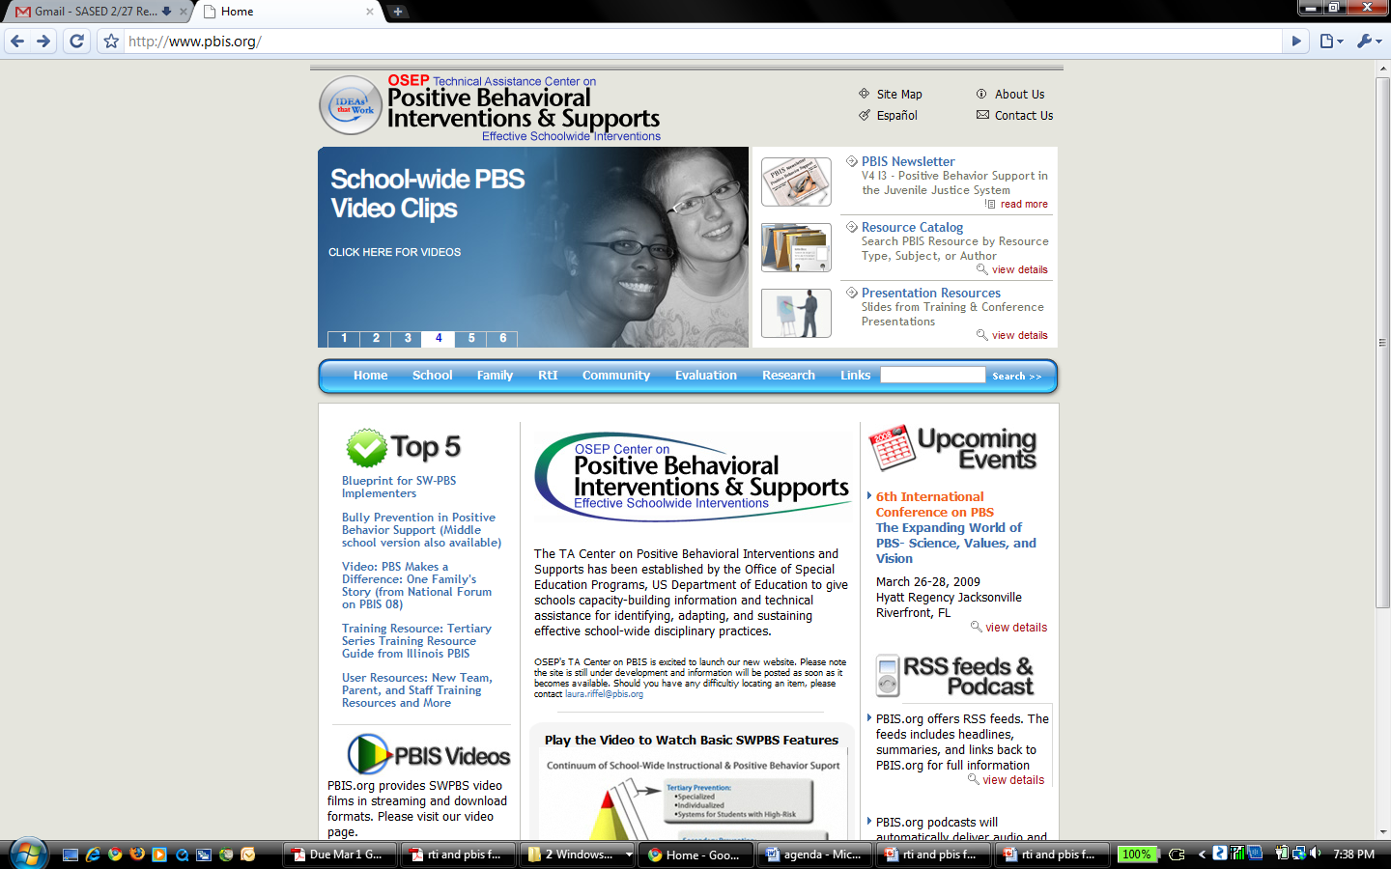
www.pbis.org

Slide 55
Resources
OSEP Center on Positive Behavioral Interventions & Supports
www.PBIS.org
PBIS Assessment
www.pbisassessment.org
SWIS
www.swis.org
University of Missouri PBIS
pbismissouri.org/
Contact Info:
Alaska Education & Early Development:
Sharon Fishel
AKSW-PBS Coordinator
phone: 907-465-6523
Sharon.Fishel@alaska.gov phone: 907-465-6523

