Slide 1
Preparing
College, Career,
& Culturally Ready Graduates
Standards
Assessment
Accountability
Accountability
Parents & Community
Support
January 14, 2014

Slide 2
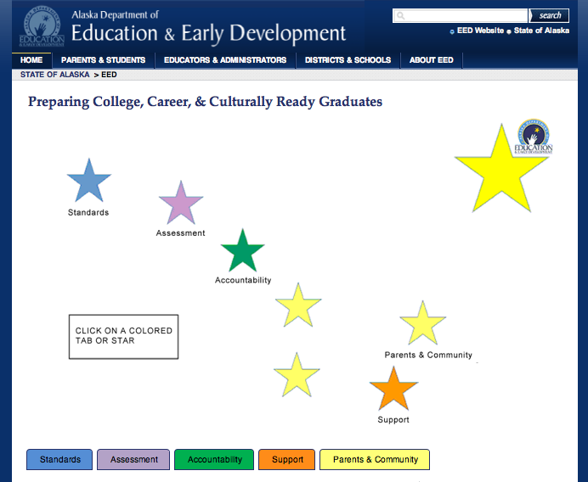
Notes:
On the Alaska Department of Education & Early Development home page you will find the c3g graphic.
By clicking on the star or tab labeled accountability you will find the information in this PowerPoint as well as additional resources.
NOTE: this PowerPoint can be found under the Support Star on the main tab along with other resources presented at this conference.

Slide 3
Accountability
Teacher & Principal Accountability
School & District Accountability

Slide 4
Goals Today
After this presentation you will
Understand the purpose, process, and metric of both ASPI and the AMOs;
Be able to read and explain the ASPI worksheet;
Know where to find information and resources about Alaska’s school & district accountability system.

Slide 5
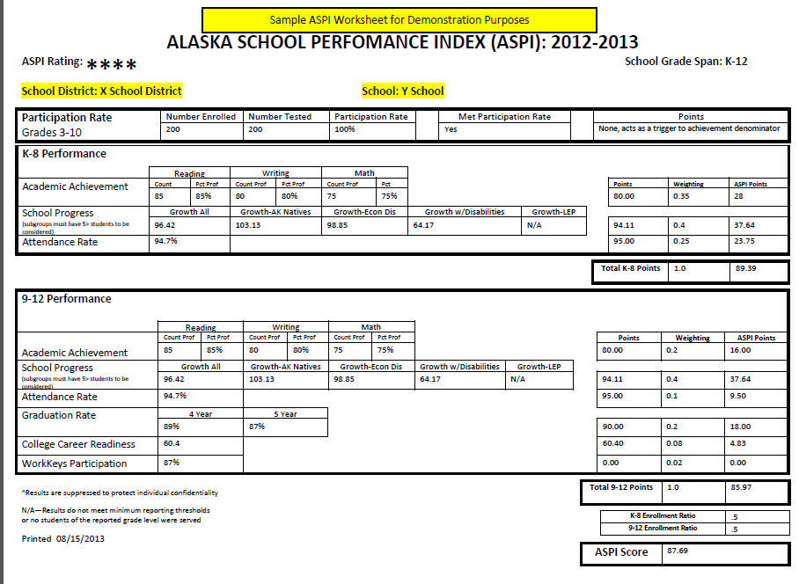
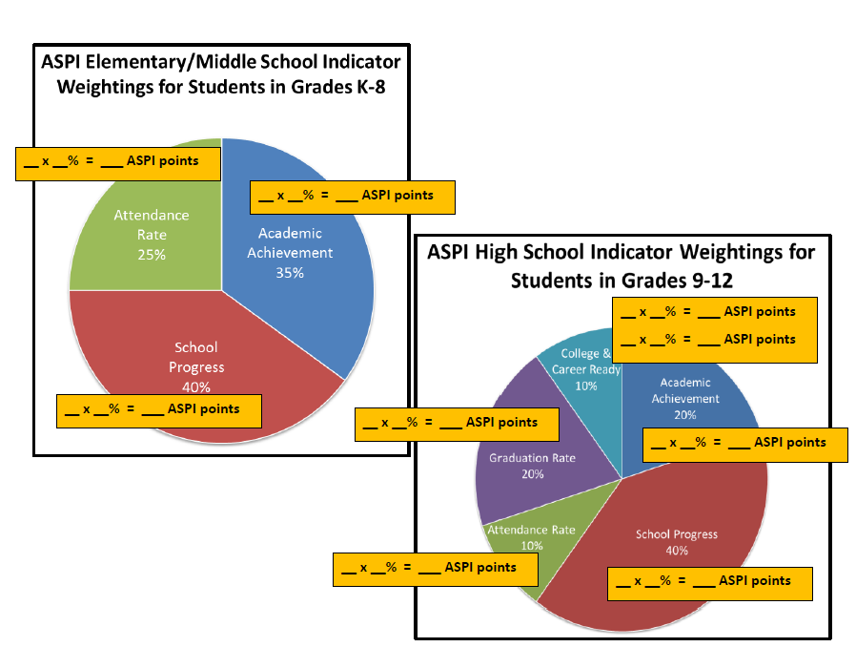
2 Note Taking Tools
1. Sample ASPI Worksheet
2. ASPI Components Graphs

Slide 6
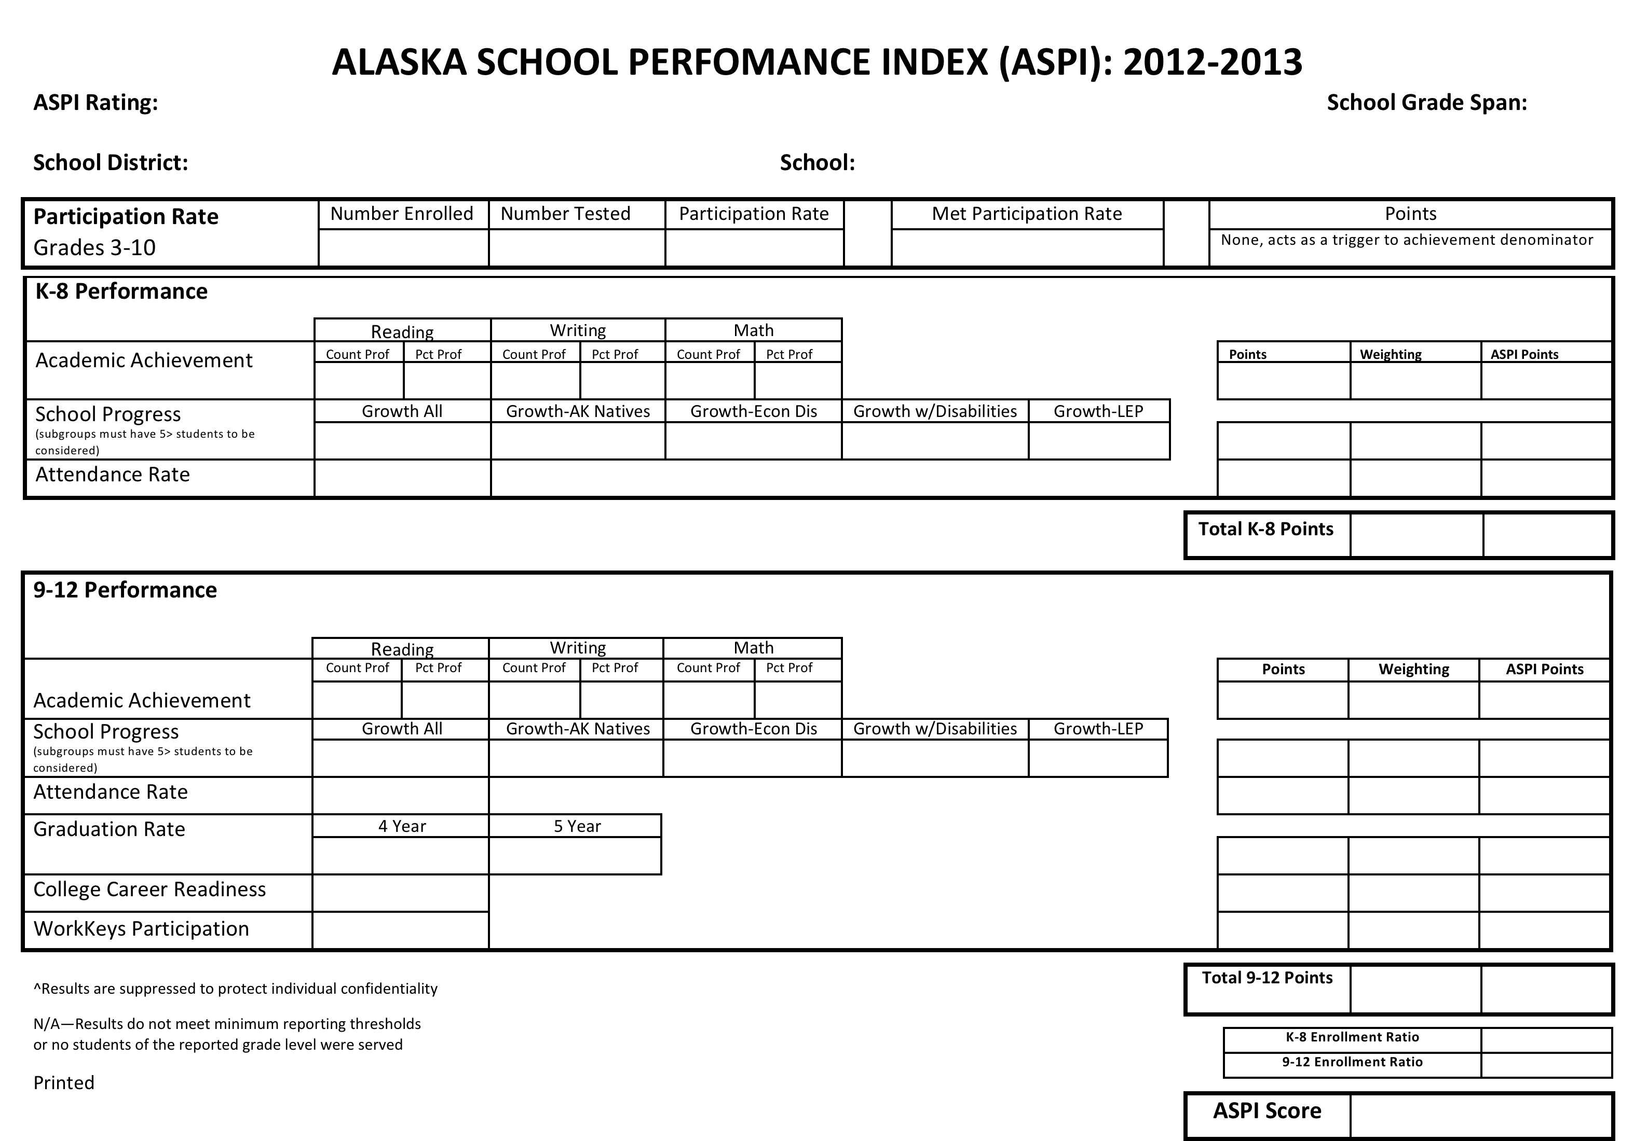
Handout
ASPI SCHOOL WORKSHEET

Slide 8
Question Protocol for Learning
Clarifying questions- ask in the moment!
Detail questions, analytical questions, district-specific questions- write them down; we’ll answer them once everyone has the Big Idea.
Concerns & feedback- write them down; as time allows we will listen and take notes to bring back to the EED team. If we aren’t able to fully discuss your concern/feedback at this time, please email Elizabeth and she will take it to the team.

Slide 9
ESEA Flexibility Waiver from NCLB
ESEA Flexibility Waiver application submitted in October 2012
Approved by US Department of Education in May 2013
Permitted Alaska to develop new regulations for school accountability
Those regulations approved by the Alaska State Board of Education in June 2013
Notes:
In October 2012, Alaska submitted to the U.S. Department of Education its application for a waiver from components of the Elementary and Secondary Education Act (ESEA), which since 2002 has been called No Child Left Behind (NCLB). Alaska’s flexibility waiver was approved by the U.S. Department of Education in May 2013. This permitted Alaska to develop new regulations for school accountability to replace the Adequate Yearly Progress metric it had been required to follow as part of NCLB. These regulations were approved by the Alaska State Board of Education & Early Development in June 2013.

Slide 10
The New Accountability System Replaces
Adequate Yearly Progress (AYP)
  Expectation that 100% of students are proficient by Spring of 2013-2014 school year
  Annual Measurable Objectives for 2012-2013 school year were 94.28% proficient in Language Arts; 91.53% proficient for math
Consequences of not meeting AYP
    Corrective action
    Restructuring
    Restricted use of Title funds
    School Choice
    SES
Notes:
The new accountability system replaces the Adequate Yearly Progress model, which was built on an expectation that 100% of assessed students would be proficient by the spring of the 2013-2014 school year. Without the ability to develop our own accountability system, all schools would have been accountable to an Annual Measurable Objective (AMO) this past spring of 94% of students proficient in language arts and 91% of students proficient in math. Additionally, all of the consequences of not meeting those targets would have been required.

Slide 11
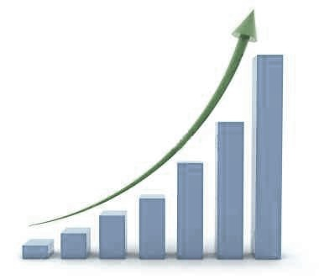
Alaska School Performance Index (ASPI)
Annual Measurable Objectives
(AMOs)
Alaska’s New Accountability System

Slide 12
Notes:
Red circle: the ASPI star rating for the school (out of 5 stars)
Green circle: the grade span of the school (K-8, K-5, 9-12, etc.)
Blue circles: the district and school names
Note: the number of students enrolled (YELLOW HIGHLIGHT) in the entire school is not included on this worksheet (e.g., in a K-6 school, grades’ K, 1, and 2 enrollment would not be reflected on the ASPI worksheet).

Slide 13
Participation Rate
Participation Rate is calculated by dividing the number of students tested in a school by the number of students enrolled.
The Participation Rate drives the calculation used for the Achievement score.
If the school meets or exceeds 95% participation in the standardized tests, only the students who assessed are included in the calculation for the Achievement score.
If the school does not meet 95% participation, any students who were not assessed but were enrolled will be counted as not proficient in the Achievement score calculation. If a school has 40 or fewer students enrolled in the assessed grades (3‐10), the requirements for participation are satisfied if two or fewer students do not participate in the state assessments.
Notes:
SUPPLEMENTARY INFORMATION REGARDING PARTICIPATION RATE
If a school has 40 or fewer students enrolled in the assessed grades (3‐10), the requirements for participation are satisfied if two or fewer students do not participate in the state assessments.

Slide 14
Participation
Grades 3-10
Number enrolled | Number tested | Participation rate | Met Participation rate | Points
200 | 200 | 100% | Yes | None…
Notes:
The first line of the ASPI worksheet reports on the participation rate. This is calculated by dividing the number of students in grades 3-10 who took the assessment by the number of students enrolled on testing day.
Students taking the Alternate Assessment (for the severely cognitively delayed) count in the participation rate.
The requirement is 95% participation rate.
If a school has 40 or fewer students enrolled in the assessed grades (3-10) the requirements for participation are satisfied if two or fewer student do no participate in the state assessments.

Slide 15
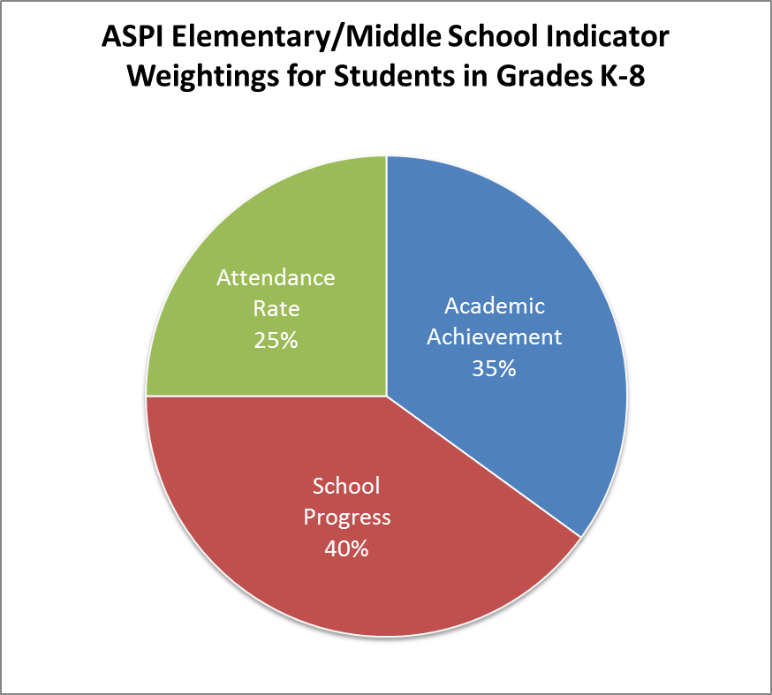
Notes:
For a K-8 school, there are three components of the ASPI system: Academic Achievement, which is 35% of the index; School Progress, which is 40% of the index; and Attendance Rate, which is 25% of the index.

Slide 16
Academic Achievement
Average of % of students proficient or above in reading, writing, and math.
Example: 100 students tested
85% proficient in reading = 85 students
80% proficient in writing = 80 students
75% proficient in math = 75 students
Total # proficient R, W, M
85 students + 80 students + 75 students = 240 students
Average % proficient
240 students / 300 tested students = 80% proficient
Notes:
The first component, Academic Achievement, is defined as the average of the % of students who are proficient or above in reading, writing, and math. For example, assume there are 100 students. If 85% of those students were proficient in reading, that would equal 85 students. If 80% were proficient in writing, that would equal 80 students. If 75% were proficient in math, that would equal 75 students. The total number of students who are proficient equals 85 plus 80 plus 75, which is 240 students. To get the average % proficient, the total of 240 students is divided by a total of 300 students who took the test. The average percent proficient is 80%.

Slide 17
80 x 35% = 28 ASPI points
Notes:
That 80% proficiency is weighted within the ASPI index at 35% of the index. 80 multiplied by 35% equals 28 ASPI points.

Slide 18
Academic Achievement
Reading |  | Writing |  | Math
Count Prof | Pct Prof | Count Prof | Pct Prof | Count Prof | Pct Prof
85 | 85% | 80 | 80% | 75 | 75%
Points | Weighting | ASPI Points
80.00 | 0.35 | 28

Slide 19
School Progress
The progress from the previous year’s Standards Based Assessments.
Calculated for five groups of students: All Students & the four subgroups of students with the highest achievement gaps in Alaska:
Alaska Native
Economically Disadvantaged
Limited English Proficient
Students with Disabilities
Notes:
The next component of the ASPI index is School Progress, which is 40% of the index. School Progress is defined as the progress from the previous year’s Standards Based Assessments. School Progress uses seven proficiency levels, from a high of Advanced to a low of Far Below Proficient Minus. This is very different from the AYP system, which recognized only two levels of student progress: proficient or not proficient. School Progress is calculated for five groups of students: All Students, Alaska Native, Economically Disadvantaged, Limited English Proficient, and Students with Disabilities. These include the four subgroups of students with the highest achievement gaps in Alaska.

Slide 20
School Progress: In the Future
2015
Vertically Aligned Assessments
Features a continuous scale from 0 to infinity.
The continuous scale means that a student who improves by 10 points between 3rd and 4th grades (moving from 204 to 214) has improved just the same as a student who improves by 10 points between 5th and 6th grades (moving from 219 to 229).
Equal interval feature makes measuring growth of individual students easy and reliable.
Notes:
The continuous scale means that a student who improves by 10 points between 3rd and 4th grades (for example, moving from 204 to 214) has improved just the same as a student who improves by 10 points between 5th and 6th grades (for example, moving from 219 to 229). This equal interval feature makes measuring growth of individual students easy and reliable. The RIT scale is one type of vertically aligned scale; commonly known assessments that use a vertical scale are the SAT and ACT college entrance examinations and the National Assessment of Educational Progress (NAEP).

Slide 21
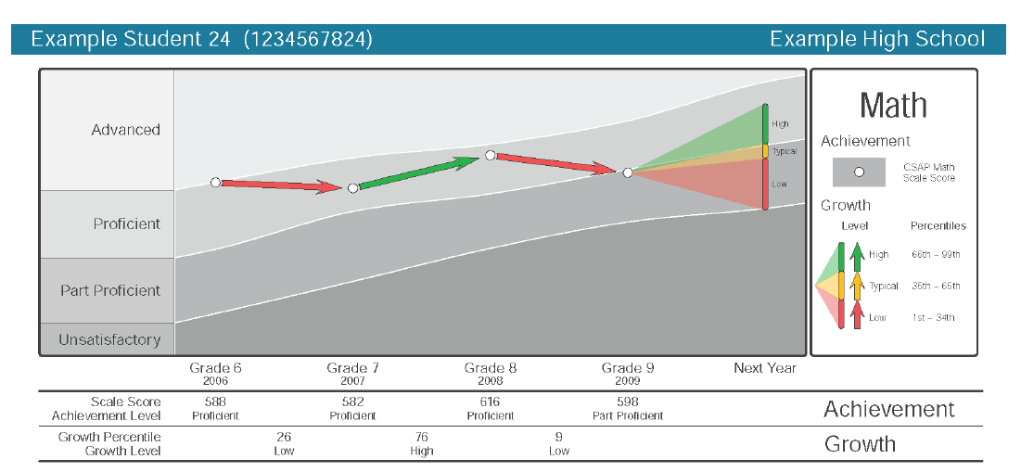
School Progress: In the Future
Probable range of next year’s scores; shows how much growth will be necessary for this student to achieve the next proficiency goal.
Scale Score & Achievement Level
Growth Percentile & Growth Level
Growth percentile between grades
Notes:
This is a student assessment score report example from Colorado, a state that currently uses a vertically aligned, or vertically equated, scale.
From the Colorado parent assessment score report explanation document:
“There are two issues involved when tests are given: Level of Achievement and Growth. Most tests we take give only a score reflecting something about our level of achievement (pass/fail, A/B/C/D/F grade, etc.). It is important to recognize kids’ progress towards a higher achievement level, even if they are not quite there yet – high growth means they can get there with more time. Achievement levels provide only one part of the story- a snapshot of performance at a single point in time. The other half of the story is each child’s growth in learning. Growth shows success in the education system, because it shows us where positive change is happening for students and schools.
The Colorado Growth Model measures the academic progress each student has made in a year. However, instead of just saying how many points student has gained or lost since the previous year, the model tells us how a student’s progress compares to other students with a similar score history. The student growth percentile scores range from 1 (lowest growth) to 99 (highest growth). Percentiles are not percent correct scores, and do not tell us anything about students’ “snapshot” achievement levels. Even students with low test scores can get high student growth percentiles, if they made great progress since the previous year's test. A 50th percentile growth score is right in the middle, so it’s a typical growth score across the state- not particularly low or high.”

Slide 22
School Progress 2012, 2013, 2014
The progress from the previous year’s Standards Based Assessments.
Calculated for five groups of students: All Students & the four subgroups of students with the highest achievement gaps in Alaska:
Alaska Native
Economically Disadvantaged
Limited English Proficient
Students with Disabilities
Notes:
The next component of the ASPI index is School Progress, which is 40% of the index. School Progress is defined as the progress from the previous year’s Standards Based Assessments. School Progress uses seven proficiency levels, from a high of Advanced to a low of Far Below Proficient Minus. This is very different from the AYP system, which recognized only two levels of student progress: proficient or not proficient. School Progress is calculated for five groups of students: All Students, Alaska Native, Economically Disadvantaged, Limited English Proficient, and Students with Disabilities. These include the four subgroups of students with the highest achievement gaps in Alaska.

Slide 23
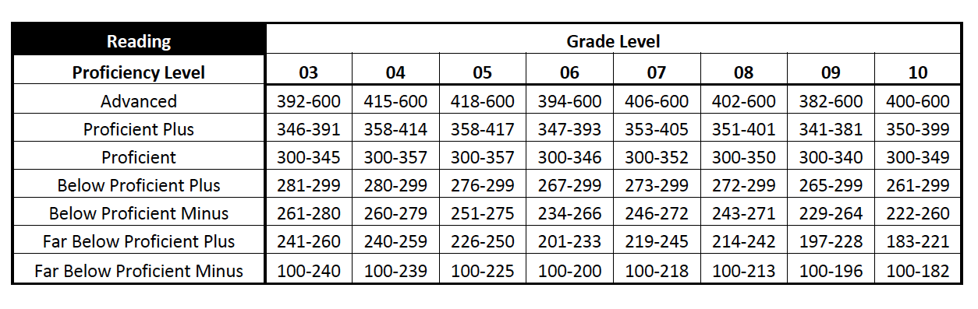
Alaska Standards Based Assessments (SBAs) Proficiency Levels
The student score only gives a description of the student’s scale score relative to the GLE.
See Alaska School Performance Index (ASPI) Worksheet Explanation, Appendix A page 5
Notes:
The SBA scores are not on a vertically aligned scale; it is on a vertically articulated scale. Every grade has a cut score of 300 and scale scores that differ at each grade. The proficiency levels were set by Alaskan teachers who went through a process called standard setting. Vertical articulation (making sure one grade was not out of line when compared to another grade) was addressed by these teachers looking at data across grades within a given subject. Note: the bands of scores are not the same in each grade (e.g., proficient at grade 5 is 300-357; at grade 6 300-346; at grade 7 300-352).
Therefore, in order to measure progress or growth of students we must use two tables, the proficiency level table (above) and the Growth & Proficiency Index table (next slide).
The first step in determining School Progress is to define each of the proficiency levels in terms of a student’s scale score on the state’s Standards Based Assessments. This chart shows the levels and correlating scale scores for reading.
Reading the chart:
red circle- content area
Green circle- grade levels
Blue rectangle- 7 proficiency levels
For example, a 3rd-grader who scores 285 would have a level of Below Proficient Plus. If that student receives a 349 score the next year in 4th grade, that student’s level would be Proficient. There are similar charts for writing and math that define the seven proficiency levels for each of those subject areas.

Slide 24
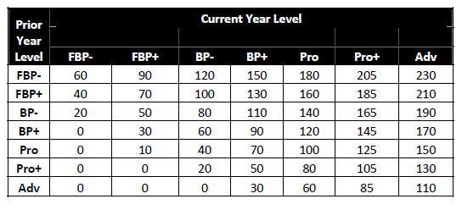
Growth & Proficiency Index
See Alaska School Performance Index (ASPI) Worksheet Explanation, Appendix A page 5
Notes:
The next step is to determine how many points are earned for each student based on his or her two scores on the Standards Based Assessment using the Growth & Proficiency Index.
Reading the chart:
Blue circle: prior year and column of proficiency levels
Red circle: current year and row of proficiency levels

Slide 25
Example
In grade 7 reading, student earned a scale score of 297.
The following year, in grade 8 reading, student earned a scale score of 303.

Slide 26
Example: Proficiency Levels
In grade 7 reading, student earned a scale score of 297 (BP+).
The following year, in grade 8 reading, student earned a scale score of 303 (Pro).
Notes:
In grade 7 reading, student earned a scale score of 297 (BP+). BLUE RECTANGLE
The following year, in grade 8 reading, student earned a scale score of 303 (Pro). PURPLE RECTANGLE

Slide 27
Example: Growth & Proficiency Index
In grade 7 reading, student earned BP+ .
In grade 8 reading, student earned a Pro.
This student has a growth and proficiency index score of 120.
Notes:
In grade 7 reading, student earned BP+ . BLUE RECTANGLE
In grade 8 reading, student earned a Pro. PURPLE RECTANGLE
This student has a growth and proficiency index score of 120. RED RECTANGLE

Slide 28
School Progress: Group Weighting
Group | # of students | Index Score | Weight | Points
All Students | 100 | 96.42 | 70% | 67.49
Alaska Native | 10 | 103.13 100 | 10% | 10.00
Econ Dis | 47 | 98.85 | 10% | 9.89
Stud w/ Dis | 5 | 64.17 | 10% | 6.42
LEP | 4 | 64.17 | 0% | 0
TOTAL |  |  |  | 94.11
Notes:
The final step before applying School Progress to the ASPI index is to consider each of the possible five student groups for which a school is held accountable in the index. If there are five or more students in any of the four subgroups (Alaska Native, Economically Disadvantaged, Students with Disabilities, or Limited English Proficient), that subgroup is weighted as 10% of the total points.
For example, if there were 110 students in the All Students group, with an average score of 96.42, that group counts for 70% of the points, for a total of 67.49 points. In this example, the All Students group counts for 70% because there are three subgroups with five or more students and those subgroups account for the remaining 30% of the School Progress score, as will be further explained.
In the Alaska Native subgroup, there are 10 students, with an average score on the Growth & Proficiency Index of 103.13. The index scores are capped at 100 (the index score received if a student is proficient both years). This accounts for 10% of the School Progress points, which equals 10 points.
In the Economically Disadvantaged subgroup, there are 47 students, with an average score of 98.85. This group, too, is weighted at 10% of School Progress because there are at least five students in the subgroup.
In the Students with Disabilities subgroup, there are five students, with an average score of 64.17. This group, too, is weighted at 10% of the School Progress points, for a total of 6.42 points.
In the Limited English Proficient (LEP) subgroup, there are four students, with an average score of 64.17. However, because this subgroup has fewer than five students, it does not meet the threshold of five or more students and therefore it is weighted at 0% of School Progress points and shows up as N/A.
When all of the earned points are totaled, they equal 94.11 points. Note that even if a subgroup does not meet the five-student threshold, a school is always responsible for all of its students through the All Students group.

Slide 29
80 x 35% = 28 ASPI points
94.11 x 40% = 37.64 ASPI points
Notes:
Those 94.11 points account for 40% of the ASPI index. 94.11 multiplied by 40% equals 37.64 ASPI points.

Slide 30
School Progress
Growth all | Growth AK Natives | Growth- Econ Dis | Growth w/Disabilities | Growth LEP
96.42 | 103.13 | 98.85 | 64.17 | N/A
Points | Weighting | ASPI Points
94.11 | 0.4 | 37.64

Slide 31
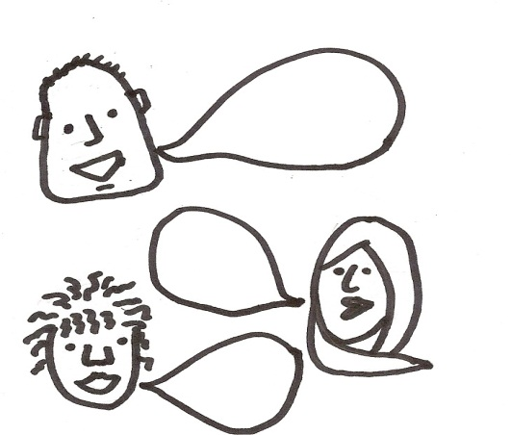
Triad activity (3 minutes)
Appendix A: School Progress
Look at example on page 6
What factors remove a student’s score from the school’s calculation?
When you think about your school, how might your subgroup scores effect your school growth score?

Slide 32
Attendance Rate
Average attendance of all students.
Example:
100 students total
16,100 combined days of attendance
17,000 days of membership (@170 days each)
16,110 / 17,000 = 94.7% attendance rate
Attendance Rate (%) | Points
96-100 | 100
93-95 | 95
90-92 | 80
85-89 | 50
70-85 | 25
Below 70 | 0
Notes:
The final component for a K-8 schools is Attendance Rate. Attendance Rate is defined as the average attendance of all students.
For example, if there were 100 students with a combined days of attendance of 16,100 days and a total possible days of attendance of 17,000 days, that equals an attendance rate of 94.7% (16,110 divided by 17,000). On the slide’s right side are the attendance points that are earned for attendance rates. In this example, a 94.7% Attendance Rate equals 95 points.
Attendance is reported by districts using the Summer OASIS file. It days in session are defined by state regulation (see below). Please note: “unexcused” and “excused” absences are not relevant to the attendance rate as those definitions are locally determined and vary by district. From regulation: “A student is considered present if physically present at the school or engaged in a school activity even if the activity is away from the school.” This is further defined as follows, “when he or she is actually at school or is present at another school-sponsored instructional program. This may include authorized independent study, work-study programs, academically related field trips and instruction for homebound students.”
State regulation and State statute regarding public school attendance:
4 AAC 06.895. Report card to the public
(i) Each school shall compute and report the information required by AS 14.03.120 (d)(5) and this section as follows:
(1) the attendance rate is a fraction, expressed as a percent, the numerator of which is the aggregate daily attendance during the regular school year, and the denominator of which is the aggregate daily membership for the school year; the aggregate daily attendance is the sum of the days present for all students when school is in session during the school year; the aggregate daily membership is the sum of the days present and absent for all students when school is in session during the school year; in-service days are not included in the computation; for the purposes of this paragraph, a student is considered present if physically present at the school or engaged in a school activity even if the activity is away from the school;
From Student Data Reporting Manual, adopted by reference 2004
Day of Attendance - Students are counted in attendance when present at school. Days of attendance do not include in-service days. Attendance shall be recorded based upon the percent of the student’s normally scheduled instructional day. For example, a student who is normally scheduled for two hours per day as a part-time student would be recorded with half a day in attendance if he were absent for one hour. The sum of a day of attendance and a day of absence must equal one. A student may be counted present only when he or she is actually at school or is present at another school-sponsored instructional program. This may include authorized independent study, work-study programs, academically related field trips and instruction for homebound students. It does not include "making up" school work at home, or activities sponsored by private individuals or groups. Correspondence school students are counted in attendance as long as they are in membership. Homebound students are counted in attendance, if they are receiving at least ten hours of instruction per week by an itinerant teacher. (Definition) 4 AAC 06.895
Full Day in Attendance - Attendance during a complete full-day school session or approved curtailed session. Attendance at a state-approved half-day session for kindergarten or pre-kindergarten should be counted as a half day of attendance. An excused absence should not be counted as a day of attendance. (Definition) 4 AAC 09.040
Full Day in Session - A full day in session is defined as: (1) under normal circumstances, grades one through three must be in session at least four hours and grades four through twelve must be in session at least five hours; (2) when students are dismissed to their homes due to an unforeseen emergency provided that the student body was gathered at the school facility while teachers were present, then subsequently released. (Definition) AS 14.03.040; 4 AAC 09.040

Slide 33
95 x 25% = 23.75 ASPI points
80 x 35% = 28 ASPI points
94.11 x 40% = 37.64 ASPI points
Notes:
Those 95 attendance points account for 25% of the ASPI index. 95 multiplied by 25% equals 23.75 ASPI points.

Slide 34
Attendance Rate
94.7%
Points | Weighting | ASPI Points
95 | 0.25 | 23.75

Slide 35
95 x 25% = 23.75 ASPI points
80 x 35% = 28 ASPI points
TOTAL
ASPI POINTS = 89.39
94.11 x 40% = 37.64 ASPI points
Notes:
Those 95 attendance points account for 25% of the ASPI index. 95 multiplied by 25% equals 23.75 ASPI points.
The total ASPI points, therefore, are 28 points for Academic Achievement, plus 37.64 points for School Progress, plus 23.75 points for Attendance, for a total of 89.39 ASPI points.

Slide 36
Star Ratings
ASPI Points | Number of Stars
94 – 100
85 – 93.99
65 – 84.99
55 – 64.99
0 – 54.99
Notes:
This chart shows how ASPI points correlate to star ratings. In the example, 89.19 correlates to a star rating of 4 stars.
The total ASPI points, therefore, are 28 points for Academic Achievement, plus 37.52 points for School Progress, plus 23.67 points for Attendance, for a total of 89.19 ASPI points.

Slide 37
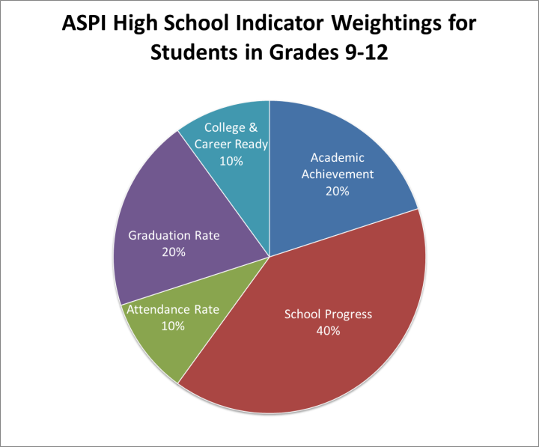
80 x 20% = 16 ASPI points
94.7 x 10% = 9.5 ASPI points
94.11 x 40% = 37.64 ASPI points
Notes:
For a 9-12 schools, there are two additional components: Graduation Rate and the College & Career Ready Indicator. In order to include these components, the weightings of two components are reduced.
Academic Achievement is reduced from 35% for a K-5 schools to 20% for a 9-12 schools.
School Progress stays the same at 40% of the ASPI index.
Attendance rate is reduced from 25% for a K-5 school to 10% for a 9-12 school.
This allows the Graduation Rate to account for 20% of the ASPI index and the College & Career Ready Indicator to account for 10% of the ASPI index for a 9-12 school.
For the purposes of this PowerPoint, we will use the same earned points for attendance rate, academic achievement, and school progress as used in the K-8 example.

Slide 38
Graduation Rate
Use higher of 4-year or 5-year cohort rate (required graduation rate formula)
4 year rate | 5 year rate | Points
98-100 | 98-100 | 100
90-97 | 93-97 | 95
85-89 | 89-92 | 90
80-84 | 85-88 | 70
70-79 | 80-84 | 50
60-69 | 70-79 | 25
50-59 | 60-69 | 10
Below 50 | Below 60 | 0
Notes:
Graduation Rate is calculated as the % of students who graduate four or five years after they begin 9th grade. A school’s graduation rate points are whichever is higher: the four-year or five-year gradation rate.
In this example, if a school had a 4 year cohort graduation rate of 89%, that would correlate to 90 points.

Slide 39
Graduation Cohort Formula
The number of students who entered the school in grade 9 who graduate either 4 or 5 years later, minus students who transfer out of school.
Students who transfer in join the cohort of their origin.
The ASPI scores published in the fall of 2013 were based on the following cohorts.
 | 2008-09 | 2009-10 | 2010-11 | 2011-12 | 2012-13
4 year |  | Grade 9 | Grade 10 | Grade 11 | Graduate
5 year | Grade 9 | enrolled | enrolled | enrolled | Graduate
Notes:
The five year graduation cohort formula includes all the student who graduated in 4 years and those who graduated in 5 years.
For example, the 4 year graduation rate in 2013 is based on student who entered grade 9 in 2009-10 SY.
The 5 year graduation rate also includes those students who entered grade 9 in 2008-2009.
The high rate will be used for ASPI.
2009/10 grade 9 (THIS GROUP OF STUDENTS IS THE 2013 4 YEAR COHORT)
2010/11 grade 10
2011/12 grade 11
2012/13 grade 12 (graduation year)

Slide 40
80 x 20% = 16 ASPI points
90 x 20% =
18 ASPI points
95 x 10% = 9.5 ASPI points
94.11 x 40% = 37.64 ASPI points
Notes:
Those 90 points for Graduation Rate multiplied by 20% of the ASPI index equal 18 ASPI points.

Slide 41
Graduation Rate
4 Year | 5 Year
89% | 90%
Points | Weighting | ASPI Points
90 | 0.2 | 18

Slide 42
College & Career Ready Indicator
  Calculated by dividing the combined value of all grade 12 scores by the combined count of grade 12 students who attempted any qualifying test.
  Qualifying scores earned in WorkKeys, ACT, or SAT assessment.
  Includes current 12th graders tested in either 11th and/or 12th grades.
  The test score leading to the highest number of ASPI points will be used.
Notes:
The final component for a 9-12 school is the College & Career Ready Indicator. Schools earn points for students’ scores on any of three assessments: WorkKeys, which is required for all
11^{th-} graders, the ACT, and SAT. A school’s points are determined by the total points earned by its 12^{th-} graders in 11th grade or 12th grade, recognizing the highest points earned by each student. The total number of points is divided by the total number of students tested.

Slide 43
College & Career Ready Indicator
  25 12th graders; 25 took assessment(s)
  17 earned qualifying points
  3 x 100 = 300 points
  6 x 95 = 570 points
  8 x 80 = 640 points
  1,510 points/25 students = 60.4
WorkKeys Certificate | ACT Score | SAT Score | Points
Gold or Platinum | 25 | 1680 | 100
Silver | 23 | 1560 | 95
Bronze | 21 | 1450 | 80
Notes:
In this example, there are 25 12th-graders. 25 of them took at least one of the assessments. 17 of them received qualifying points as follows:
3 had their highest assessment level on WorkKeys and qualified for a Gold or Platinum Certificate for a total of 300 points (3students multiplied by 100 points each equals 300 points).
6 of them had their highest assessment level on the SAT and received an SAT score of between 1560 and 1679, for a total of 570 points (6 multiplied by 95 points each equals 570points).
8 of them had their highest assessment level on the SAT and received an SAT score of between 1450 and 1559 for a total of 640 points (6 multiplied by 80 points each equals 640 points).
8 of them did not have a qualifying score; they do not earn points but are counted in the denominator.
The combined total points is then divided by the number of students who took any of these assessments. A total of 1,510 points divided by the 25 students who took any of the assessments equals 60.4 points.
This is multiplied by the weight of 8% (.08) for 4.83 ASPI points.

Slide 44
60.4 x 8% = 4.83 ASPI points
80 x 20% = 16 ASPI points
90 x 20% = 18 ASPI points
95 x 10% = 9.5 ASPI points
94.11 x 40% = 37.64 ASPI points
Notes:
The 60.4points weighted at 8% of the ASPI index equals 4.83 ASPI points.
The total weight of the Index is 10% for College & Career Ready; 2 percentage points are reserved for Participation Rate, which will be explained next.

Slide 45
College Career Readiness
60.40
Points | Weighting | ASPI Points
60.40 | 0.08 | 4.83

Slide 46
College & Career Ready Assessment Participation Rate
Percentage of grade 11 students who take WorkKeys assessment (required by regulation).
Participation Rate | Points
95-100 | 100
90-94 | 50
0-89 | 0
Notes:
WorkKeys is a required assessment for all 11th-graders, with points given for the percent of students who take the WorkKeys assessment.
In this example, 20 of the 25 students took the WorkKeys assessment; the participation rate is 80% and therefore 0 points are earned.
If there had been full participation in WorkKeys, 2 ASPI points would have been earned.

Slide 47
60.4 x 8% = 4.83 ASPI points
0 x 2% = 0 ASPI points
90 x 20% = 18 ASPI points
80 x 20% = 16 ASPI points
94.11 x 40% = 37.64 ASPI points
95 x 10% = 9.5 ASPI points
Notes:
Those 0 points weighted at 2% of the ASPI Index equals 0 ASPI points.

Slide 48
WorkKeys Participation
87%
Points | Weighting | ASPI Points
0 | 0.02 | 0

Slide 49
60.4 x 8% = 4.83 ASPI points
0 x 2% = 0 ASPI points
90 x 20% = 18 ASPI points
80 x 20% = 16 ASPI points
94.11 x 40% = 37.64 ASPI points
TOTAL ASPI POINTS = 85.82
95 x 10% = 9.5 ASPI points
Notes:
All of the five areas for a 9-12 school are then added, with a result of 85.82 ASPI points.

Slide 50
Star Ratings
ASPI Points | Number of Stars
94 – 100
85 – 93.99
65 – 84.99
55 – 64.99
0 – 54.99
Notes:
This chart shows how ASPI points correlate to star ratings. In the example, 85.97 correlates to a star rating of 4 stars.

Slide 51
K-12 Schools– enrollment ratios
Total K-8 ASPI Points: 89.27 Total 9-12 ASPI Points: 85.82
K-8 Enrollment Ratio | .5 (100/200=.5) | (represents the percentage of students enrolled K-8; divide the number of student enrolled K-8 by total number of students K-12)
9-12 Enrollment Ratio | .5 (100/200=.5) | (represents the percentage of students enrolled 9-12; divide the number of student enrolled 9-12 by total number of students K-12)
ASPI scores x Enrollment Ratios (89.39 x .5) + (85.97 x .5) = ASPI score (44.70) + (42.99) = 87.69 ASPI score Four Star K-12 School

Slide 54
“Ambitious but achievable” targets for student achievement, participation, and graduation.
Annual Measurable Objectives
(AMOs)
Alaska’s New Accountability System

Slide 55
Annual Measurable Objectives (AMOs)
Targets
Reading, writing, and math.
  For all-students group
  For each of the 9 subgroups
  For state, districts, and schools
Graduation Rate (90%)
Participation Rate (95%)
Goal to reduce by ½ over a 6-year period the number of non-proficient students
Reduction in equal increments over 6 years
Notes:
The ASPI score and correlating star rating is the first method of accountability for a school. The second method is through Annual Measurable Objective targets (AMOs). The Adequate Yearly Progress model set the same AMOs for all schools. For spring 2013, the AMOs would have been approximately 94% in language arts and 91% in math and -- had Alaska not received a waiver -- all schools would have been held accountable to those AMOs.
The waiver permitted Alaska to set its own AMO targets as long as they met the U.S. Department of Education’s expectations of being “ambitious but achievable.” Alaska was required to set targets in reading, writing, and math for the All Students group and for all subgroups recognized by No Child Left Behind: a total of 10 groups.
Alaska set targets based on a goal of reducing by half over a six-year period the percentage of non-proficient students. The baseline for each school is based on the spring 2012 data. This means that each school has its own targets rather than the one-size-fits-all targets of AYP.
Using the baseline data from 2012, targets are set for 2018, six years later, that reduce by half the percent of non-proficient students in each subgroup for reading, writing, and math. The reduction in the percent of non-proficient students is expected to occur in increments over six years, with each increment equal to at least one-sixth of the target. Targets also are set for the state as a whole.
A school meets the AMO targets if it meets its own targets or the state’s targets, and if it obtains a graduation rate of 90% an a participation rate on state assessments of 95%.

Slide 56
Annual Measurable Objectives (AMOs)
Each school, and each subgroup, has its own target. (Very different from the one-size-fits-all AMOs of AYP/NCLB).
School AMO targets are met if the school or the state target is met.
School subgroup targets must also be met. This can impact school designations (Reward, Priority, Focus) and school requirements (such as school improvement plans).

Slide 57
AMO Example
2012
  Percent not proficient in reading = 24%
  Percent proficient in reading = 76%
2018 Targets
  Percent not proficient in reading = 12%
  Percent proficient in reading = 88%
Each year…
  2% reduction in the number of students who are not proficient [12% over 6 years]
Notes:
For example, if a school’s percent of students not proficient in reading in 2012 was 24%, the target would be to reduce the percent of non-proficient students to 12% by 2018. The target for each year would be 12% divided by six years, which equals a 2-percentage-point reduction in non-proficient students in reading each year.
The other way to think about this is an increase in the number of proficient students each year by 2%.
Using the school with 100 students as an example, this is 2 student per year that we move from not proficient to proficient
The baseline was set in 2012 because that is the year Alaska submitted the ESEA Flexibility Waiver to USDOE.

Slide 58
2% increase in the number of proficient students each year for 6 years
Based on 2012 baseline of 76% proficient
Notes:
This chart shows the school’s targets in reading based on a baseline in 2012 of 76% proficient.

Slide 59
AMO Example
2012
  Percent not proficient in reading = 76%
  Percent proficient in reading = 24%
2018 Targets
  Percent not proficient in reading = 38%
  Percent proficient in reading = 62%
Each year…
  6% reduction in the number of students who are not proficient [38% over 6 years]
Notes:
For example, if a school’s percent of students not proficient in reading in 2012 was 76%, the target would be to reduce the percent of non-proficient students to 38% by 2018. The target for each year would be 38% divided by six years, which equals a 6.3-percentage-point reduction in non-proficient students in reading each year.
The other way to think about this is an increase in the number of proficient students each year by 6.3%.
In our example of 100 students, this would be 6 students each year moving from not proficient to proficient.

Slide 60
6% increase in the number of proficient students each year for 6 years
Based on 2012 baseline of 24% proficient
Notes:
This chart shows the school’s targets in reading based on a baseline in 2012 of 24% proficient.

Slide 61
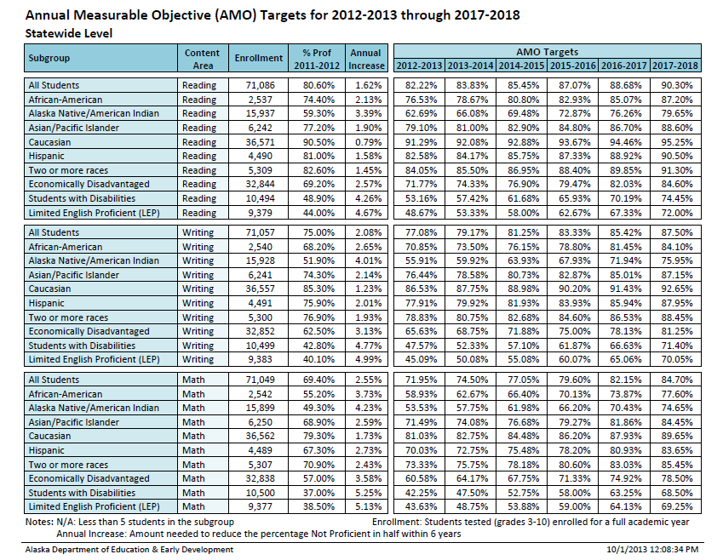
AMO Targets Worksheet
Notes:
AMO Targets worksheet
Pink rectangle: Subgroups
Purple circle: annual increase in target (5)
Red oval: targets over 6 years

Slide 62
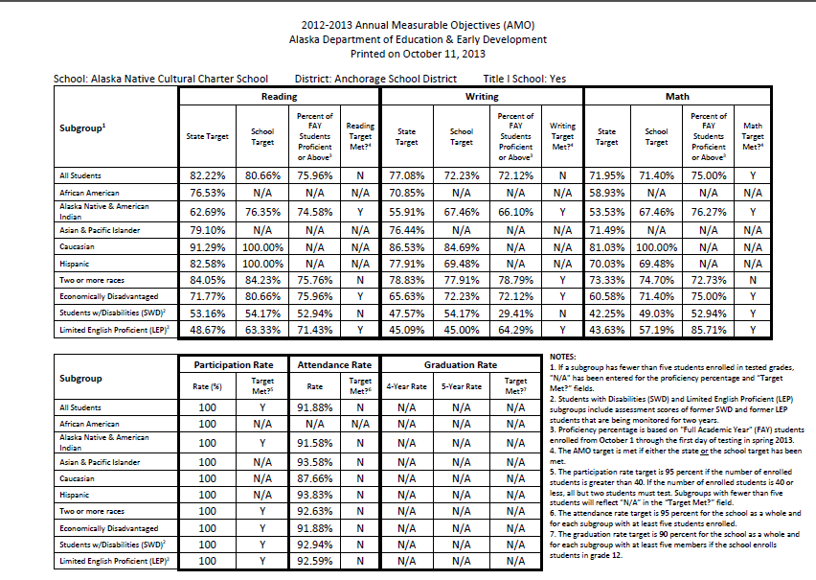
School & District Progress Worksheet

Slide 63
Star Ratings & AMOs
Used to:
  Identify school designations: Priority schools, Focus schools, and Reward schools;
  Identify schools and districts that need to complete school improvement plans using Alaska STEPP;
  Assist districts and EED to determine where to direct resources and support.

Slide 64
Where to Find More Information and Resources
Notes:
On the Alaska Department of Education & Early Development home page you will find the c3g graphic.
By clicking on the star or tab labeled accountability you will find the information in this PowerPoint as well as additional resources.
NOTE: this PowerPoint can be found under the Support Star on the main tab along with other resources presented at this conference.

Slide 65
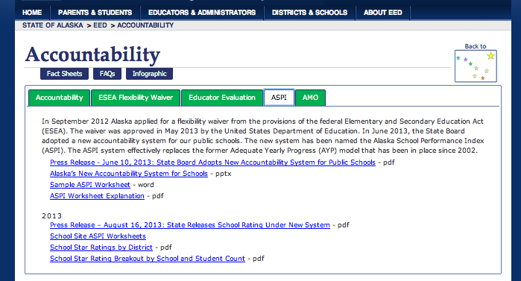
Find your school’s rating
Notes:
The ASPI tab has further information regarding Alaska’s accountability system.
The school site ASPI worksheets link is where you will find specific school’s ASPI worksheets.

Slide 66
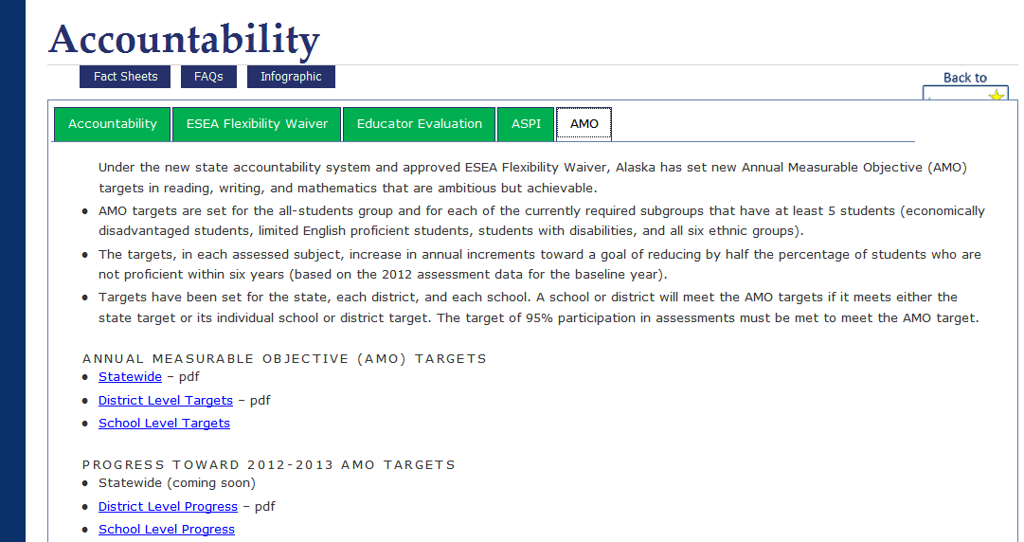
State, district, and school targets
District and school progress

Slide 67
Well done! You’ve earned it!
ASPI?
Ask Me!

Slide 68
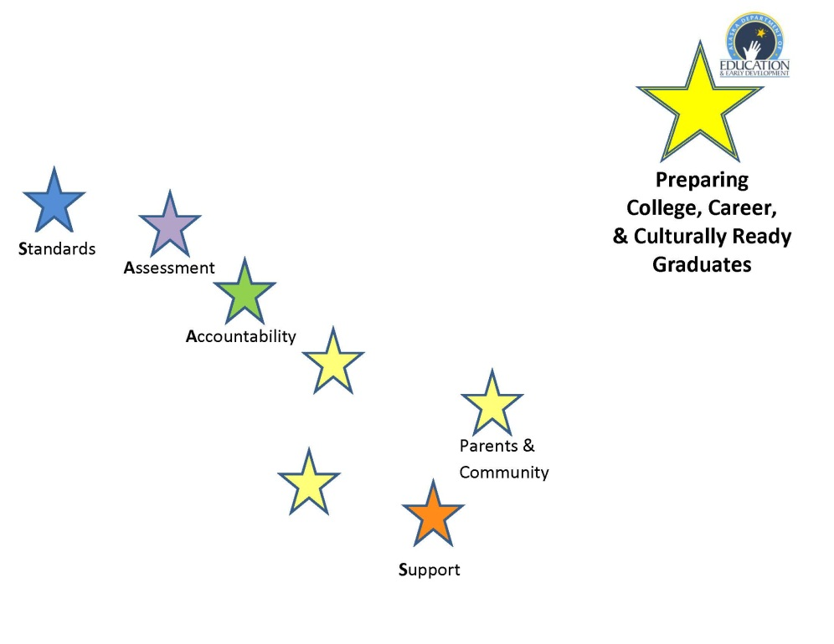

Thank you!
Elizabeth Davis
Assessment Administrator
elizabeth.davis@alaska.gov
907-465-8431

