Slide 1
SCIENCE STANDARDS FOR ALASKA (SSA’s)
6-8 Webinar
Jon Dykstra (Anchorage SD)
Alex Tannehill (Hoonah City Schools)
Kevin LaBar (Bering Strait SD)
Patty Brown (Alaska Science Teachers Assoc. )
Alaska Department of Education & Early Development
February 5th, 2020
Presented By:
Notes:
Jon Intro

Slide 2

Icebreaker Padlet- What is good science teaching to you?
Introduce yourself.
Where are you from?
What do you think makes effective science teaching?
Rate your level of awareness with the SSA’s (1-5)
1 - Completely Unfamiliar
2 - Somewhat familiar, more comfortable with NGSS
3 - Understand and implement DCI’s
4 - Understand the key changes from NGSS and am attempting to unpack and apply the three dimensions
5 - Very aware and familiar with implementing the three dimensions
Notes:
Jon

Slide 3
Objectives
What are the Science Standards of Alaska (SSA)?
GLE vs. NGSS vs SSA
What is 3 dimensional Science teaching?
Phenomena, storyline, performance expectations
Transferring existing lessons to SSA friendly lessons
Integration of all 3 dimensions
Resources for teaching with the SSAs
Notes:
Kevin

Slide 4
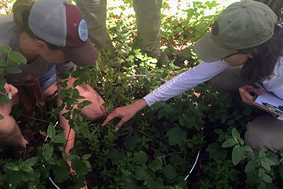
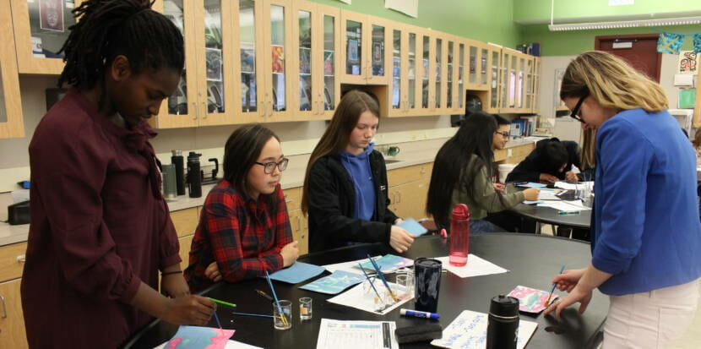
Rigor, Relevance, and Equity
Address complex situations and questions
Assuring ALL students have access to “the real thing,” - challenging explorations and problem-solving that develops science thinking and doing
Focus on phenomena familiar to students
Notes:
Alex: For sources of relevance: Alaska Science Nuggets by Ned Rozell, Village Science by Alan Dick, subscribe to Alaska Public Media daily or weekly bulletins, use local partners such as NOAA, REAP, USGS, USFS...

Slide 5
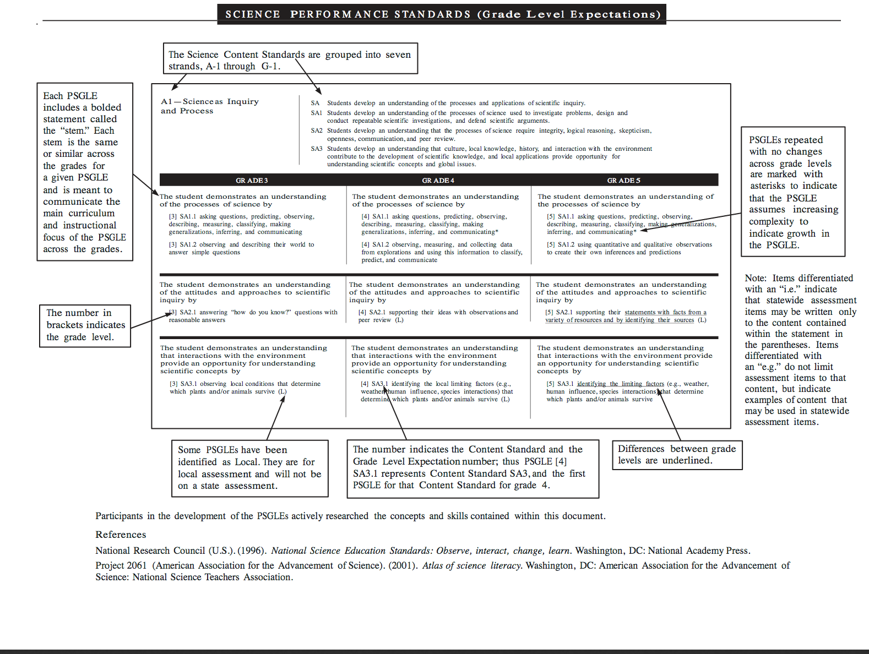
Performance Standards/Grade Level Expectations
GLE’s → Alaska’s grade level expectations for understanding adopted
in the early 2000’s; identified as performance standards.
“Core content to be mastered”
Notes:
Alex - Shift in jargon

Slide 6
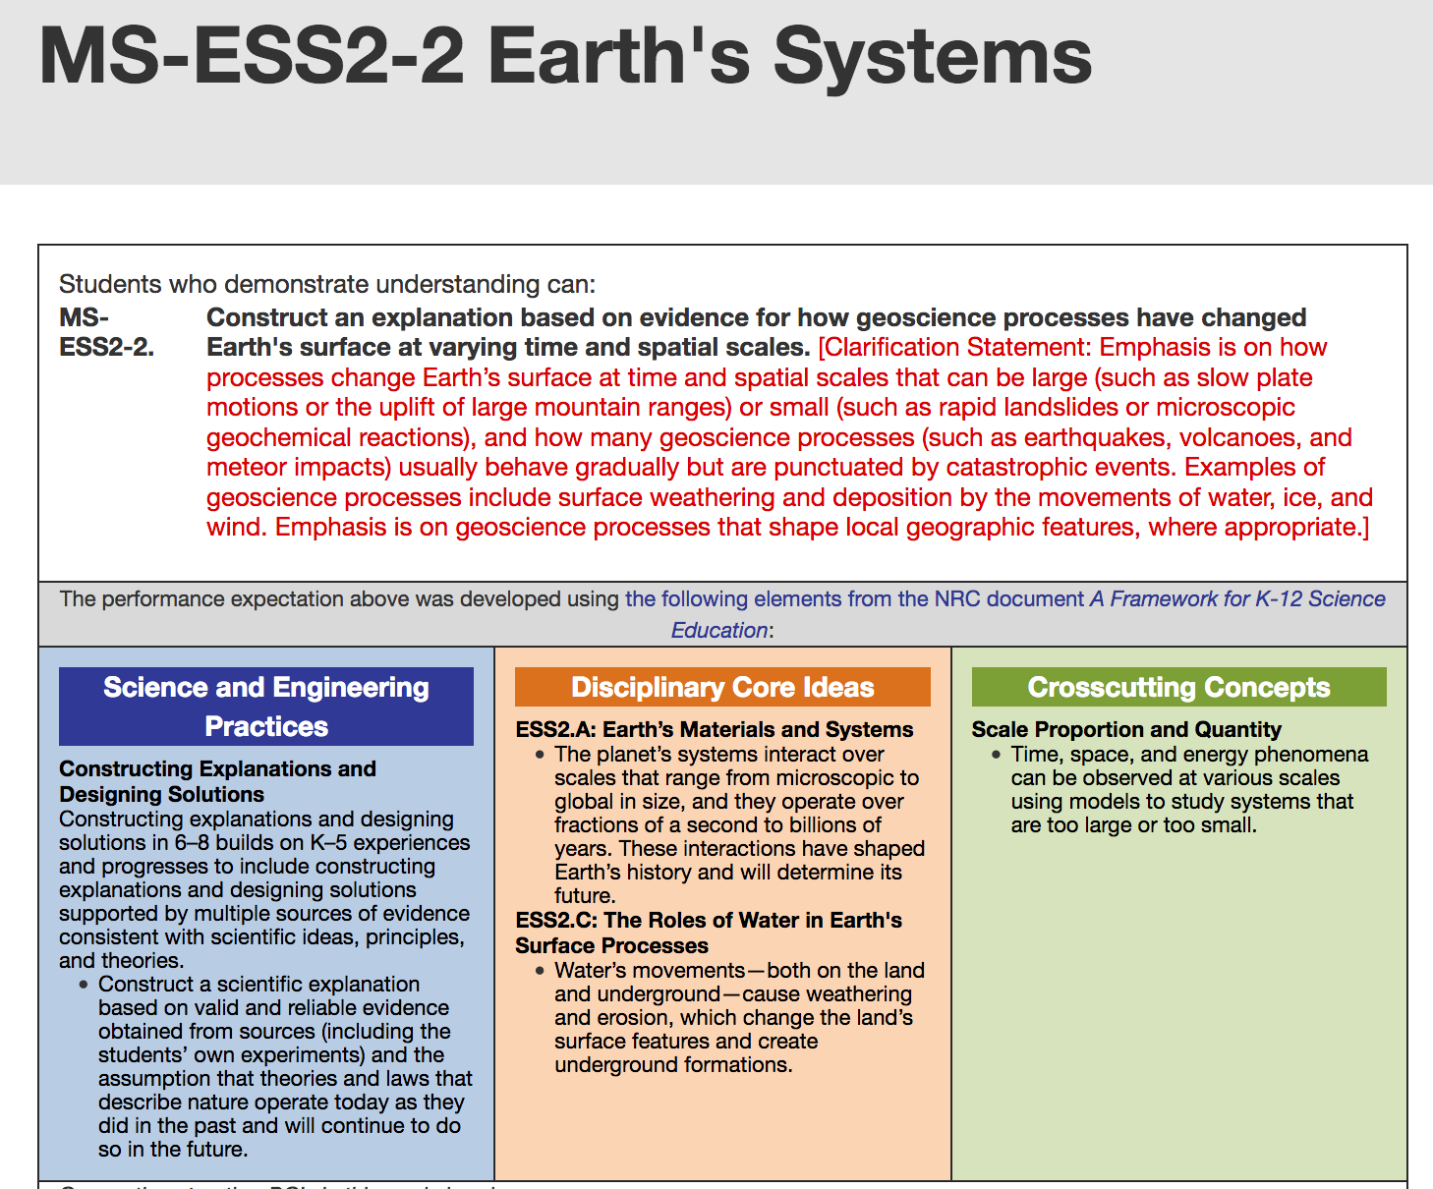
Next Generation Science Standards (NGSS)
NGSS → developed by a team of scientists and educators, adopted in some form by at least 20 states. Goal is to assure that science is for every student and growing scientific thinking, investigating, and communicating is essential to problem-solving in contemporary society.
Notes:
Jon

Slide 7
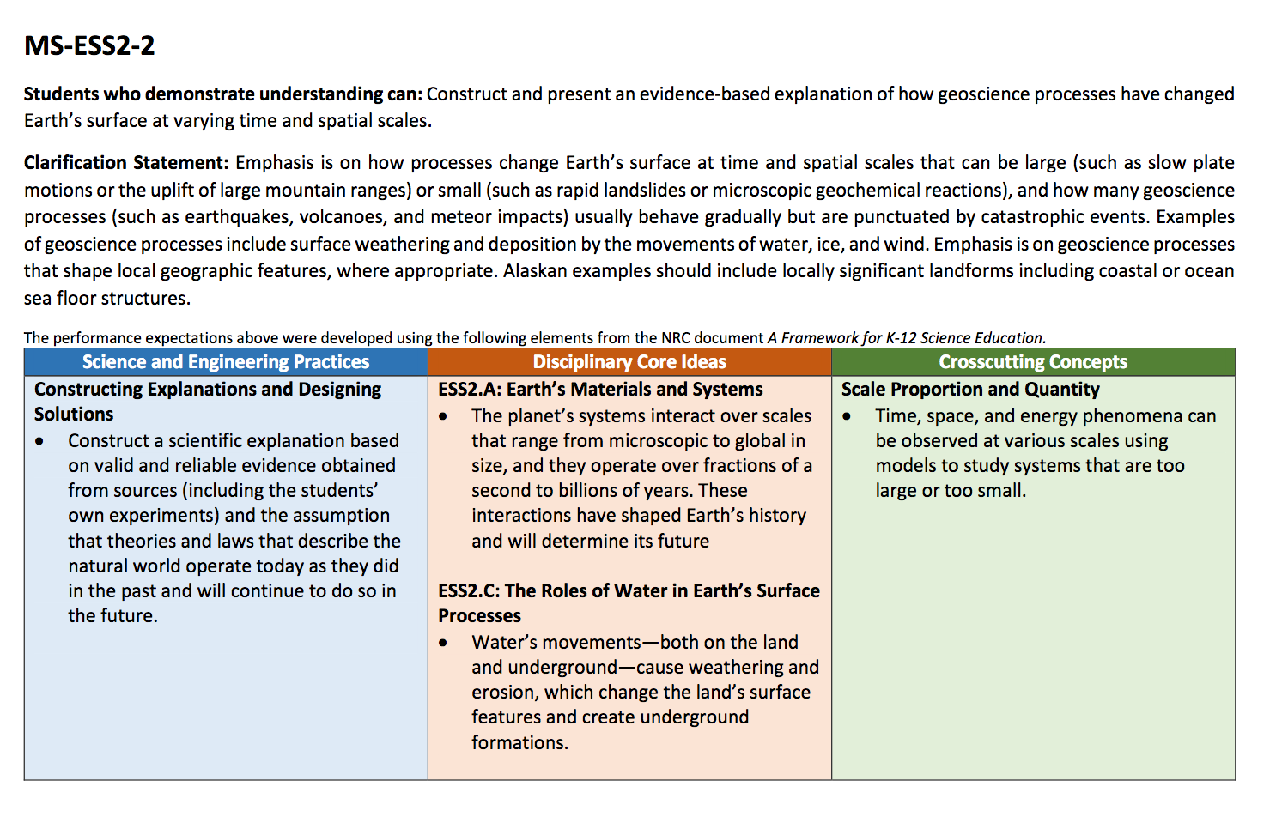
Science Standards for Alaska (SSAs)
SSA→ developed by a team of Alaska educators, sometimes working in grade band groups, guided by veteran facilitators; carefully reviewed and adapted elements of the Framework for K-12 Science Education to incorporate relevant Alaska examples in the content and performance expectations.
Intended as a guide to developing curriculum meaningful to each District.
Notes:
Jon - Guide to curriculum, not a curriculum itself

Slide 8




The BIG Picture:
Growing science minds
Phenomena are in everyone’s lives!
not just for professional pursuits but decision-making in our lives. 3-dimensions build a strong foundation for engaging in more complex ideas grade-to-grade
Storylines
weave concepts together for progression and students making sense of ideas in their own way
Performance Expectations
incorporate all three dimensions
3 Dimensions
are: disciplinary core ideas (DCI), cross-cutting concepts (CCC), Science and Engineering Practices (SEP)
Notes:
Kevin: Examples: weather for boating and flying, efficient energy use, understanding of ecosystems to monitor change, growing and harvesting food, preparing building sites,

Slide 9
3D Acronyms
Disciplinary core ideas (DCI)
(key principles for that topic)
Cross-cutting concepts (CCC)
(broad principles that show up across the fields of science)
Science and Engineering Practices (SEP)
(how science is pursued to reach conclusions)
Notes:
Alex - Standards focus in on 3 main areas for developing knowledge and skills

Slide 10

Key Shifts
“Three dimensions”: ALL are essential throughout lessons and units
1. Practices: what do we do to investigate and understand science
2. Core Ideas: important principles applicable to investigation
3. Cross-Cutting Concepts: “big ideas” that are woven throughout science disciplines
Performance Expectations use new verbs
Fewer content topics per year (depth vs. breadth)
Phenomena (real, authentic, observable in nature)
Storyline
Less emphasis on rote learning
Vocabulary introduced as needed
Engineering incorporated into science content
Notes:
Alex

Slide 11
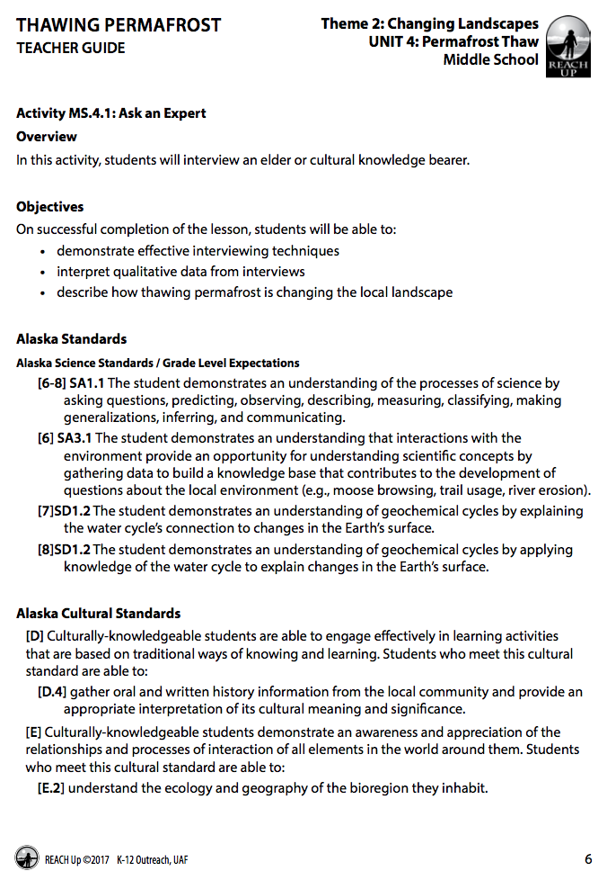
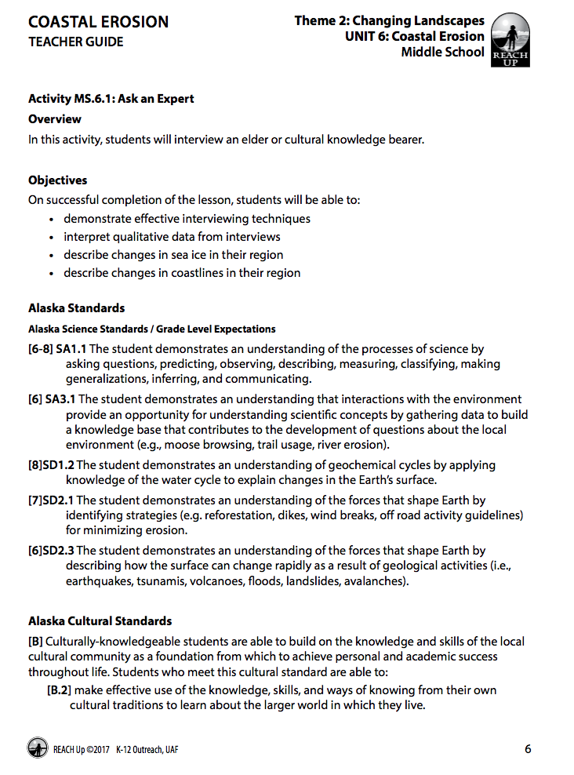
Common Language & Finding Phenomena
→ Phenomenon: Coastal Erosion and Thawing Permafrost
https://www.alaska.edu/k12reach/grade6-8lessons-theme2.php
Notes:
Alex: Reference newer phenomena of warmer winters and changes in ocean currents resulting in heavy rainfall in southeast and southcentral Alaska

Slide 12
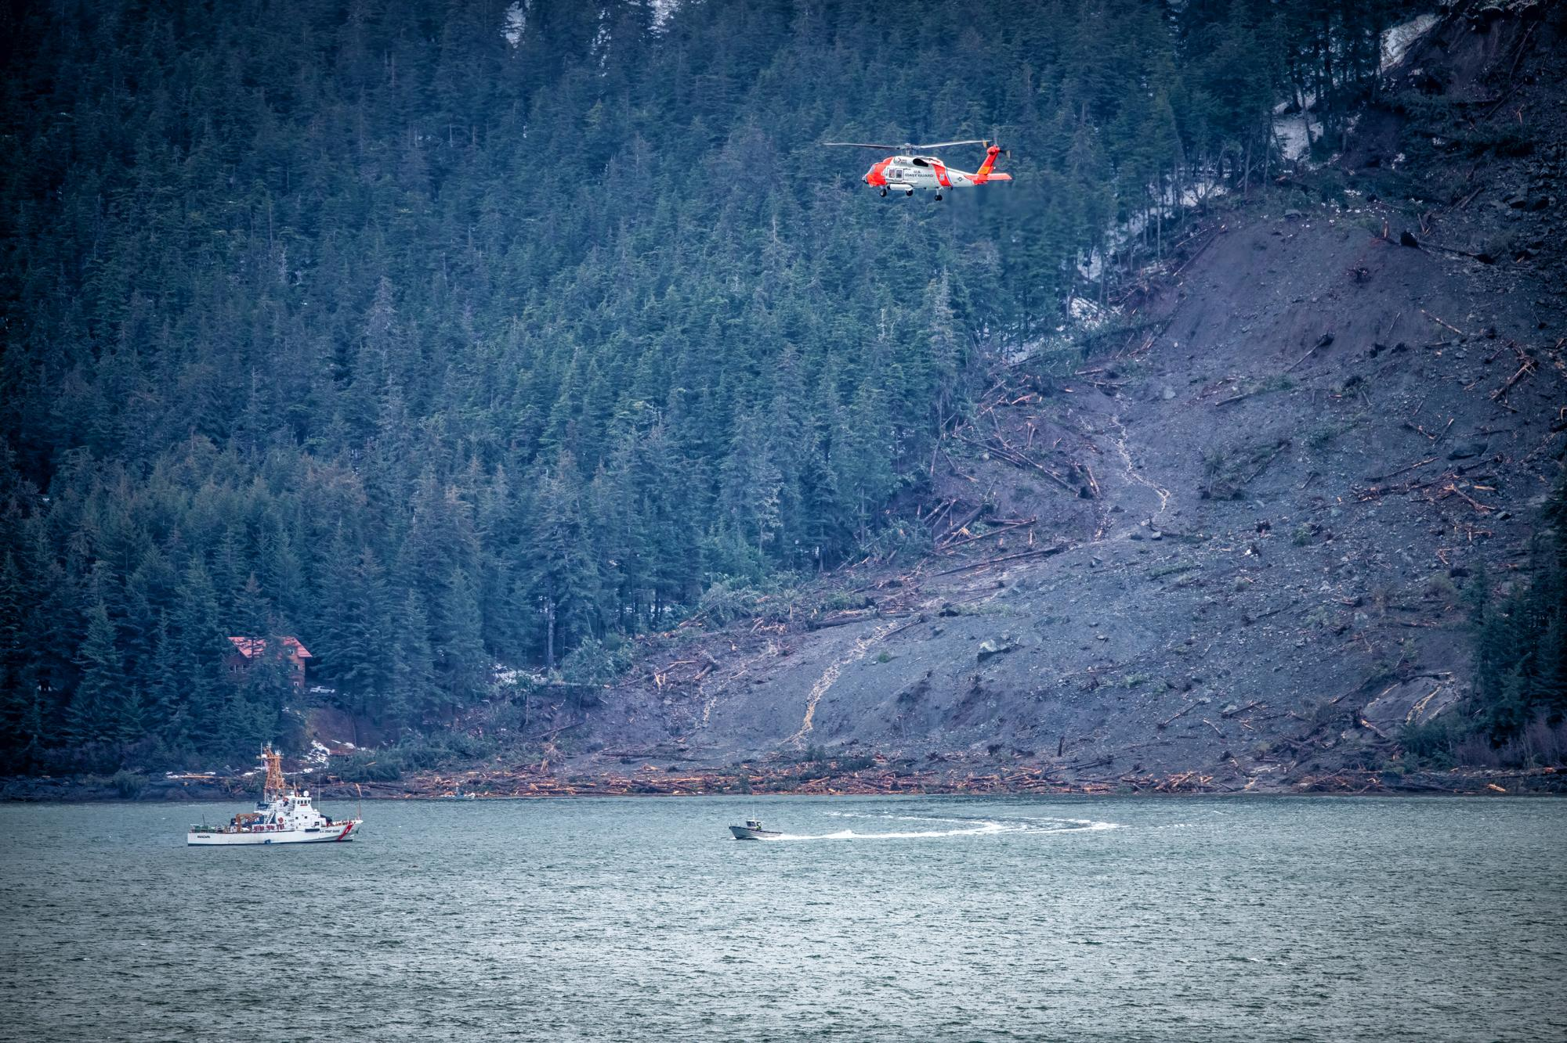
Landscape Changes in Alaska-Mountain
Photo by Tom Ganner Haines, AK 2020
Notes:
Alex

Slide 13
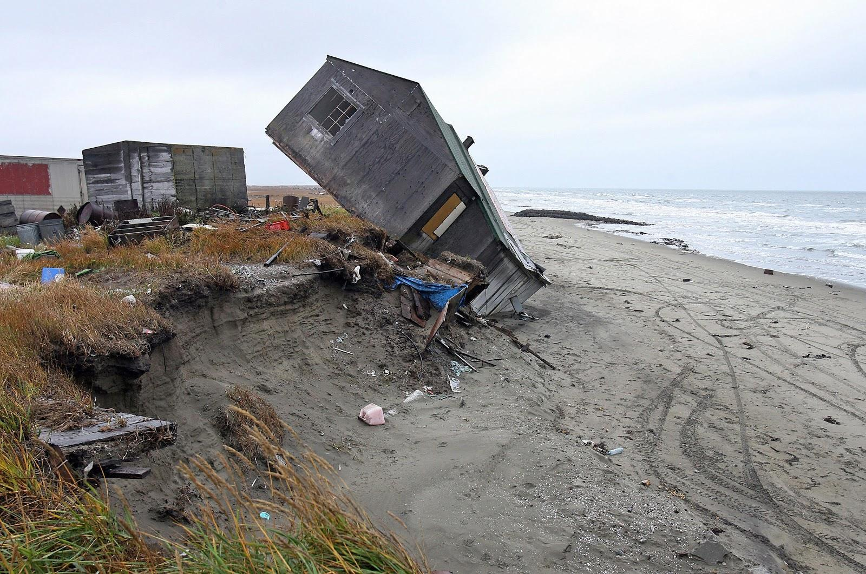
Landscape Changes in Alaska-Ocean
Shishmaref, AK
Notes:
Alex

Slide 14
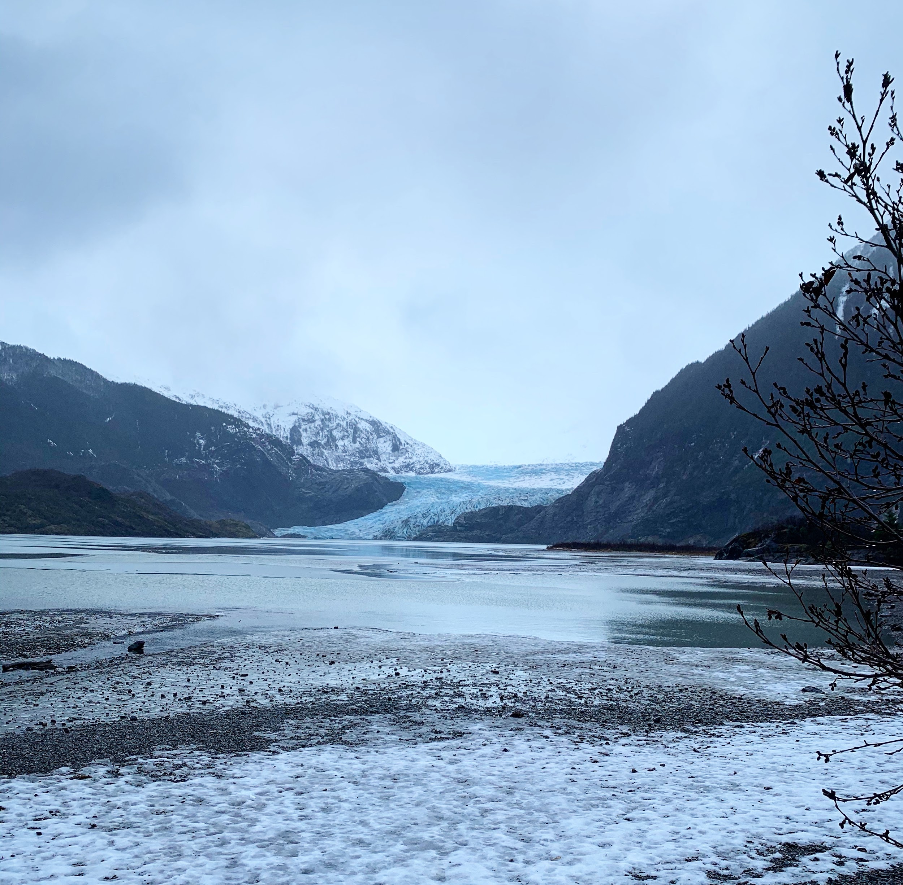
Exploring Phenomena:
Unit Idea: What evidence is there that change in climate is influencing landscape changes in Alaska?
Mendenhall Glacier, Juneau AK Photo courtesy: Alexandria Tannehill 2020
Notes:
Jon

Slide 15




Storyline:
→ How the pieces fit together for the overall understanding of the standards for that grade (found in the standards document)
OR
→ Can be written as a way to tie together bundled standards
(ex. climate and geoscience)
Notes:
Kevin

Slide 16

Disciplinary Core Ideas:
(key principles for that topic)
System interactions have shaped Earth’s history with varying scales and time frames and will determine its future over varying scales
Water’s movements cause weathering and erosion which change the earth’s surface features.
Notes:
Kevin: Standard organization can differ greatly from your unit organization. Standards help guide and develop curriculum

Slide 17



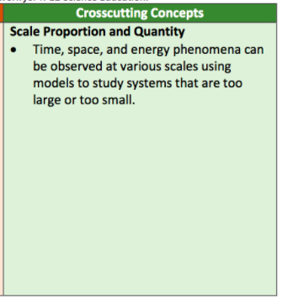
Cross-cutting Concepts:
(broad principles that show up across the fields of science)
Choose one or two to emphasize.
Often several can be applied.
That’s why they are considered the “big ideas” of science.
Energy and Matter
Patterns
Cause and Effect
Scale, Proportion and Quantity
Systems and System Models
Stability and Change
Structure and Function
https://ngss.nsta.org/crosscuttingconceptsfull.aspx
Notes:
Jon- CCC can be found in any lesson (systems, etc.) Can be considered a “lens” through which a particular exploration of a phenomenon is examined. Linkage between topics → looking back and connecting

Slide 18
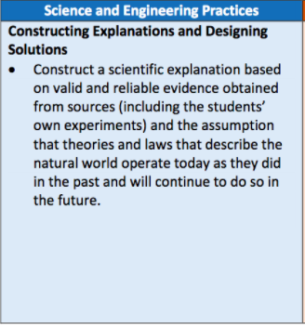


Science and Engineering Practices:
(how science is pursued to reach conclusions)
→ Choose one or two for a lesson.
→ Consider using all of them across a unit.
Asking questions and defining problems.
Developing and using models.
Planning and carrying out investigations.
Analyzing and interpreting data.
Using mathematics and computational thinking.
Constructing explanations and defining solutions.
Engaging in argument from evidence.
Obtaining, evaluating, and communicating information.
Notes:
Jon- data from glaciers, maps,
Deliberate in gathering data, etc.

Slide 19
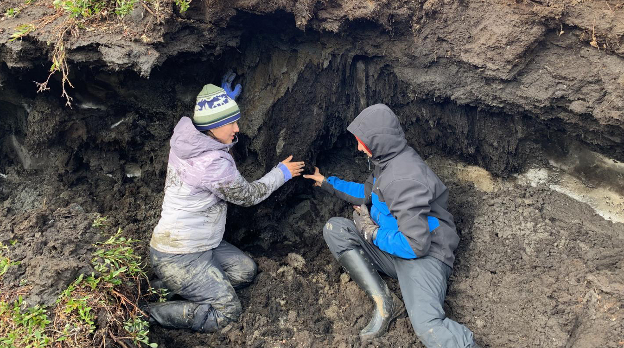
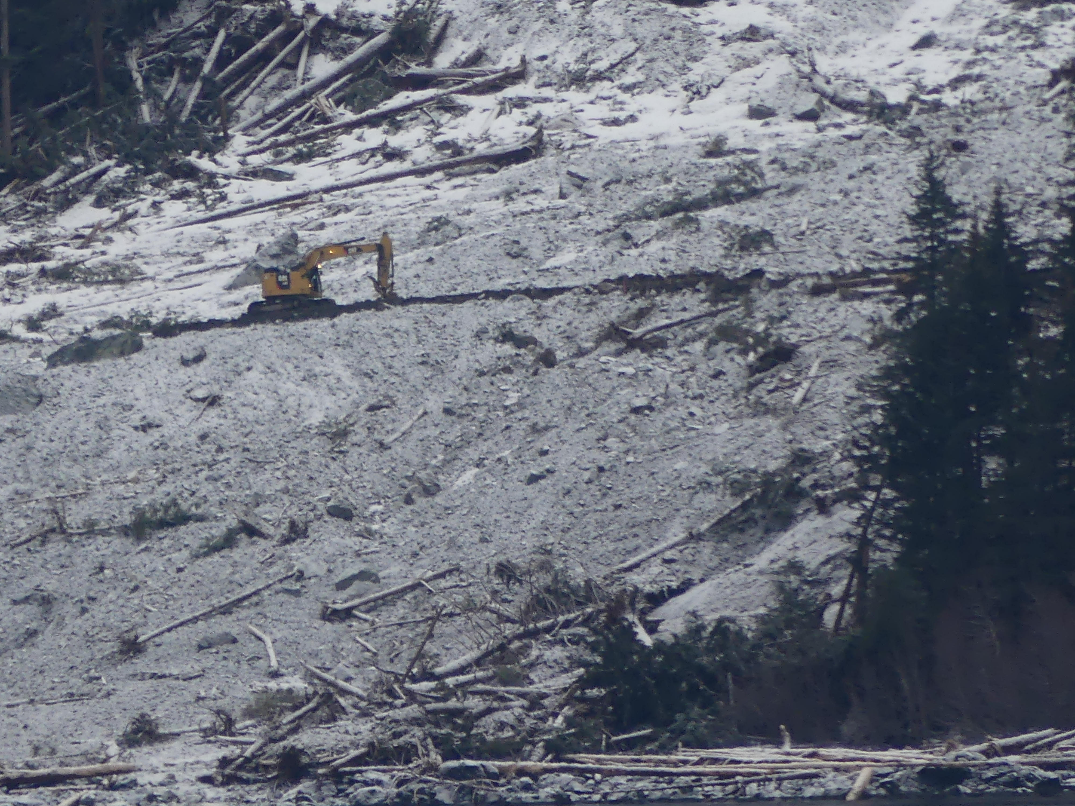
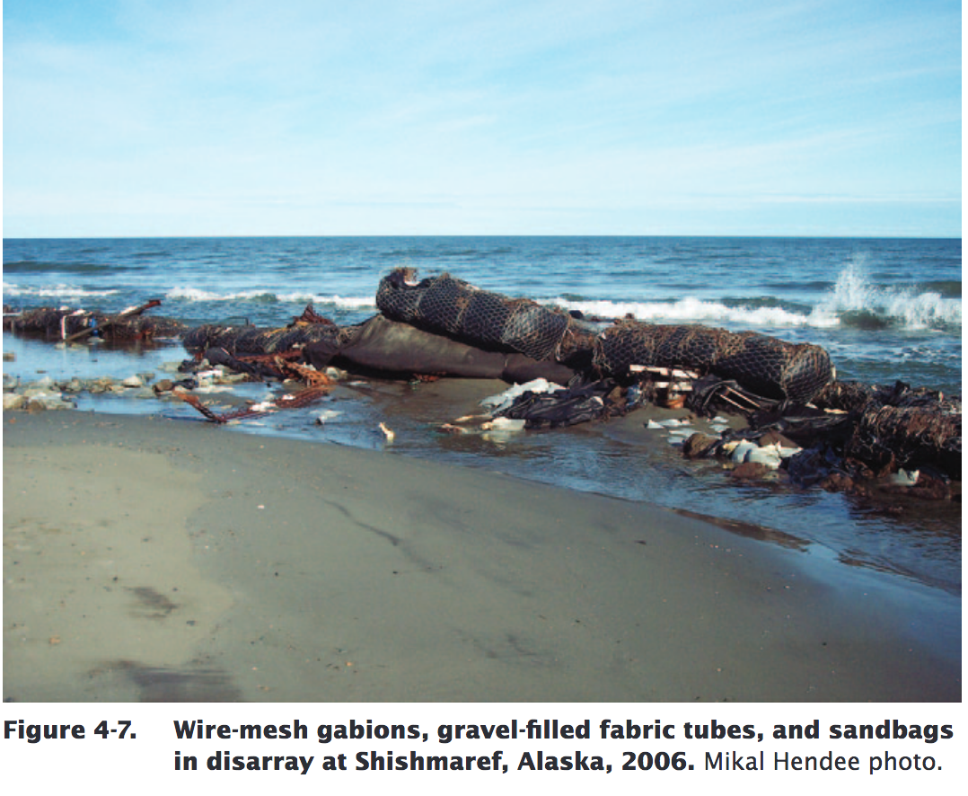
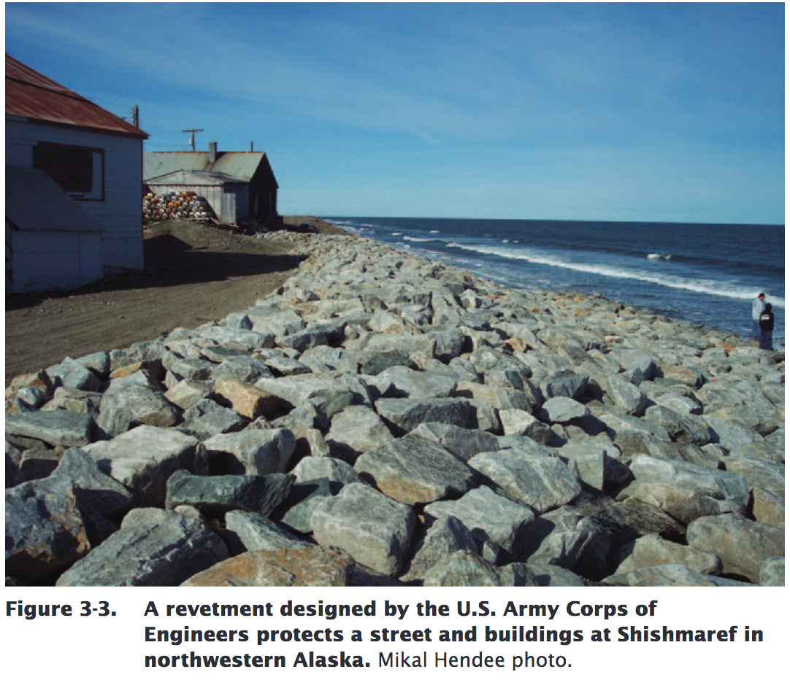
Integrating Engineering
Engineering is best integrated into lessons that incorporate all three dimensions
→ The focus of engineering is solving problems
Example: How can a road safely be built across landslide area?
How can the shoreline damage be slowed?
Notes:
Some turn out not to work - making models - thoughtful risk

Slide 20
Prior knowledge
All three dimensions are progressive across the grades
DCI for Geoscience and climate
4th Grade:
4-ESS2-1 Make observations and/or measurements to provide evidence of the effects of weathering on the rate of erosion by water, ice, wind,or vegetations.
4-ESS2-2 Analyze and interpret data from maps to describe patterns of Earth’s features.
4-ESS3-2 Generate and compare multiple solutions to reduce the impacts of natural Earth process on humans.
5th Grade:
5-ESS2-1 Develop a model using an example to describe ways the geosphere, biosphere, hydrosphere, and cryosphere, andor atmosphere interact.
Notes:
Alex: Great resources through National Science Teachers Association--tables, checklists, guides

Slide 21

Breakout Session
Discuss ways you are already applying one of the three dimensions in your current teaching.
→ Disciplinary Core Ideas
→ Cross Cutting Concepts
→ Science and Engineering Practices
Notes:
Kevin - 5 min

Slide 22




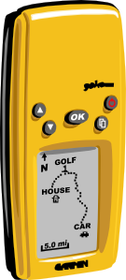
Lesson/Unit Examples
Modeling effect of rainfall rate on various soils.
Using stream table or other flat container
Plastic containers with different sizes or number of holes punched in them to apply the water
Analyzing weather data around various rapid erosion events in coastal Alaska
Reading topographic maps and evaluating risks
Tsunami effect of landslides displacing water in a narrow waterway
Notes:
Breaking out the “pieces of the puzzle” provides opportunity for discoveries that contribute to broader understanding. Patterns, cause and effect, stability and change are evident in these examples. Some people already use the 5E’s approach to investigations and there is definitely a place for that in lessons. Explicitly referencing the SEPs and CCCs along with the core principles is the aim in 3D teaching and learning.

Slide 23
Performance Expectations
Describes what students should be able to do by the end of a unit or multiple units or even the end of the year.
“Construct and present an evidence-based explanation of how geoscience processes have changed Earth’s surface at varying time and spatial scales.”
Since this unit includes reference to climate change as well, it could also include a PE related to that.
(The middle school climate change PE references human-related causes, which this unit doesn’t incorporate. It still does give a chance for an initial exploration of weather data.)
Notes:
Patty: provide evidence, support with argument, explain using a model….change in approach to “show what you know.”

Slide 24
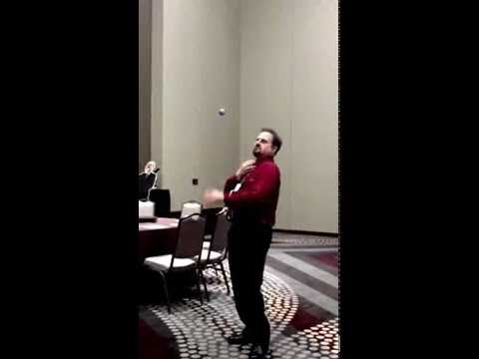
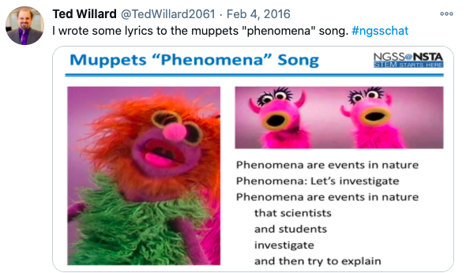
Phenomena Song!
Notes:
this is a big tweak in NGSS to SSA’s

Slide 25
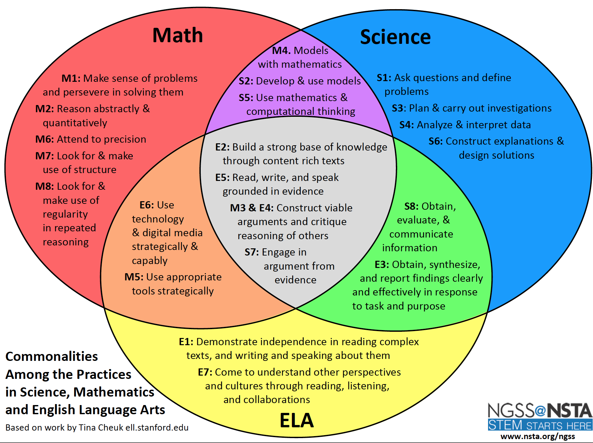
Comonalities Among the Practices in Science, Mathematics and English Language Arts
Notes:
Alex

Slide 26

Math and Literacy Links
News and magazine articles:
read and write them
Radio stories:
listening and creating mock broadcasts
Reading survival stories
Weather data
including graphs of change
Measurements and estimation
of magnitude of landslides and coastal bluff setbacks
Analyzing force
Calculating cost of damage
Notes:
Jon

Slide 27
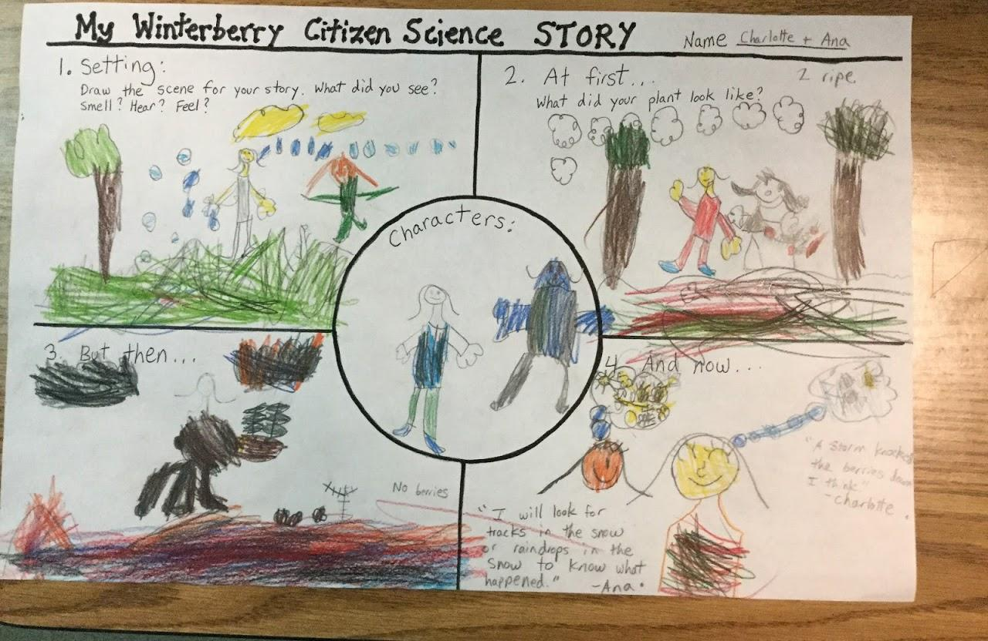
Teacher Reflection: How does the activity students are doing incorporate the SSA’s?
tinyurl.com/1xeqxmwk
Notes:
Patty: asking questions--how does the berry crop change from year-to-year? carry out investigations, notice patterns, analyze data, using mathematics and computation…

Slide 28
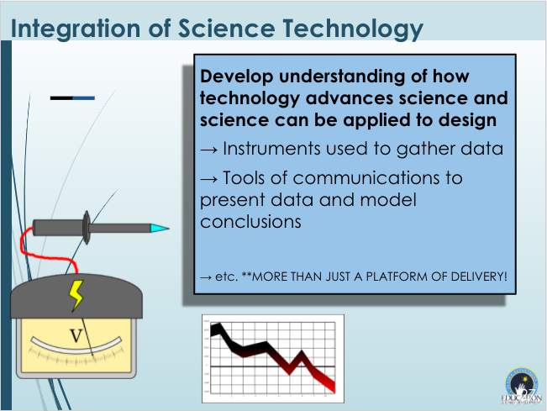
Integration of Science Technology
Notes:
Jon- This is especially useful to enhance the value of the new standards in encouraging students to choose science careers and develops the analytical and modeling skills that are integral to applying SEPs.

Slide 29
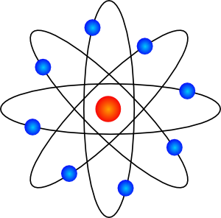
Integrating across fields of science
Change of state → (thawing of permafrost changes soil horizons and shore bluffs, heavy rains on frozen soil in southeast)
Slow decay → creates thick layer of debris in southeast, reduces vegetation cover in tundra
Old trees have held soil in place for years
Gravitational force → on a steep slope and effect on heavy masses
Effects of energy → waves on bluffs, slide gaining speed
Landscape effect on microevolution → Salmon are getting smaller
Notes:
Alex

Slide 30

Assessing Students
Shift in approach in classroom assessments:
→ Equity
→ Incorporate all three dimensions
Ex: model, evaluate an experiment, argue from evidence
→ Minimize “right vs wrong” rote answers
→ “Doing” is not all--- explaining & sharing ideas is key
→ Experience = demonstrating genuine learning
→ Discrepant events may be a resource
→ Students see themselves as scientists
SNAP = Stanford NGSS Assessment Project
TAPS = Task Annotation Project in Science
Achieve’s Science Cognitive Complexity Framework
Publications from Page Keely and associates
Notes:
Patty ?

Slide 31
Assessing Students Resource Links
SNAP: Stanford NGSS Assessment Project
https://snapgse.stanford.edu/snap-assessments-ngss
Task Annotation Project in Science
https://www.achieve.org/our-initiatives/equip/tools-subject/science/task-annotation-project-science
Science Cognitive Complexity Framework Text
https://www.achieve.org/cognitive-complexity-science
Webinar
https://www.youtube.com/watch?v=fuEmJqmYriY&t=25s
Page Keely references
https://www.uncoveringstudentideas.org/books
https://www.uncoveringstudentideas.org/resources/3dimensions
Notes:
Patty ?

Slide 32
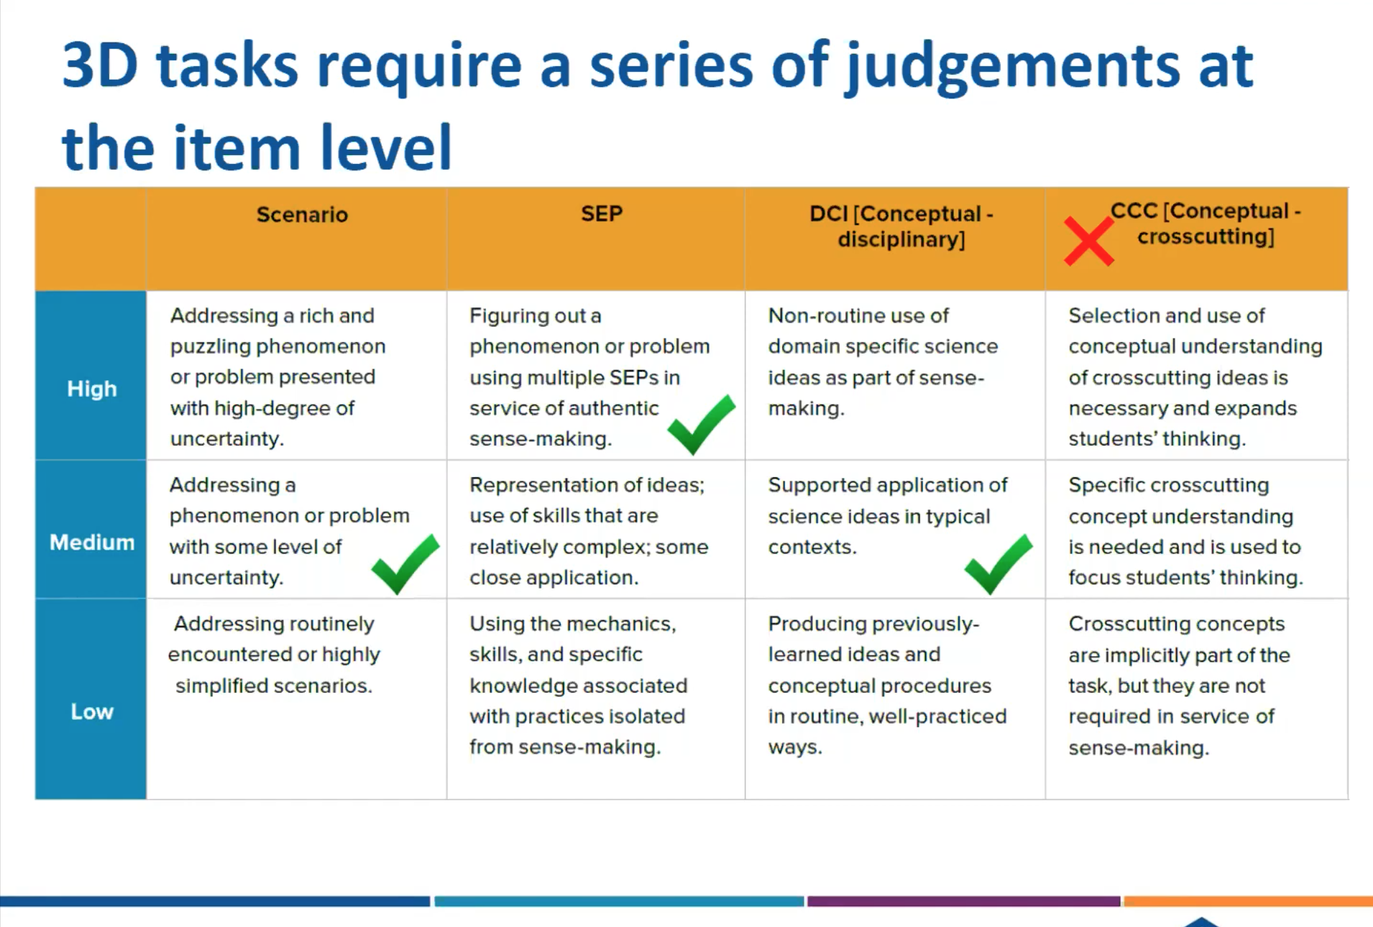
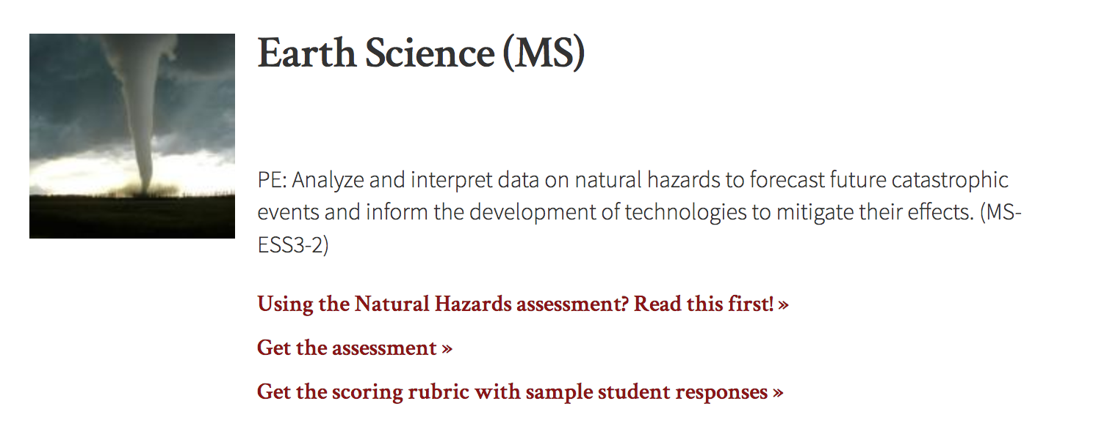
3D Tasks
Notes:
Top chart from Michigan. You can tap into NGSS materials and adapt to Alaska.

Slide 33

Self-evaluation Components
Does the learning experience incorporate all three dimensions?
Is the student tasked with explaining a phenomenon or designing a solution?
Does the investigation deliberately build understanding of certain SEPs, DCIs, and CCC’s by developing and using them?
Are the three dimensions integrated?
Are the tasks presented meaningfully and with equity?
Is the phenomenon relevant and authentic?
Is there opportunity for presentation and exchange of ideas?
Are the lessons age-appropriate and scientifically accurate?
Is instruction differentiated?
Is student progress monitored over the unit?
Is observable evidence provided through student engagement?
Is formative assessment embedded?
Are tasks and assessments unbiased?
Notes:
Kevin - Use this as a simple rubric or checklist
IT’S MORE FUN TO DO REAL SCIENCE!
This is an abbreviated version of the EQuIP rubric which was developed along with the national upgrade of standards. As you revise your lessons and create new ones, this can serve as a checklist. Effective change is accomplished with small steps. Your efforts will have huge payoffs and make learning more engaging and teaching more fun.

Slide 34

SMALL STEPS to Start
Make adjustments to lessons and units you already use
Talk to colleagues who are ready to make changes
Use resources online, but be prepared to improve them yourself
Encourage students to see themselves as scientists and engineers
Tell students themselves about what the three dimensions are
Celebrate your successes and theirs
Notes:
Kevin: Remind that some online resources need to be made more 3D

Slide 35
Resources for Further Information
Alaska Science Teachers Association: join a network of teachers interested in engaging in science education; no specialty required; phenomena library coming soon
NSTA Resource: Charts, Tables, Background, Sample Lessons
Dept. of Ed. and Early Dev. science ed listserv
Andrea’s Virtual Science Teaching Adventure
Sources for Phenomena:
Alaska Science Nuggets by Ned Rozell; Frontier Scientists
Village Science by Alan Dick
Alaska Public Media daily or weekly bulletins
Sea Grant publications
Agencies: USGS, NOAA, USFS, NPS, ADF&G, Alaska Marine Highway
Organizations: REAP, ANROE, GLOBE in Alaska, SHI, Anchorage Museum

Slide 36

QUESTIONS?
Please type any questions / comments / ideas / feedback into the chat for open discussion.

