Slide 1

Alaska ESSA State Plan 2nd Draft Key Topics and Changes from 1st Draft July 18, 2017
Notes:
Good afternoon, thank you for taking the time to join us today
My name is Erin Hardin and I’m with the Department of Education & Early Development
The purpose of today’s webinar is to highlight key topics in the state’s draft plan, specifically key changes between the first and second draft
The state plan is designed to support improvements in Alaska’s education system
Focused on the State Board’s mission of “an excellent education for every student every day”
Based on over a year’s worth of stakeholder engagement and public comments
Will continue to evolve and improve over time

Slide 2



Today’s Agenda
Teacher Quality (15 minutes)
Cecilia Miller
School Support and Improvement (15 minutes)
Brad Billings
Statewide Accountability (15 minutes)
Margaret MacKinnon
Q&A (30 minutes)
Notes:
For today’s webinar we will be focusing on the three topics listed
We will take questions at the end of all three presentations
We don’t want you to forget your questions – feel free to write your questions in the chat box as we go along
We will provide short breaks between each section for you to collect your thoughts

Slide 3
Teacher Quality
Cecilia Miller
Education Specialist

Slide 4

The influence of a good teacher can never be erased.

Slide 5

ESSA Application Item
Pages 24-28
A. Title I, Part A, Section 5 Disproportionate Rates of Access to Educators

Slide 6

DEED’s Proposal
DEED is proposing the following educator quality definitions:
Inexperienced Teacher
Out-of-Field Teacher
Ineffective Teacher

Slide 7

Inexperienced Definition
Page 37
Inexperienced Teacher (First Year Teacher)
Student teaching or other similar preparation experience do not count as experience

Slide 8

Out-of-Field Definition
Page 37
Out-of-Field Teacher
In a subject area without an Alaska Endorsement
Highly Qualified by exam and two years of experience – eligible for endorsement

Slide 9

Ineffective Definition
Page 37
An ineffective teacher . . .
was on a plan of improvement OR
when notified need for a plan of improvement – resigned.
An ineffective tenured teacher . . .
was receiving district support on a plan of professional growth
OR
either of the Level of Support indicated for non-tenured teacher
Removed teacher absenteeism from the Ineffective Definition

Slide 10

Level of Support
Page 38
An improvement plan
Unsatisfactory on one or more of the Alaska Teacher Standards
A professional growth plan (district support)
Basic on two or more Alaska Teacher Standards
Only refers to those plans that are the results of the district’s educator evaluation and support system
(e.g. not support for changing of grades levels)

Slide 11
Purposes of Alaska’s Educator Evaluation and Support System
Help Alaska educators grow professionally
Improve the effectiveness of instruction
Inform future employment of the educator
All districts are encouraged to use plans of professional growth

Slide 12
DEED’s Proposal - overview
DEED is proposing the following:
Alaska Measures
Public Reporting
Approach to Address Disproportionality

Slide 13
Alaska Measures
Page 38
Percentage of teachers categorized as inexperienced, out-of-field and ineffective in
Title I, Part A and non-Title I, Part A schools
High minority (top quartile) and low-minority (bottom quartile) schools

Slide 14
Public Reporting
Page 39
On the State Report Card
Professional qualifications of educators using the number and percentage of:
Inexperienced teachers, principals, and other school leaders
Out-of-field teachers

Slide 15
Address Disproportionality
Pages 42-45
Equitable Access to Excellent Educators Plan for Alaska – Alaska Equity Plan (2015)
Multi-Phase Approach
Initial Root Cause Analysis
Strategies to Address and Eliminate Gaps
Key Strategies

Slide 16
Multi-Phase Approach
Page 42
Share the Alaska Equity Plan with stakeholders to allow further engagement and improvement.
Phase 2: Support
Support the twelve identified districts with challenges in equitable access to effective teachers.
Phase 3: Review
Analyze the implementation of the Alaska Equity Plan and make improvements as needed.
Phase 1: Awareness

Slide 17
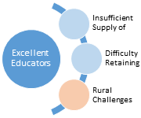
Initial Root Cause Analysis
Page 43
Through the analysis of data, information gathered at meetings, conversations with stakeholders, and various research studies . . .

Slide 18
Theory of Action
Page 44
IF
Alaska
Comprehensive approach to continuous improvement
THEN
Districts
Recruit, retain, and develop excellent teachers
THEN
Schools
Equitable access to excellent teaching
THEN
Students
Higher levels of college- and career readiness for all students

Slide 19
Key Strategies
Page 45
Awareness
Public Reporting of Disproportionate Access
Ongoing Data Collection and Analysis
Recruitment
Identification and mitigation of certification barriers
Examination of recruitment and hiring existing efforts for efficacy
Preparation
Support of Alaska's FEA, PITAS, and ANSEP
Collaboration with Alaska Universities and Colleges
Support
Continued coordination with ASMP and SSOS
Oversight of districts' EES systems

Slide 20
Title II, Part A
Supporting Effective Instruction

Slide 21
ESSA Application Sections
D.1 & 2 Use of Funds
D.3 Certification and Licensing
D.4 Improving Skills of Educators
D.5 Data and Consultation
D.6 Teacher Preparation

Slide 22

DEED’s Proposal - growth & development
Page 56
Educator Growth and Development Systems

Slide 23

ESSA Application Item – title II part A, D.1
Pages 56-58
Title II, Part A, Section D.1 Use of Funds – State-level activities
To improve student achievement

Slide 24
DEED’s Proposal – development, recognition, technical assistance
Educator qualifications and developing excellent educators
Recognition of excellent teachers
Technical assistance to districts for Title II, Part A applications

Slide 25
DEED’s Proposal – online PD, guidance, PD definitions
Online cohesive professional development network
Guidance in Educator Evaluation & Support systems
Professional Development definition knowledge and usage

Slide 26

DEED’s Proposal – digital teaching initiative, micro credentials, standards
Page 56
Digital Teaching Initiative
Personalized learning
Micro credentials
Standards
Professional Learning
AASL Library Standards
ISTE Standards for Educators

Slide 27
DEED’s Proposal – considered activities
Page 57
Activities under consideration:
Induction initiative
Teacher leader program
Principal/School leader support
Teacher/Leader academies

Slide 28

DEED’s Plans
Alaska’s Education Challenge
Ensure Excellent Educators
High-quality, cohesive professional development initiatives

Slide 29
ESSA Application Item – II-A, D.2
Page 59
Title II, Part A, Section D.2 Use of Funds – State-level activities
To improve equitable access to effective teachers

Slide 30
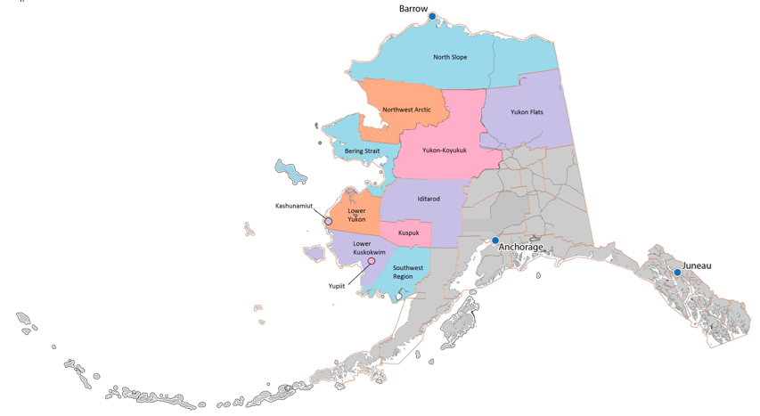
DEED’s Plans – technical assistance
Page 59
Technical assistance
All districts
Most disproportionate rates

Slide 31
ESSA Application Item – II-A, D.3
Page 60
Title II, Part A, Section D.3 System of Certification and Licensing
Teachers, principals, or other school leaders

Slide 32

DEED’s Proposal – reduce barriers to certification
Page 60
Current and future efforts to reduce barriers to certification
Alternate routes to certification

Slide 33
ESSA Application Item – II-A, D.4
Page 61
Title II, Part A, Section D.4 Improving Skills of Educators
For students with specific learning needs

Slide 34
DEED’s Proposal – district practices sharing
Page 61
Documenting district’s practices and sharing those that are relevant
Outlines available offerings that can help teachers serve diverse groups of students

Slide 35
ESSA Application Item – II-A, D.5
Page 62
Title II, Part A, Section D.5 Data and Consultation
To update and approve activities

Slide 36

DEED’s Proposals
Page 62
Commissioner’s
Teacher Advisory Committee
Education Leadership Council
Advisory committees
Educator Quality
Educator Evaluation & Support
Organizations and partners
Expertise in cohesive professional development and learning

Slide 37
ESSA Application Item – II-A, D.6
Page 63
Title II, Part A, Section D.6 Teacher Preparation
Improve and strengthen support

Slide 38
DEED’s Proposal – UAA teacher prep; internships
Page 63
UA teacher preparation
CAEP Accreditation
Merging programs
Internship component
Updated minimum hours
Remote, rural internships

Slide 39

Let’s… break #1
Notes:
Please take a moment to reflect on the presentation you just heard and collect your thoughts and questions.
Write any questions in the chat box or on a notepad at this time.
We will begin the next section of the presentation in one minute.

Slide 40
School Support and Improvement
Brad Billings
Education Administrator

Slide 41

ESSA Application Sections – A.4.viii.c, d, e
Pages 32-36
A.4.viii.c More Rigorous Interventions
A.4.viii.d Resource Allocation Review
A.4.viii.e Technical Assistance

Slide 42
Two Pronged Feedback…
A system that supports school specific and locally responsive improvement and support processes…
balanced with
Differentiated oversight and distributed responsibility.

Slide 43
Technical Assistance
Pages 34-36
Support of school improvement planning process/tool
Continued partnering to provide conference based instructional and leadership training
One-on-one technical assistance through Title Programs application process and routine monitoring
DEED website with resources and tools linked to State Content Standards, evidence-based interventions, etc.

Slide 44
Technical Assistance – draft 2 additions
Pages 34-36
Draft #2 additions:
More specific language identifying Title Program support and training
Greater emphasis on effective coordination of support across diverse programs and resources
Increased oversight and support role for districts

Slide 45
Resource Allocation Review
Page 34
Annual application processes that scrutinize spending on school improvement process/plan
Review of school/district use of school improvement funds (1003a) for identified needs
Draft #2 – DEED review across programs beyond school improvement funds for schools struggling to make progress

Slide 46
More Rigorous Interventions
Pages 32-34
Formation of strategic planning and support teams with directive authority, including stakeholders beyond DEED
External school improvement coach
Focused training and technical assistance in areas of local need
Periodic reporting/“check-in” events
State governance of school and/or districts
District and state level directives on school improvement efforts and use of resources

Slide 47
More Rigorous Interventions – draft 2 additions
Pages 32-34
Draft #2 additions:
Rigorous and routine communication and engagement of DEED with district and school staff
Continuous Improvement Planning Cycle
ASSESS NEEDS
-Analysis of student performance data
-Needs assessment by school team
-Indicators of effective practice
PLAN & ACT
-Identify and implement SMART goals
-Routine progress checks of improvement goals
-District and state level engagement and support
Evaluate Impact
-Formative assessments and progress monitoring
-Analysis of intervention effectiveness and impact
-District and state jointly ensure plan implementation

Slide 48
Two Pronged Feedback… - review
A system that supports school specific and locally responsive improvement and support processes…
balanced with
Differentiated oversight and distributed responsibility.
Notes:
(you have 18 minutes – be sure to time out each part of this section of your presentation)
Summarize DEED’s proposal.
Stating the proposal up front is more likely to engage participants.
Studies suggest that when we build backwards from what they expect, participants tend to stick with you. Going the other way is what is often done…therefore they often check-out until the end.
For example, “After great deliberation, reviewing stakeholder input, and studying what other states have done… DEED is proposing the following… As we move through this presentation, I/we will provide detail about how we came to this.”

Slide 49
Let’s… break #2
Notes:
Please take a moment to reflect on the presentation you just heard and collect your thoughts and questions.
Write any questions in the chat box or on a notepad at this time.
We will begin the next section of the presentation in one minute.

Slide 50
Title I, Part A Section 4 Statewide Accountability System
Margaret MacKinnon
Federal Programs Coordinator

Slide 51
ESSA Application Sections – A.4.ii, iii, iv, v, vi
A.4.ii. Minimum N-size
A.4.iii. Long-term goals
A.4.iv. Indicators
A.4.v. Annual Meaningful Differentiation
A.4.vi. Identification of Schools

Slide 52

ESSA Application Item – II-A, 4.ii
Pages 9-10
Title I, Part A, Section 4.ii Minimum N-size

Slide 53
DEED’s Proposal – minimum n-size
Page 9
Minimum N-size: 10
10 students - minimum number of students needed to be included in accountability system
For a subgroup
For the all students group in the school
Balance for including highest number of subgroups and schools while minimizing effect of performance of one student on a smaller N-size
Change from 1st draft – specific minimum N-size was not proposed

Slide 54

ESSA Application Item – II-A, 4.iii
Pages 10-16
Title I, Part A, Section 4.iii Establishment of Long-Term Goals

Slide 55
Long-Term Goals
Long-term goals required for:
academic achievement in ELA and Math
graduation rate
English learners in learning English
Use same time period for all students and all subgroups
Measures of interim progress must take into account need to close achievement gaps

Slide 56

DEED’s Proposal – long term goals changes
Page 11
Long-term goals:
Changes from 1st draft -
Academic achievement - reduce by half percentage of students not-proficient over 10 years
Changed from 75% goal in 1st draft
No changes from 1st draft:
Graduation rate goals of 90% (4-year) and 93% (5-year)
English learners – 80% of ELs make progress in learning English

Slide 57

ESSA Application Item – II-A 4.iv
Pages 16-25
Title I, Part A, Section 4.iv Indicators in Accountability System

Slide 58
Indicators Required
Academic achievement in ELA and Math
Other academic indicator (for non-high schools)
Graduation rate indicator (for high schools)
Progress in learning English for English learners
School quality or student success (SQSS) indicator(s)

Slide 59

DEED’s Proposal – achievement & grad. rate
Pages 17 & 20
Academic Achievement & Graduation Rate:
Academic achievement in ELA & Math
For all schools
Points weighted equally in ELA and Math
5 levels based on PEAKS
Graduation rate
For schools with grade 12
Both 4-year and 5-year rate, points weighted higher for 4-year rate

Slide 60
DEED’s Proposal – subgroup progress
Pages 17 & 21
Inclusion of subgroup progress:
Add additional points for subgroup progress in meeting measures of interim progress or long-term goals
For academic achievement & graduation rate
Change from 1st draft – removed subgroup progress as a separate indicator

Slide 61

DEED’s Proposal – growth for other academic indicator
Pages 18-20
Growth for Other Academic Indicator:
Measure growth on ELA & Math on PEAKS assessments
Use for schools with students in grades 4-8
Earn points based on student movement within achievement levels using value table (as used previously in AK for ASPI)
Change from 1st draft – measure growth on PEAKS rather than district-selected interim assessments

Slide 62
DEED’s Proposal – school quality of student success
Pages 23-24
School Quality or Student Success (SQSS):
Total weight of all SQSS indicators is 10% (10 points out of 100)
Three indicators per grade spans (K-8 and 9-12)
Change from 1st draft – SQSS measures were not specifically proposed

Slide 63
DEED’s Proposal – school quality grades K-8 & 9-12
Page 25
School Quality of Student Success (SQSS):
Grades K-8
Chronic absenteeism
District-selected interim assessments participation
Grade 3 literacy (students proficient or above on PEAKS)
Grades 9-12
Chronic absenteeism
Freshman on-track for graduation credits
APS scholarship eligibility

Slide 64

ESSA Application Item – II-A, 4.v
Pages 26-28
Title I, Part A, Section 4.v Annual Meaningful Differentiation of Schools

Slide 65
DEED’s Proposal – annual meaningful differentiation
Pages 26-28
Annual Meaningful Differentiation:
Index based on 100 points
Change from 1st draft – points earned rather than points subtracted
Weighted by grade spans K-8 and 9-12
Schools with combination of grades receive points based on percentage of students enrolled in each grade span
Change from 1st draft – specific weights were not proposed

Slide 66
DEED’s Proposal – annual meaningful differentiation, continued
Pages 26-28
Annual Meaningful Differentiation:
Changes from 1st draft -
Designations proposed for every school
Included methodologies for special types of schools (e.g. schools with no tested grades, new schools, those with fewer than 10 students)

Slide 67

ESSA Application Item – II-A, 4.vi
Pages 28-31
Title I, Part A, Section 4.vi Identification of Schools

Slide 68
DEED’s Proposal – identification of school
Pages 28-31
Identification of schools:
Every school receives a designation
Superior
Satisfactory
Needs Improvement
Targeted Support (required under ESSA)
Comprehensive Support (required under ESSA)

Slide 69
DEED’s Proposal - Identification of schools, changes from draft 1
Pages 26-28
Identification of schools:
Changes from 1st draft -
Added additional clarification for categories of comprehensive and targeted support
Included criteria for determining other designations
School must have 95% participation in PEAKS to receive superior or satisfactory rating

Slide 70
Let’s…
Notes:
Please take a moment to reflect on the presentation you just heard and collect your thoughts and questions.
Write any questions in the chat box or on a notepad at this time.
We will begin the next section of the presentation in one minute.

Slide 71
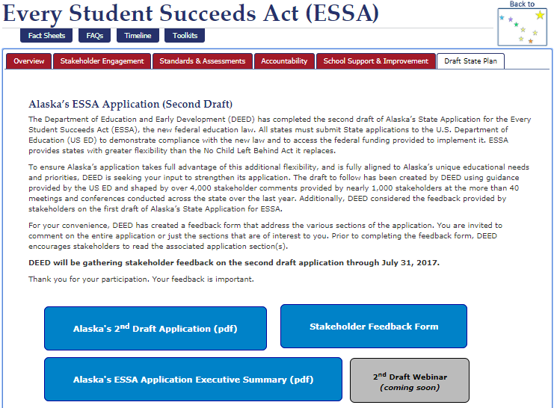
Resources
education.
alaska.gov
ESSA Red Star
Draft State Plan
Notes:
Visit the DEED website at education.alaska.gov, click on the Red Star, and select the Draft State Plan tab
Here you will find the 2nd draft of the state plan, a 10 page executive summary that includes a list of key changes from the first draft, and the Survey Monkey feedback form

Slide 72

Timeline
July 31: Public comment closes on 2nd draft
August 1: State Board of Education reviews 2nd draft and public comment
No later than August 18: Final draft is provided to the public and the Governor’s office for required 30-day review period
September 18: DEED submits application to US ED

Slide 73

Questions?

