Slide 1
Replacement Behaviors
Teaching & Changing Unexpected Behaviors to Expected Behaviors

Slide 2
Role of the Child Study Team
Refer
Provide Data
Determine Areas of Need
Prioritize Behavior
Develop Action Plan and Determine Replacement Behavior
Implement Plan and Collect Data Every Two Weeks
Evaluate

Slide 3
Q: When Do I Consider Replacement Behaviors?
A: When a student is referred to Child Study Team

Slide 4
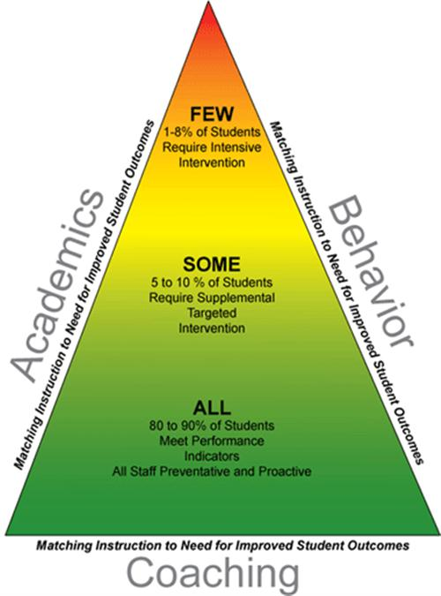
aka Tier 2 & 3

Slide 5
Q: Why Do We Consider Replacement Behaviors?
A: So the student knows what to do instead (expected behavior)

Slide 6
Why Teach Replacement Behaviors
Teach the student an appropriate behavior that serves the same function as the undesired behavior.
If we use punishment the behavior will go away, but if we don’t teach something to do instead, the unwanted behavior will come back or the child will come up with a way to get what they want.
Notes:
Focusing on the problem behavior may just reinforce the behavior, especially if the consequence (reinforcer) is attention. It also helps you teach the behavior that you want to see in the target behavior's place.

Slide 7
Discuss: What Does This Mean to You?
“Treat the symptom, ignore the disease!”

Slide 8
Q: What is a Replacement Behavior?

Slide 9
A: A replacement behavior is:
The behavior you want the student to use instead of the unwanted behavior (aka the EXPECTED behavior).
the behavior that you want to see in the problem behavior's place.

Slide 10
Q: Who Determines the Replacement Behavior?
A: Child Study Team and/or Student

Slide 11
Q: How Do We Determine the Replacement Behavior?
A: 1. Clearly Define Problem Behavior, 2. Determine Function of Problem Behavior, and 3. Determine Replacement Behavior

Slide 12
1. Clearly Define the Problem Behavior
Observable terms
Understandable and observable by all
Example: Which is operationally-defined?
Johnny is non-compliant.
Johnny says no, puts down pencil and refuses to work.

Slide 13
Prioritize Behavior
Determine behavior that is causing the most interference
Data: frequency counts, office discipline referrals, minor violations, others??

Slide 14
2. Determine Function of Problem Behavior
Best guess on what is the function of the behavior
Question to Ask:
Is Johnny throwing his pencil down because he can’t do the work?
Is Johnny throwing his pencil down because he won’t do the work?

Slide 15
3. Determine a Replacement Behavior
Based on the problem behavior, choose a replacement behavior that:
Clearly tells the student what to do
Has the same function as the unexpected behavior
Is something the student can do
Can be taught across the board

Slide 16
3. Determine a Replacement Behavior (cont.)
Review the definition to ensure it
describes actual behavior rather than an outcome of behavior
describes an action or activity rather than the “absence” of behavior
Example: Johnny requests a short break instead of throwing his pencil down.

Slide 17
Q: Who Teaches the Replacement Behavior?
A: All of us

Slide 18
Q: How Do We Teach Replacement Behaviors?

Slide 19
How to Teach Replacement Behaviors
Teach by Modeling
Give Prompts
Positive Reinforcement When Replacement Behavior Occurs

Slide 20
Reinforcing Replacement Behaviors
Don’t want
Want
Cut/skip class
Rude remarks/bullying
Refusing to do classwork
Reinforce for being in class on time
Positive attention when showing appropriate social interactions
Reinforce when working

Slide 21
Q: How Do We Track & Collect Data on Replacement Behaviors?

Slide 22
Frequency Counts
Frequency or Interval Recording
How often?
How much?
When is it most likely to occur?
Examples: Check-In/Check-Out sheets, Tallies, Yes/No

Slide 23
Q: How Do We Know If We Are Making Progress?
A: Calculate a Percentage

Slide 24
The Magic Formula
Times the Replacement Behavior Was Used
Opportunities to Use the Replacement Behavior
% Replacement Behavior was Utilized

Slide 25
Example: Tally Sheet

Slide 26
Data Shows Progress
It is important to use data to see progress.
Example: Moving from hitting people to simply saying “go to hell” is PROGRESS.

Slide 27
If the Replacement Behavior Not Being Used
Develop a plan to:
Reteach, model, practice, reinforce with the individual student or whole class
Coordinate with home and community agencies to teach, model, and reinforce the new skill across environments

Slide 28
Scenario #1
Nathan started the new school year doing great. He came to class happy and eagerly did his work. One day he started refusing to work and saying no to the teacher. When asked what’s wrong, he looks at the teacher and says “none of your business.”
What’s up with Nathan?
Function of behavior?
Replacement behavior?
Data to collect/progress monitoring?
Outcome?

Slide 29
Scenario #2
One day Mary started calling out in class. It caused quite a disturbance. The Behavior Team came up with an intervention plan and stopped the calling out by ignoring it. It got worse for a while, but we were so excited when it stopped. Staff couldn’t stop taking about it, but we said nothing to Mary. One day Mary stood up, pulled up her shirt, ran around the room, and stuck her belly in people’s faces. The class thought it was very funny.
What’s going on with Mary?
Function of behavior?
Replacement behavior?
Reinforcement?
Data to collect/progress monitoring?
Outcome?

Slide 30
Scenario #3
Johnny arrives to class on time and is eager to do his work. He raises his hand and asks questions about seatwork and what he needs to do. On a daily basis, Johnny gets up two or three times to sharpen his pencil. Johnny was told he can no longer sharpen his pencil during class. Johnny did a great job sharpening his pencil before class until one day he threw his book across the room, tore his paper, and refused to work.
What’s going on with Johnny?
Function of behavior?
Replacement behavior?
Data to collect/progress monitoring?
Outcome?

