Slide 2
Presentation Topics
School Improvement Plans
Combing Title I Schoolwide with SIPs
Submitting Plans & Required Documents
Districtwide Initiatives
Training Resources
District Improvement Plans
Training ideas for Alaska STEPP

Slide 3
Improvement Plan Requirements
1-Star, 2-Star, & 3-Star Schools must submit school improvement plans using the Alaska STEPP software program.
It is understood that districts are aware and guide the processes and content for all school improvement planning in their districts; EED provides additional support and accountability for specifically designated schools.

Slide 4
Responsibilities
Districts are responsible for documenting school improvement plan submittal, implementation and review for all schools in their district.
EED is responsible for documenting school improvement plan submittal and review for 1 & 2-Star Schools, but does not approve/disapprove plans
Notes:
While the process for submitting all plans on Alaska STEPP requires the push of a button, there is a difference in who will be documenting and approving the submittal of those plans.
It is understood that the district is aware of all school improvement plans and guides the processes and content for all schools in their districts; EED provides additional support and accountability for specifically designated schools.
Priority & focus school plans’ submittal will be documented, reviewed and approved by EED.
One, & two star school plans’ submittal will be documented and reviewed by EED, and EED will offer feedback, but EED does not approve/disapprove 1 & 2 star school’s plans.
Three star schools’ plans’ submittal will be documented and reviewed by Districts and the process for giving feedback to those plans will differ amongst the different districts.
Four and Five star plans’ submittal for subgroups will be documented and reviewed by Districts and the process for giving feedback to those plans will differ amongst the different districts.

Slide 5
Responsibilities
EED is responsible for documenting school improvement plan submittal and review for Priority and Focus Schools and does approve/disapprove plans.
Plans are submitted using the Submit Forms/Reports Tab on the Dashboard of
Alaska STEPP.
Notes:
While the process for submitting all plans on Alaska STEPP requires the push of a button, there is a difference in who will be documenting and approving the submittal of those plans.
It is understood that the district is aware of all school improvement plans and guides the processes and content for all schools in their districts; EED provides additional support and accountability for specifically designated schools.
Priority & focus school plans’ submittal will be documented, reviewed and approved by EED.
One, & two star school plans’ submittal will be documented and reviewed by EED, and EED will offer feedback, but EED does not approve/disapprove 1 & 2 star school’s plans.
Three star schools’ plans’ submittal will be documented and reviewed by Districts and the process for giving feedback to those plans will differ amongst the different districts.
Four and Five star plans’ submittal for subgroups will be documented and reviewed by Districts and the process for giving feedback to those plans will differ amongst the different districts.

Slide 6
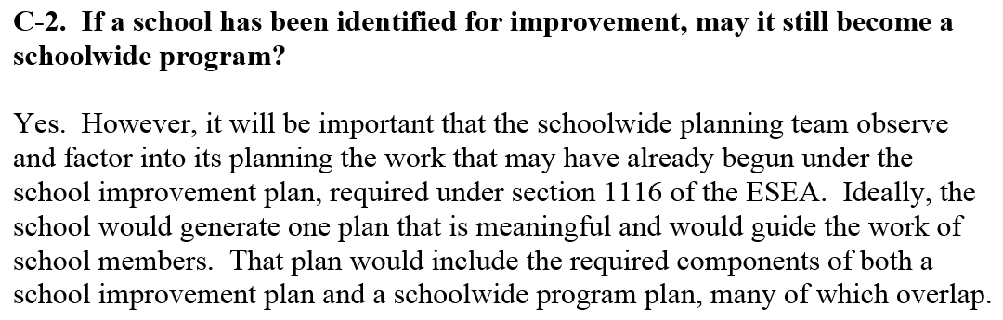

Combining Title I Planning
with School Improvement Planning
Notes:
This language is taken from the US DOE Schoolwide Guidance document.

Slide 7
Required Assessing and Planning
Priority Schools-
Must address all 7 of the Turnaround Principles
Must Assess the 12 Key Indicators
Must Create a plan for the 12 Key Indicators
Focus Schools-
Must carefully consider the 7 Turnaround Principles
Must Assess the 12 Key Indicators
Must Create a plan for the indicators that address the school’s greatest areas of need
Notes:
5 of the 7 turnaround principles have been cross walked with the 12 Key indicators.
7 Turnaround Principles Categories: [Strong and effective leadership, Effective teachers] [These principles will be addressed by a school/district’s teacher and admin. evaluation systems]
School calendar maximizes time for learning, Strengthen school’s instructional program, Use of data to inform instruction, School environment, Family and community engagement
Ensure strong leadership
ensure effective teachers by reviewing quality of staff and retaining those determined to be effective and providing professional development;
Redesign school day, week or year to provide additional time for student learning and teacher collaboration;
ensure research-based and aligned instructional programs;
use student data to inform instruction;
establish positive school environment; and
provide mechanisms for family and community engagement
12 Key Indicators
1.1 School staff implements the district approved, research based curricula that are aligned with Alaska Content Standards.
2.3 School staff use universal screening assessments and routinely administer them multiple times a year in at least literacy and math.
3.2 School staff implement a coherent, documented plan throughout the school to ensure that all students receive core instruction and all low-performing students receive additional support to meet their needs and reach proficiency.
3.3 School staff use research-based instructional practices, programs and materials.
3.4 School staff consistently, and regularly measure the effectiveness of instruction using data from a variety of formative assessments.
4.3 School staff communicate school-wide behavior expectations that are understood and achieved by students, and staff provide positive behavioral supports.
4.5 School staff provide extended learning opportunities, and students in need of additional support regularly participate.
4.6 School and classroom environments reflect respect for all students and cultures, and they reflect an understanding of the cultural values of the students and community.
4.7 School staff communicate effectively with parents about learning expectations, student progress, and reinforcing learning at home; staff implement effective strategies to increase parent engagement.
4.8 School priorities, goals, plans, and events are collaboratively developed by school staff members, parents, students, and community members, and these plans are communicated to all stakeholders by school staff.
5.1 School staff use multiple sources of student performance data as a primary factor in determining professional development priorities.
5.3 School staff embed professional development into daily routines and practices.

Slide 8
Required Assessing and Planning
1, 2, & 3-Star Schools
Assess the school’s areas of greatest need.
Work within the indicators that support the identified needs.
The Leadership Domain does not include Key indicators, because STEPP is not designed as an evaluative tool and the first 2 Turnaround Principles, Strong and Effective Leadership & Effective Teachers, involve using an effective system of evaluation. Therefore, the 12 Key Indicators are cross walked only with the last 5 of the 7 Turnaround Principles. Priority schools will be expected to address areas in the leadership domain through educator evaluations.

Slide 9
Overlapping School Improvement Plans with Title I Schoolwide Plans
Title I Requirements | 7-Turnaround Principles | Indicators
Reform Strategies | Instructional Programs | 3.03 and 1.01 Key
Additional Support | School Calendar | 3.02 and 4.05 Key
Use of Assessments | Use of Data | 2.03 and 3.04
Professional Development | Effective teachers | 5.01 and 5.03 Key
Family Engagement | School Environment/Behavior | 4.03 and 4.06 Key
Family Engagement | Family and Community Engagement | 4.07 and 4.08 Key
Highly Qualified Staff |  | 8.06 Title I SW
Recruiting and Retaining |  | 8.07 Title I SW
Transitioning Preschoolers |  | 8.04 Title I SW
Integrating Resources |  | 8.05 Title I SW

Slide 10
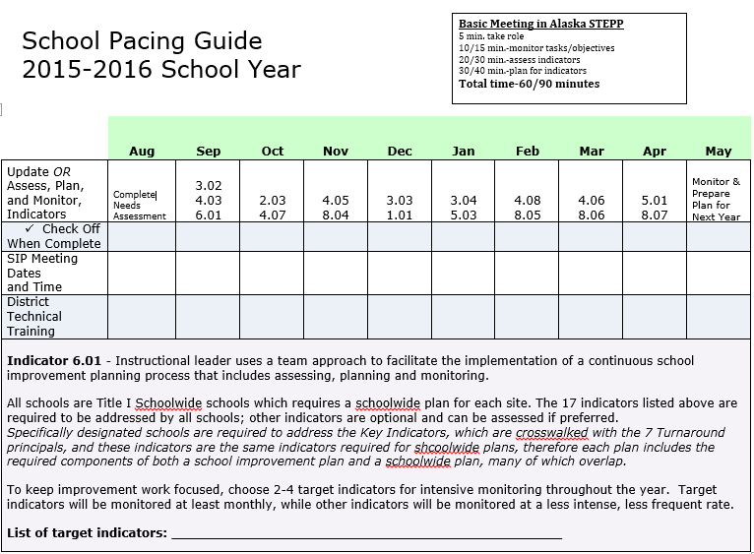
Sample School Pacing Guide
Notes:
The district team can determine a pacing guide for both the district and site levels that will be used by all teams. Adhering to a pacing guide is important so that work is completed continuously and predictably throughout the year. It is also essential for ensuring that the district’s assessing and planning is one step ahead of the schools, which allows for alignment of plans.
The district team can also monitor and guide the site plans as the year progresses. The district login allows districts the unique viewing option of selecting any of the sites’ plans to determine if they are in need of assistance or coaching. The coaching comments function gives the district administration the option to make and store messages within the tool.

Slide 11
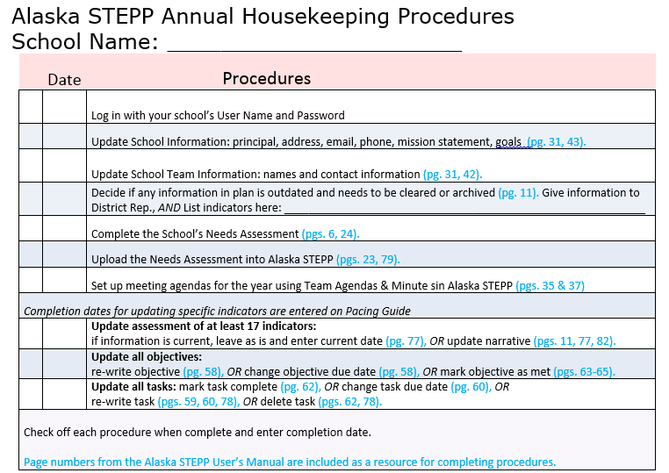
Sample Annual Housekeeping Checklist
Notes:
Having an annual housekeeping checklist enables Alaska STEPP users to keep their plans updated.

Slide 12
Planning Processes - School Improvement/Title I
Data Analysis - analyze state test data and MAP/AIMSWeb/Diebels/Attendance/Graduation Rate/Behavior/Perception data.
School Needs Assessment Form
Enter sources of data used and areas of need.
Pre-written assumed goals are listed based on ASPI and AMO targets.
Write specific goals based on need.
Write a narrative statement that reflects strengths and/or needs.
Notes:
There is a sample School Needs Assessment on the EED website under the Orange Support Star, & Alaska STEPP tab.

Slide 13
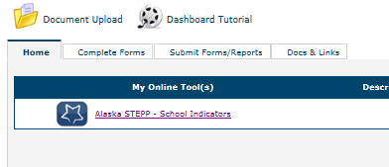
Where to Find the School Needs Assessment
Go to the Dashboard of your site’s STEPP account
Find the Complete Forms Tab
The Needs Assessment Form link will be visible.
Fill the Report out, Save, Upload into the Document Upload Folder, and submit under the Required Reports Tab.
Here

Slide 14
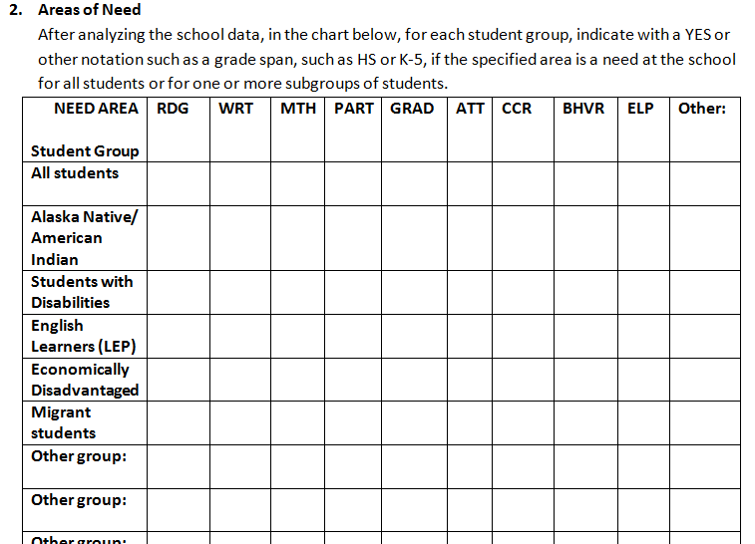
School Needs Assessment
Notes:
The school needs assessment supplemental form is a document that provides a place for collection of information about school goals/objectives, student performance, sub-group performance, school demographics, and possibly school programs and perception data. It is essential to have an accompanying collection of clear charts and graphs with succinct interpretations of data results to aid in filling out the school needs assessment. On page 2 of the School Needs Assessment number 3 contains five pre-written goals/objectives (A-E) for schools to plan for, and on page 3 of the form there is a table for writing any additional goals/objectives the school might have. Also on page 3 of the form is an area to write a narrative summary of the data analysis results.
Objectives created for school improvement are based upon the needs emerging from the data; therefore, it is important that schools, with the support of districts, are able to collect appropriate data efficiently and find ways to manage and display the data so that all staff members are able to analyze, communicate, and act upon it. This analysis, communication, and subsequent actions are the heart of the continuous improvement process.

Slide 15
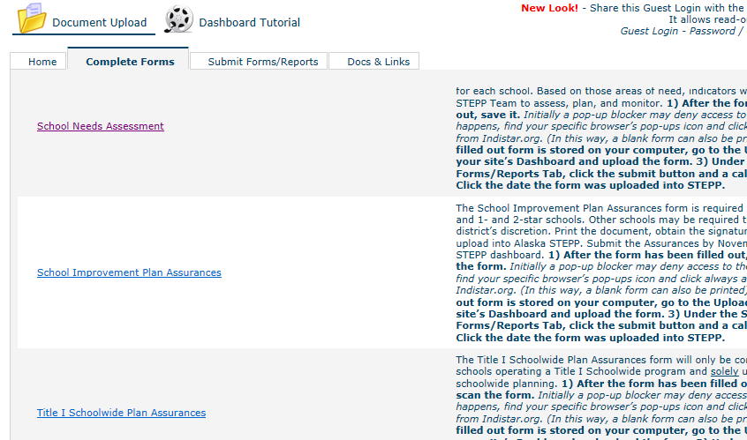
ASSURANCES
Notes:
The School Improvement Plan Assurances form is required for all Priority, Focus, and 1- and 2-star schools. Other schools may be required to submit it at the district’s discretion. Print the document, obtain the signatures, scan to PDF and upload into Alaska STEPP. Submit the Assurances by November 1 through the STEPP dashboard.
The Title I Schoolwide Plan Assurances form will only be completed by Title I schools operating a Title I Schoolwide program and solely using Alaska STEPP for schoolwide planning.

Slide 16

DISTRICT INITITIATIVES
Building on the work that
is already being done.

Slide 17
Example Scenario 1: A district is already focusing on three of the six domains of Alaska’s Effective Schools Framework: Instruction, Learning Environment and Professional Development. Therefore, each school in that district is expected to assess at least one Key Indicator from each of those domains.
QUESTION:
How might a school choose three Indicators to assess that have the same overall objective in mind? This is a good idea, because the tasks will be related, have more depth, be more practical to implement, and be in line with district initiatives.

Slide 18
DISTRICT GOAL: ALL STUDENTS BENEFIT FROM RESEARCH BASED INSTRUCTION
KEY INDICATORS:
3.04 School staff consistently, and regularly measure the effectiveness of instruction using data from a variety of formative assessments.
4.05 School staff provide extended learning opportunities, and students in need of additional support regularly participate.
5.03 School staff embed professional development into daily routines and practices.
Notes:
Three Key Indicators that are related are 3.4, 4.5, & 5.3

Slide 19
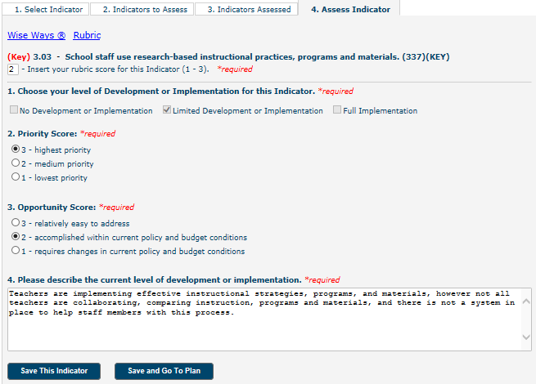
ASSESSING THE INDICATORS RESULTED IN RUBRIC SCORES OF 2
3.04 School staff consistently, and regularly measure the effectiveness of instruction using data from a variety of formative assessments.
4.05 School staff provide extended learning opportunities, and students in need of additional support regularly participate.
.
5.03 School staff embed professional development into daily routines and practices.
DISTRICT GOAL: ALL STUDENTS BENEFIT FROM RESEARCH BASED INSTRUCTION
Notes:
The first step would be to assess the indicators. Either with a STEPP team, or depending on the size of a school, as a whole staff.
It is important to realize that the purpose of assessing indicators is to give an accurate representation of what is currently happening at the site. Providing accurate descriptions is essential for two reasons. First, it provides teams a clear starting point, thus opening the possibility of making a meaningful decision about what plan to make. Second, it provides the district the opportunity to support efforts at the site in an efficient and effective manner. District teams set the tone of this honest reflection by stating the intention of assessing.

Slide 20
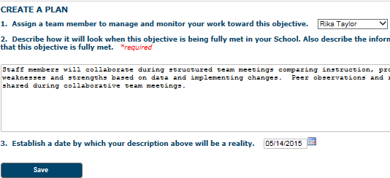
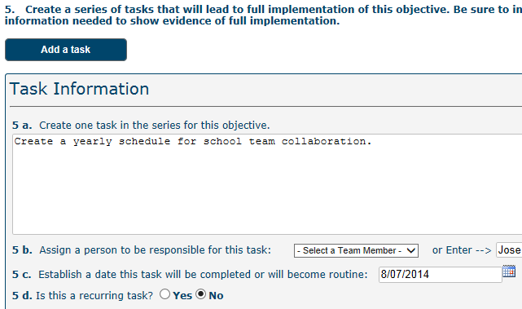
CREATING A PLAN - OBECTIVES & TASKS
SCHOOL GOAL: ALL STUDENTS BENEFIT FROM RESEARCH BASED INSTRUCTION
Notes:
The team describes how it will look when fully implemented (beginning each description entry with the current date); this description is the objective. Though it’s not highly recommended to use the rubric for a pre-written objective, many teams find it helpful to get ideas from the 3 or 3+ rubric descriptions and then personalize them to their sites.
Objectives should not include information that describes how to achieve the goal, but only what the targeted accomplishment will be; they are written in an active voice and are written to directly or indirectly have a positive impact on student academic achievement.
Objectives reflect the highest priority needs of the school. Measurable objectives can be proven with evidence.
Teams create practical tasks that lead to the full implementation of the objective. Teams can create as many tasks as are needed. Created tasks indicate or imply that specific action will be taken. Tasks should be clearly linked to the identified needs and objectives. Each task helps objectives be reached. Tasks are assigned to appropriate and multiple staff members, and tasks are acceptable and understood by all stakeholders.
If professional development was about formative assessment, and extended learning opportunities for students include formative assessment & writing, the objective of indicator 3.4 could include having formative assessment in writing. In that way, all indicators will be connected and the overall goal of the district can be achieved.

Slide 21
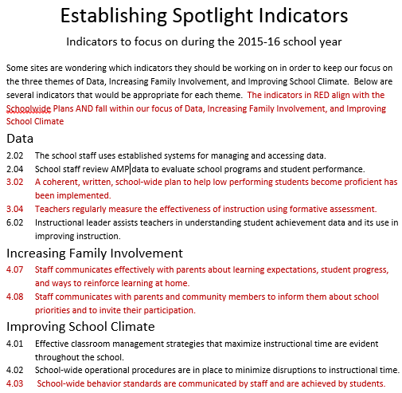
Notes:
One district’s way of having their sites focus on district initiatives. The Indicators highlighted in red are to be focused on more frequently than other indicators.

Slide 22
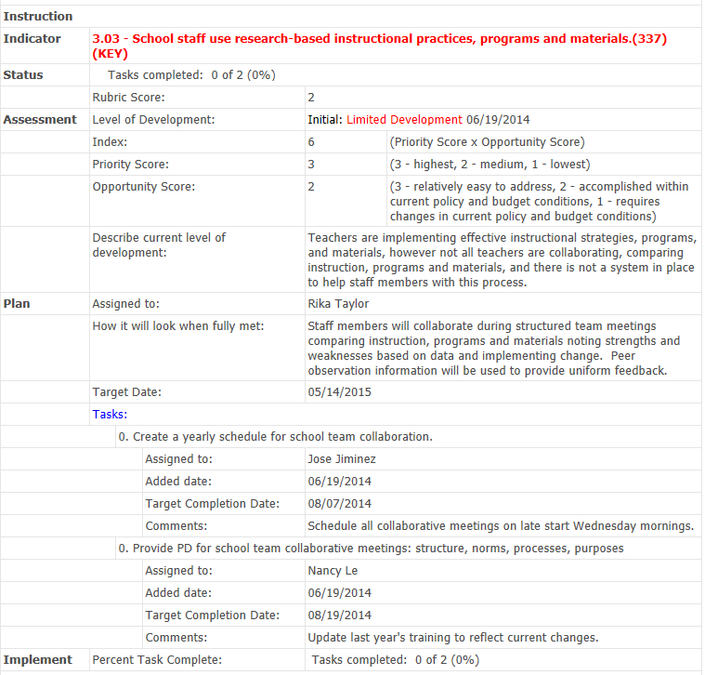
Comprehensive
Plan Report
Assessment
Objective
Notes:
This is what the process can look like in subsequent years.
The Comprehensive Plan report shows the current status of each Objective and each related task.
The Comprehensive Plan Report is what schools submit for their school improvement plan

Slide 23
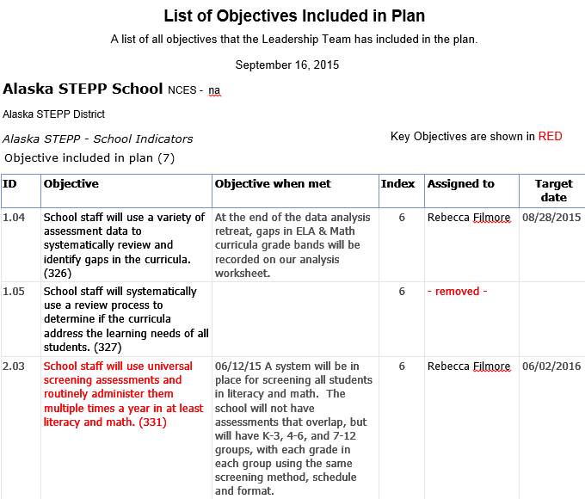
A Good Report for Parents to
Understand
Objectives
Indicators
Notes:
This is what the process can look like in subsequent years.
The Comprehensive Plan report shows the current status of each Objective and each related task.
The Comprehensive Plan Report is what schools submit for their school improvement plan

Slide 24
View Reports,
View Plans, and
Make Coaching Comments
With Alaska STEPP
Notes:
The district team can monitor and guide the site plans as the year progresses. The district login allows districts the unique viewing option of selecting any of the sites’ plans to determine if they are in need of assistance or coaching. The coaching comments function gives the district administration the option to write and store messages within the tool.

Slide 25
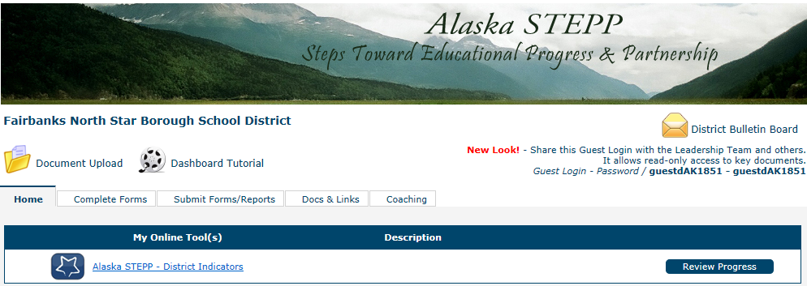
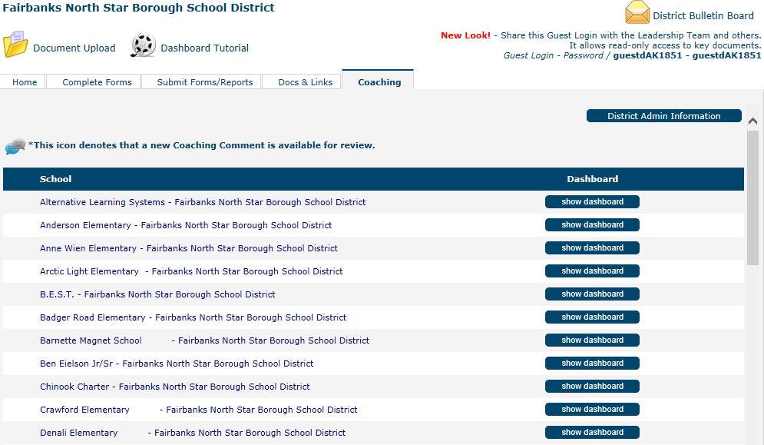
Districts Viewing School Plans & Reports
On the district dashboard select the coaching tab
Click the show dashboard button to view the site’s work.
Notes:
District School Improvement Coordinators can open STEPP with their Logins & Passwords and in the Dashboard, there will be a coaching tab on the right. Using that feature District Staff members can comment and give feedback.
Sign into the District’s STEPP account
Click the coaching tab
Click on a school’s dashboard

Slide 26
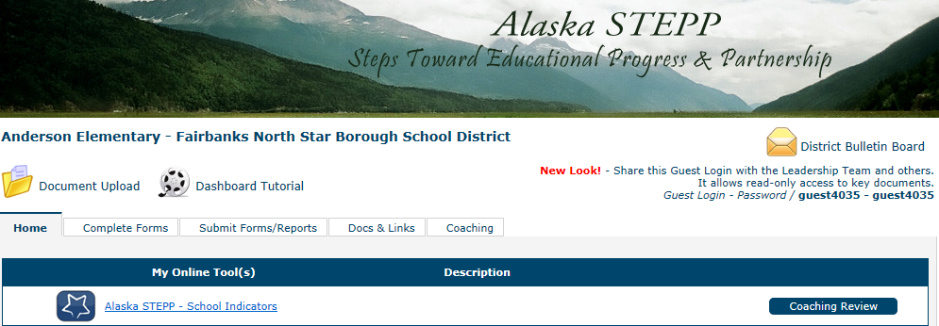
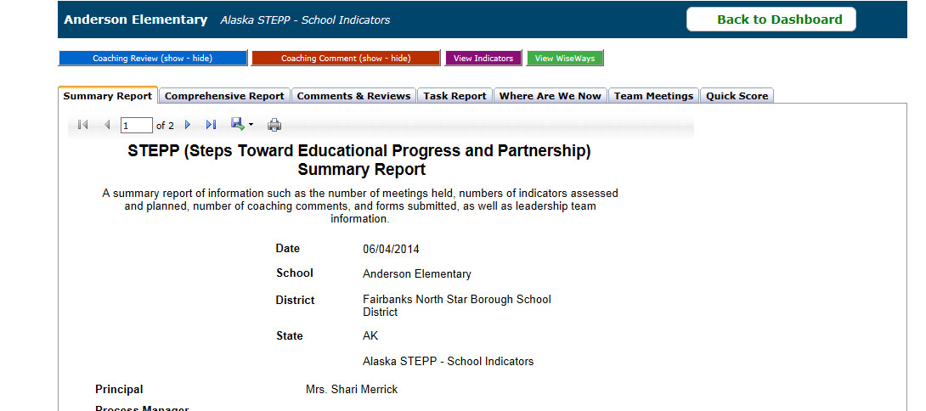
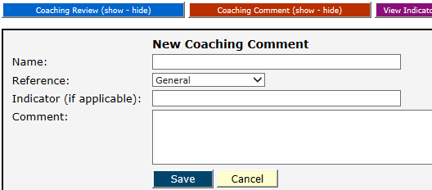
Reports & Making Coaching Comments
Select the Coaching Review short cut to view reports and leave coaching comments.
Select the Create a New Coaching Comment button.
Tabs on the Coaching Review page allow you to view the most frequently used reports.
Notes:
The district team can also monitor and guide the site plans as the year progresses. The district login allows districts the unique viewing option of selecting any of the sites’ plans to determine if they are in need of assistance or coaching. The coaching comments function gives the district administration the option to make and store messages within the tool.
4. Click Coaching Review on the school’s dashboard
5. Click on the desired tab to review reports, or create a coaching comment.

Slide 27
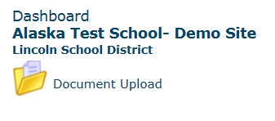
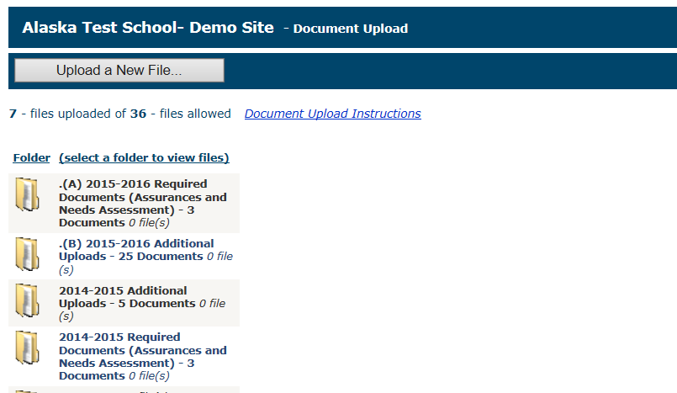
Upload Folder
Notes:
The top folder is for the Assurances documents.
Some districts are using the Upload Folder for Title I documents.

Slide 28

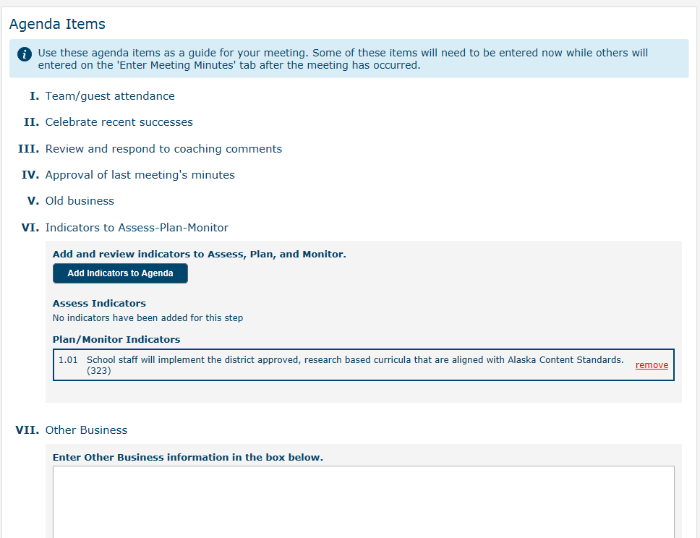
Team Agendas & Minutes
Notes:
The Team, Agendas and Minutes feature is a useful way to help schools stay engaged with plans. Consistent monitoring of an improvement plan is what makes it effective.

Slide 29
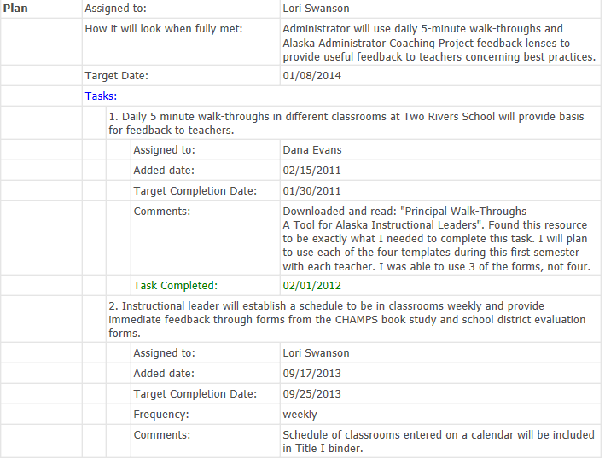
Summary Report... summary report of all work, information and activity that a school or district team has completed.
Comprehensive Report...detailed report of all assessments, plans, and monitoring information.
Comments & Reviews...Coaching comments, reviews and responses; history and ability to send or respond anew.
Task Report...detailed list of all tasks created.
Where Are We Now...overview of a school or district’s plan, in graph form.
Team Meetings... agendas and meeting minutes as entered by the school or district.
Quick Score Report...a quantitative rating summary of the school or district’s progress, based on key factors within the tool.
Coaching Critique/Feedback… an electronic form used by coaches and/or state administrators to add a standardized assessment of the quality of work of the school or district team. Critiques are a series of questions or items, determined by the state.
Notes:
A variety of reports can be generated using the coaching review feature.

Slide 30

Training Resources in Alaska STEPP
Notes:
One of the resources available is Indicators In Action.

Slide 31
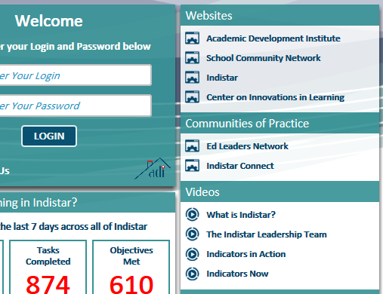

Indicators In Action
Notes:
Indicators in Action can be found on the Indistar login page. Instruction, Leadership, and School Community
Instruction: Instructional Planning, Classroom Management, & Instructional Delivery
Leadership: The Role of the Principal, Teams, Professional Development
School Community: The Curriculum of the Home, Shared Leadership & Goals and Roles, The Compact, Homework and Studying and Reading at Home, A Welcoming Place and a Connected Community.

Slide 32
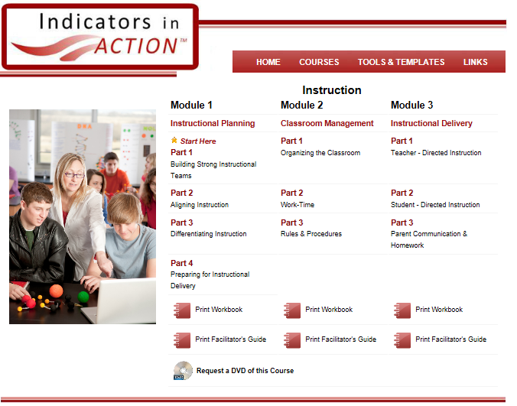
Indicators In Action
Notes:
Video Clips. Workbooks. Templates. Facilitators Guide.
Instruction: Instructional Planning, Classroom Management, & Instructional Delivery
Leadership: The Role of the Principal, Teams, Professional Development
School Community: The Curriculum of the Home, Shared Leadership & Goals and Roles, The Compact, Homework and Studying and Reading at Home, A Welcoming Place and a Connected Community.

Slide 33
District Improvement
A district shall prepare and submit to EED a District Improvement Plan if
at least 25% of the schools in the district are one- or two-star schools
at least 25% of the students in the district attend a one- or two-star school
Planning will be done through the use of Alaska STEPP
Notes:
When you log into your account the name of your District will be in the top left corner of your Dashboard page. Also on your dashboard page are Tabs that include Complete Forms, Submit Forms/Reports, and Docs & Links.
***See Alaska STEPP New Users Webinar, or Alaska STEPP Manual for detailed instructions about Alaska STEPP features and how to mechanically maneuver the processes of Assess, Create, and Monitor.
Assess

Slide 34
Additional District Improvement Information
A district shall prepare and submit to EED a District Improvement Plan if
an audit demonstrates significant specific, district deficiencies
one or more subgroup in the district is not making progress toward the subgroup’s annual measureable objective
Notes:
When you log into your account the name of your District will be in the top left corner of your Dashboard page. Also on your dashboard page are Tabs that include Complete Forms, Submit Forms/Reports, and Docs & Links.
***See Alaska STEPP New Users Webinar, or Alaska STEPP Manual for detailed instructions about Alaska STEPP features and how to mechanically maneuver the processes of Assess, Create, and Monitor.
Five areas for improvement: 1.) Aligned reading and Math curricula, 2.) weekly facilitated staff(teacher) PLC or team meetings discussing student progress, 3.) Regular assessment of offer feedback for on going teaching and learning 4.) staff PD for Alaska Content Standards instruction, 5.) over sight of school plans

Slide 35
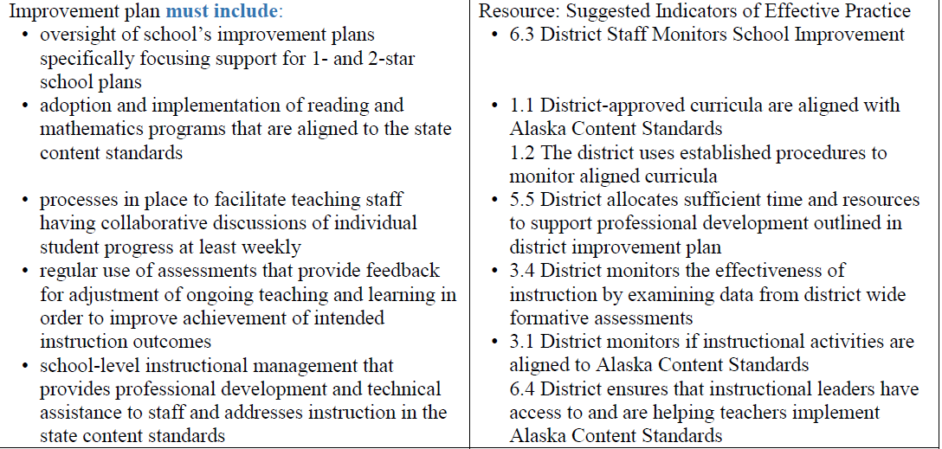
District Plan Components

Slide 36
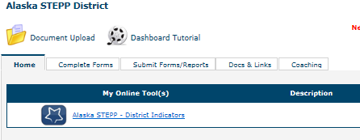
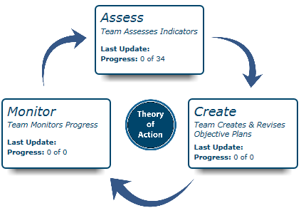
District Improvement
Main Menu Page
ASSESS
CREATE
MONITOR
Notes:
When you log into your account the name of your District will be in the top left corner of your Dashboard page. Also on your dashboard page are Tabs that include Complete Forms, Submit Forms/Reports, and Docs & Links. When the home tab is clicked the Alaska STEP – School Indicators link is highlighted. This is how to get to the main menu page where assessing, creating, and monitoring can occur.
***See Alaska STEPP Basics Webinar, or Alaska STEPP Manual for detailed instructions about Alaska STEPP features and how to mechanically maneuver the processes of Assess, Create, and Monitor.
Five areas for to assess and plan: 1.) Aligned reading and Math curricula, 2.) weekly facilitated school staff(teacher) PLC or team meetings discussing student progress, 3.) Regular assessment to offer feedback for on going teaching and learning to increase intended instructional outcomes 4.) staff PD and technical assistance for Alaska Content Standards instruction, 5.) over sight of school plans
Suggested indicators
1.1 District-approved curricula are aligned with Alaska State Standards.
1.2 The district uses established procedures to monitor aligned curricula.
2.1 District-wide assessments are aligned with Alaska State Standards and district approved curricula.
3.1 District monitors that instructional activities are aligned to Alaska State Standards.
5.2 The District teacher and principal evaluation processes are aligned with the Alaska Professional Teacher Standards and the Standards for Alaska’s Administrators.
5.3 The district provides professional development that is embedded into the daily routines and practices of school staff.
6.1 District leaders facilitate the development of the district improvement goals and the alignment of school and district goals.
6.2 District leaders assist instructional leaders in understanding student achievement data and its use in improving instruction.
6.3 District staff systematically monitors the implementation of the school improvement plans.
6.4 District ensures that instructional leaders have access to and are helping teachers implement Alaska Content Standards

Slide 37
Planning for Alaska STEPP Training
Notes:
The following topics and slides can be used for a District, or School wide staff training in Alaska STEPP.

Slide 38
STEPP Training Topics
Philosophy
Understanding the Tool
Assessing & Planning
Monitoring
Notes:
Giving the background of STEPP is important, because the philosophy behind STEPP is what drives the process.

Slide 39

Using Alaska STEPP Must be a
Team Driven Process for School Improvement
Notes:
This process relies on a team- it is not a plan to be written by one person. Many voices can give input in the School Improvement Process and that change does not have to happen over night. Change requires collective strategies and disciplined collaboration, shared responsibility and shared ownership of everyone working toward the same goal.
A clear purpose is widely shared. With STEPP a school can start with realistic goals and practical tasks, and then build the planning process over time.

Slide 40
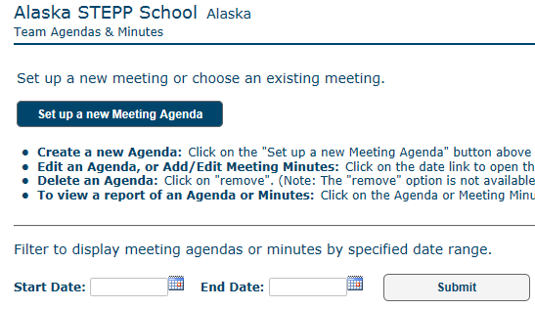
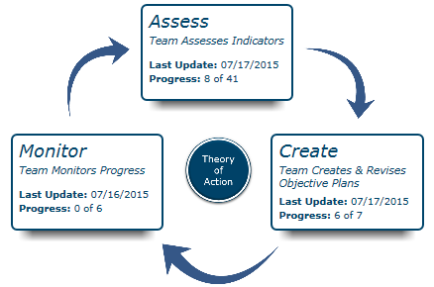
Alaska STEPP Program
Provides the Structure to Implement Effective Processes
There isn’t a once a year paper plan for compliance, rather continuous planning is a process that is never done.
Notes:
It is important for staff to know that the planning is a process and is never done. With STEPP there is a paradigm shift. It is also important to keep in mind that STEPP can be a place that captures what is happening at schools, picture and a reflection of. When staff members are brought into the planning process and the work they are doing is stored in one common place people are pulled together. Whereas, not everyone in a school, (depending on the size of school) will be inputing data into a school’s STEPP account, everyone will have access to look at the work that is happening. They will see their names in relation to objectives and tasks assigned and reports will show the work that has been accomplished.

Slide 41
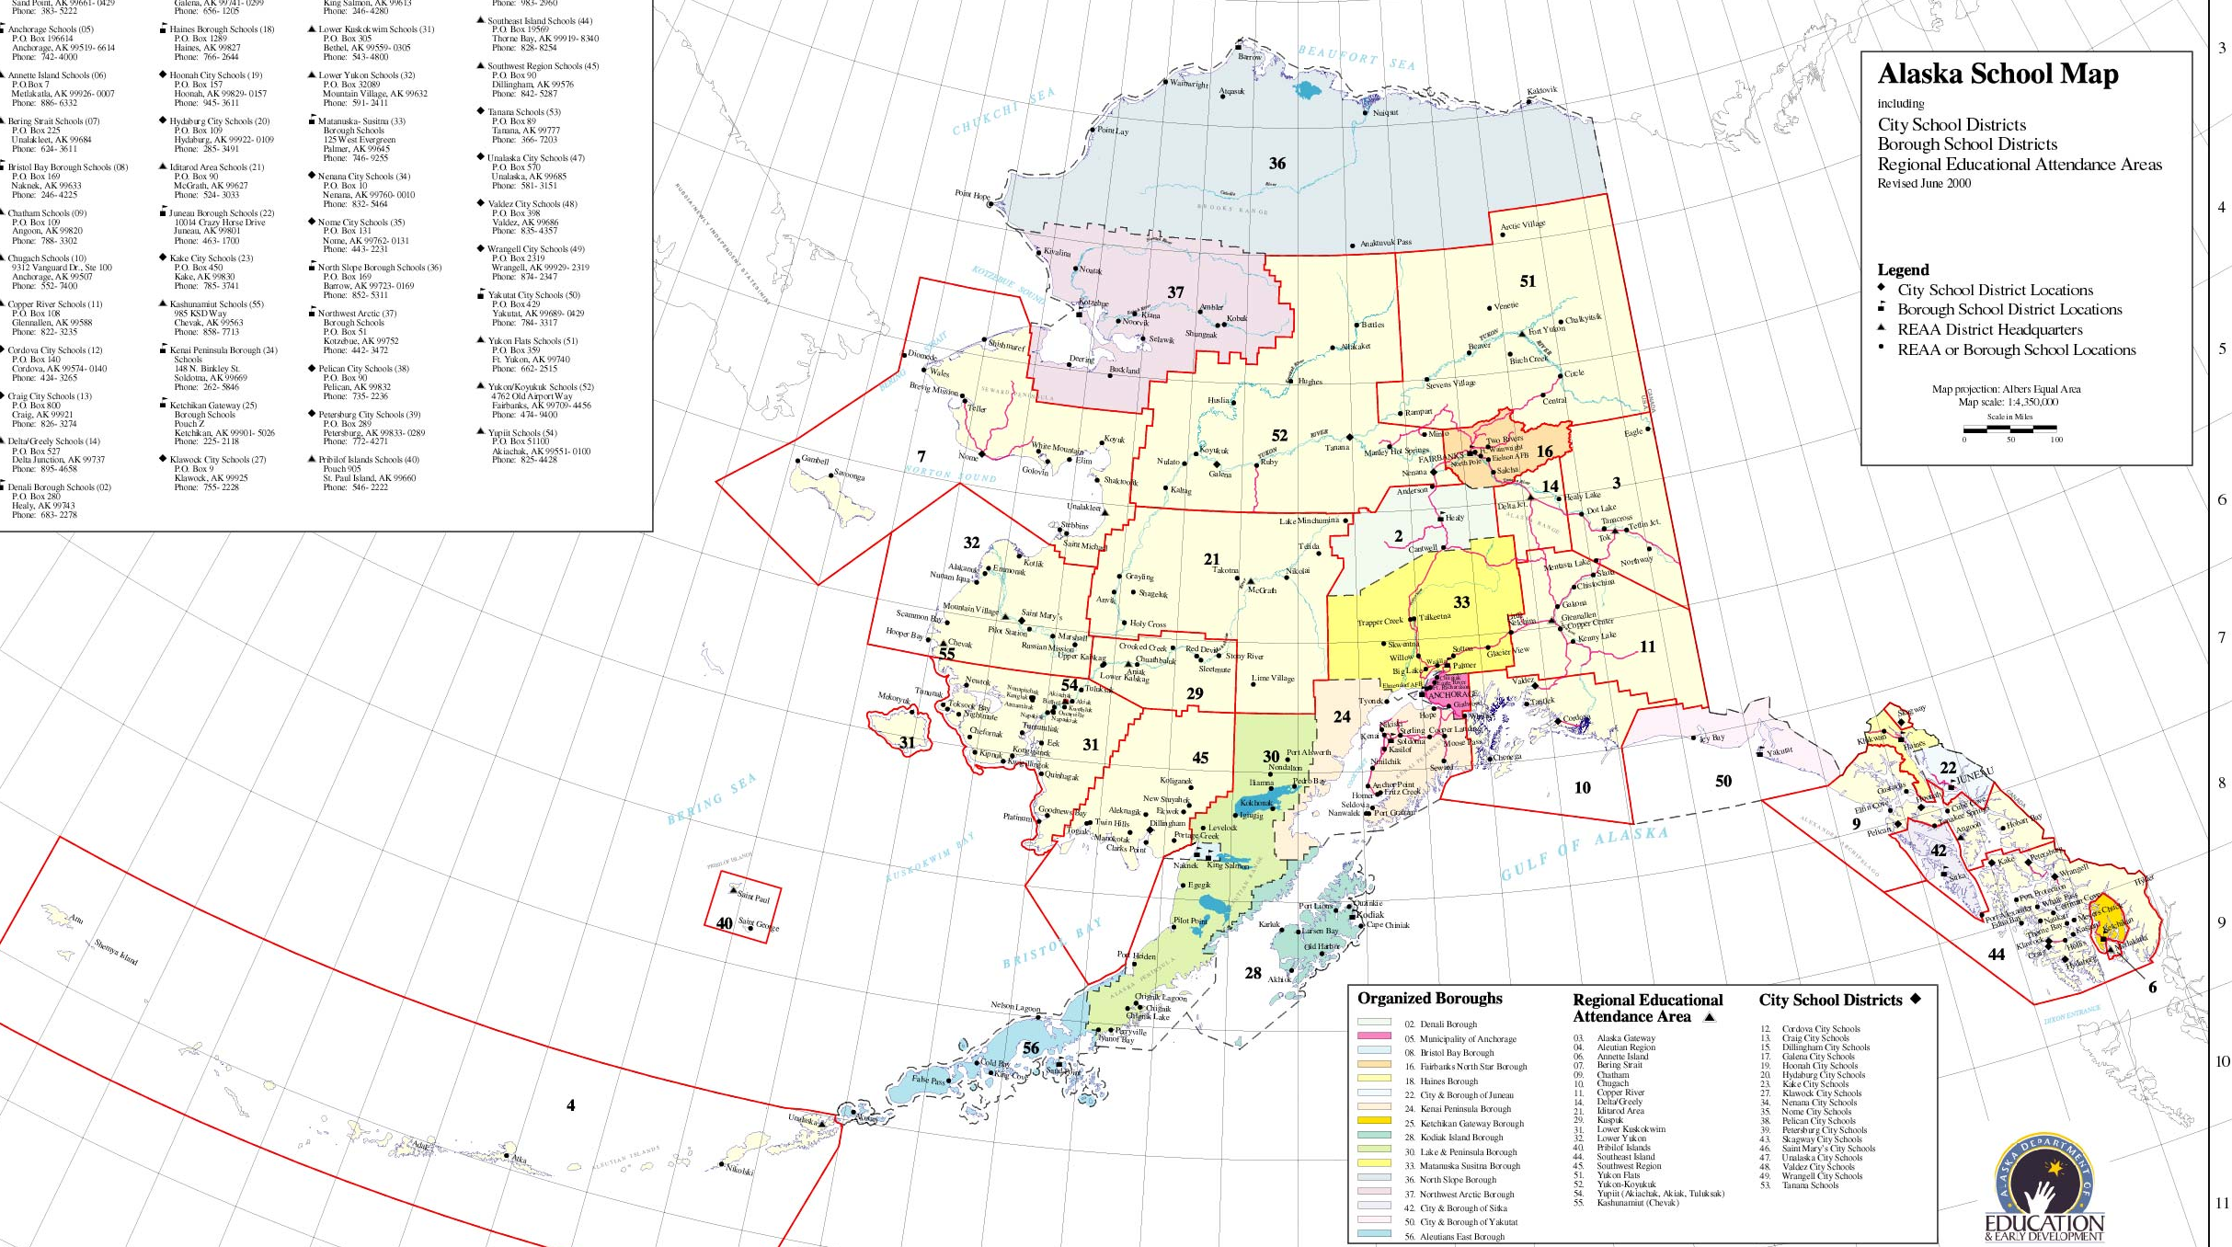
Alaska STEPP is Adaptable
It is designed to be flexible in order to meet the individual needs of Alaska’s diverse schools and districts.
Notes:
Staff can be made aware that STEPP is Flexible:
STEPP is designed to meet the needs of the largest school in Anchorage, as well as smaller schools with only a few staff members and 20- 30 students.
The pacing can be realistically established, they can have input in establishing objectives, and creating tasks. And, staff can be kept in the loop regarding what is going on with planning at their site.

Slide 42

Research Based Practices
The Domains, Indicators, Rubrics,
and WiseWays provide benchmarks
for measuring effectiveness.
Notes:
The indicators originally came from the Alaska audit tool, developed by the department to comply with statutes created by the legislature to determine if Alaskan schools were in need of additional support. Alaska’s Effective Schools Framework.
The domains and indicators of effective practice are drawn from both national education research and the priorities of the Alaska Department of Education
& Early Development.

Slide 43
The Six Domains Include...
Curriculum
Assessment
Instruction
Supportive Learning Environment
Professional Development
Leadership
Within those domains are 32 indicators with assessment rubrics.
Notes:
These domains include practices that are proven indicators of school success. The indicators themselves are a baseline to measure school success; they are an instrument for schools to use in assessing how effective their practices are. Title I, domain 8, includes four indicators for schools with Title I schoolwide plans to assess. There is no domain 7.

Slide 44
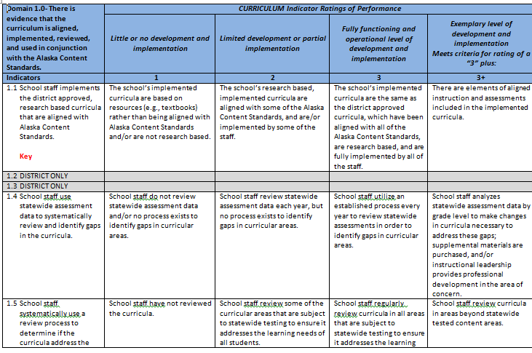
Domains and
Indicators Rubric

Slide 45

Alaska STEPP is a Place to Build a Structure
The indicators of effective practice are the framework that supports the school.
Notes:
Framework: An organizational structure for systematically addressing the challenges schools face. The indicators are the walls that hold up the building.

Slide 46
Understanding the Features
of the Alaska STEPP Online Program
Notes:
Alaska STEPP for New User’s slides 15 – 26 explain the different places and features in Alaska STEPP

Slide 47
Alaska STEPP is based on the Continuous Improvement Model
Plan
Implement
Monitor (assess)
Revise (plan)
Assess
Implement
Notes:
Alaska STEPP is a tool that facilitates a shift in the improvement planning process from one year plans addressing only compliance-related requirements to a continuous process of assessing, planning, and self-monitoring.
It assists teams in setting up plans that are strategic because you assess areas of need first
It assists teams in avoiding the planning whirlpool with a built in self monitoring mechanism
It adapts to the changing nature of schools by allowing for revisions based on the results of the monitoring

Slide 48

Assessing and Planning
with Alaska STEPP
Notes:
Use Alaska STEPP Basics PPT & Alaska STEPP Updating for specific Processes

Slide 49
Monitoring with Alaska STEPP
Notes:
See Alaska STEPP Basics Webinar and Power Point to guide school’s through the Monitoring Process in Alaska STEPP, Slides 48 – 55.

Slide 50

STEPP Search
Login to STEPP using
Login: ak - Password: ak.
With a partner, complete each item.
Go between dashboard, main menu page, and navigation toolbar.
Add a person to the School Team.
Delete a person from the School Team.
Enter new school information.
Find and Upload the School Needs Assessment.
Assess an indicator.
Write an objective and add tasks.
Monitor an indicator that has tasks.
Create a new Meeting Agenda.
Generate a Comprehensive Plan Report.
Generate a Detailed Report of Assessed Indicators
Generate a List of Objectives Included in Plan
Notes:
Do NOT Assess an Indicator on your site’s account until your site’s Team has fully agreed on an assessment score. Once an Indicator is given a rubric score, it cannot be changed; the entire monitoring process must be completed once an indicator is given a score in the online tool.
I can email copies of this.

Slide 51





Yearly Flow of Work for Schools
Form Team
Monitor
Assess
Implement
Create Plan
Notes:
Non linear view

Slide 52
Yearly Planning Components
School improvement teams are formed.
Current team and school information is entered into Alaska STEPP.
Monthly team meetings for the entire school year are scheduled in Alaska STEPP.
Assessed indicators, objectives, and tasks are updated, making sure the objectives and tasks are well written and realistic.
Target indicators are chosen to focus on monthly throughout the year.
The School Needs Assessment is filled out and uploaded using information from a data analysis.
Monitor. Monitor. Monitor. Monitor. Monitor.

Slide 53


Slide 54

Contact Information:
Patricia Farren
Patricia.farren@alaska.gov Ph# 907-465-2892
Thank you for
all the Work You
do for Alaska’s Kids

